Slide 1
Quantitative analysis of distribution of the nominative form of the diminutive suffix -kene in Estonian runosongs
Kaarel Veskis
University of Tartu / Estonian Folklore Archives of the Estonian Literary Museum Plotting Poetry 2022

Slide 2
Outline of the presentation
Diminutives in linguistics and in folklore texts
Diminutives in the Estonian language and in the Estonian runosongs
Goals of the quantitative analysis
Datasets
Results

Slide 3
Diminutives
Commonly conveyed senses:
smallness
intimacy
endearment
many other (mixed, unclear) senses (e.g. in Italian pejorative –accio, -ucolo)
A diminutive form (DIM): most commonly nouns (adjectives) + suffixes: isa (= father) + -kene (DIM suffix) = ISAKENE (= dad)

Slide 4
Diminutives in linguistics studies
DIM as part of the morphology system
DIM in pragmatics and semantics (meaning and context)
DIM in pre- and protomorphology (language acquisition)
Many studies about DIMs in indo-european languages
Many contrastive studies about DIMs in literary fiction (since 1990’s)

Slide 5
Diminutives in Estonian
In Estonian DIMs are less frequent compared to Russian and many other languages
However – frequent in the archaic poetic language of the Estonian runosongs
Mostly suffixal diminutive (-ke, -kene, -u, -t) but also analytic and non-suffixal diminutive derivation (e.g desuffixation: hobune ‘horse’ > hobu ‘id.’; lexicalization of the form of genitive: emm ‘mother’ > emme ‘id.’)
Many lexicalized diminutives (e.g. mehike)

Slide 6
Runosong (regilaul, regivärss)
Traditional songs in the poetic metre regivärss (runoverse, Finnic tetrameter, Kalevala-metric song, runolaulu) that are shared by all Finnic peoples
The runosong tradition may be ca 2000 years old
Oral runosong poetry tradition was alive and widespread in Estonia until the formation of new type of Germanic influenced folk song with end rhymes and harmonic melodies in 18th and 19th century
The Estonian and Finnish national epics are in runosong verse format
Archaic poetic language well preserved but with many historical layers

Slide 7
Runosong texts in electronic format I: Runosongs’ database, https://www.folklore.ee/regilaul/:
Ca 100 000 Estonian runosongs texts, constantly added to the database
Two thirds of all originally collected regilaul texts preserved
All manuscripts of collected regilauls are available in the Estonian Literary Museum, most of them also in the digital repository Kivike
Texts in the database mostly originate from folklore collections of the 19th century folklore collectors Jakob Hurt and Matthias Johann Eisen
The database has been developed in the Estonian Folklore Archives of the Estonian Literary Museum by the Regilaul database workgroup
Download options of annotated texts in different formats

Slide 8
Runosong texts in electronic format II: The FILTER project
A corpus of Estonian–Karelian–Ingrian–Finnish runo-song, and analytical tools for linguistic analysis of the corpus
Search interface: http://runoregi.rahtiapp.fi
FILTER database user guide: https://a3s.fi/filter-db-doc/index.html
Consortium of the Finnish Literature Society and University of Helsinki with the Estonian Folklore Archives at the Estonian Literary Museum.
Kallio, Kati, Eetu Mäkelä, ja Maciej Michal Janicki. „Historical Oral Poems and Digital Humanities: Starting with a Finnish Corpus“. FF Network, nr 54 (2020): 12–18.

Slide 9
DIM in runosongs
Diminutives are common to poetic synonyms of runosongs
Diminution is frequent in runosongs - also in folklore texts of other nations (eg Belarus)
Meaning of DIM not as clear as other affixes/suffixes
DIM forms are often used in runosongs to „fit“ the metre by lengthening words that refer to persons or objects of focus but they often also are used when trying to be polite or flattering towards the person that is addressed in the song, e.g.:

Slide 10
DIM in runosongs: lind (=bird) + DIM -kene (= ‘little bird’) as a poetic synonym of ‘daughter‘ when addressing her with a teaching (example and translation from: Anthology of Estonian Traditional Music)
EE “Tüdärlaits, sina linnukene, selle ütle ma sinule, selle õppa õige'esta, pane sina miile parre'esta: ole sina oolas ommukulle, mõse suu, suiu pää, jala ala kengitsele! ENG “My daughter, darling dickeybird, this I say to you, this I teach you and it is right, keep it in mind even better: be diligent in the morning, wash your face, comb your hair, put your shoes on!

Slide 11
Some goals of study
To get an overview of distribution of DIM suffix -kene in regilaul:
most frequent dialectal forms
distribution of DIM lemmas (words modified by the -kene suffix)
geographical variation of DIM suffix and DIM lemmas
most frequent other conjugation forms of -kene dialectal forms (in addition to Nom sg)

Slide 12
Dataset 1: occurrences (tokens) of each -kene DIM form (sg Nom)
base form (lemma)
token
root
suffix form used
region of origin
verse line context
frequencies of variables in the corpus

Slide 13
Outline of RE to find sg Nom dialectal forms of -kene in regilaul texts (FILTER database SQL query)
Finds for example: -kene, -känä, -kõnõ, -kõne, -käenõ, -käinen, -kaine, -känne but not -kana or -koni Find:
".+k[aeiouõä]n[aeiouõä][[:>:]]“ OR „.+k[äõe][in]ne[[:>:]]“ OR „.+k[äe][en]n[eä][[:>:]]“ AND NOT ".+k[aou]na[[:>:]]“ OR „.+kin[iaeouõ][[:>:]]“ OR „.+kun[eõioäu][[:>:]]“ OR „.+kon[aiu][[:>:]]“ OR „.+kän[aiuä][[:>:]]“ OR „+k[õa]nu[[:>:]]“ OR „.+ken[aui][[:>:]]"

Slide 14
Dataset 1: occurrences (tokens) of each -kene DIM form in corpus
sorted by the base form (text) variable:

Slide 15
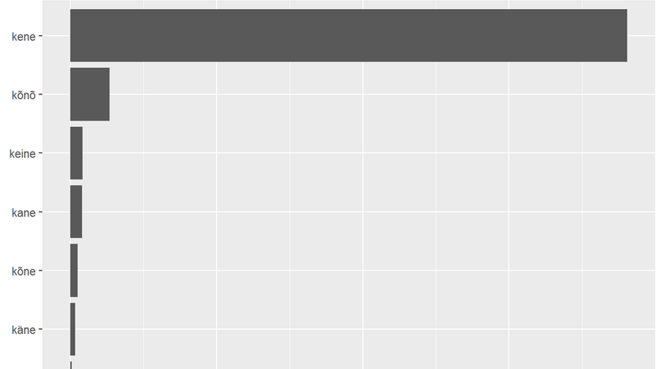
Results: most frequent dialectal forms of DIM suffix -kene

Slide 16
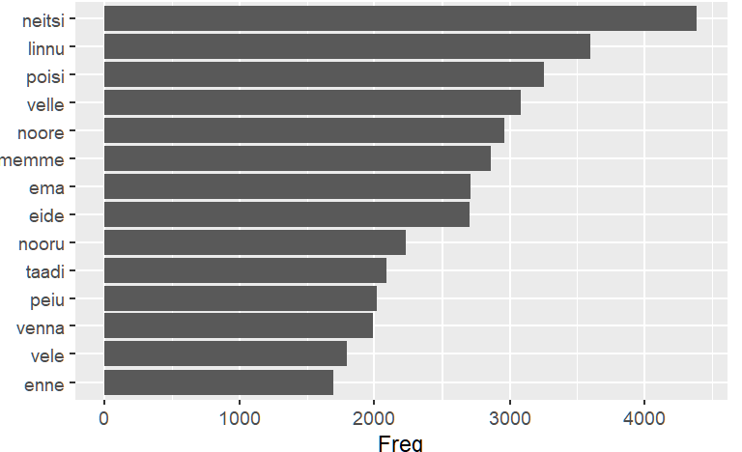
Frequencies of DIM lemmas (base words without the DIM)
Top DIM referents: girl, „little bird“ = girl, boy, brother, young, mother, grandmother, grandfather, bridegroom

Slide 17
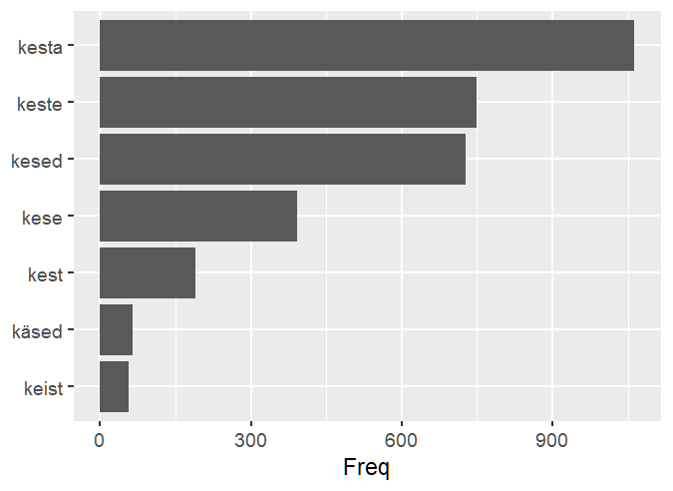
Frequency of DIM suffix forms other than sg Nom of the most frequent DIM lemma neitsi (see previous slide)
Sg Partitive + a, Pl Genitive, Pl Nominative, Sg Genitive, Sg Partitive, dialectal variations of Pl Nominative, Sg Partitive, ...
TODO: find out typical contexts of DIM inflected forms groups of all DIM lemmas. Sg Nom (neitsikene) refers typically to addressee, typical context of Sg Partitive (neitsikesta) might be enumeration of daughters (Neli noorta neitsikesta), ...

Slide 18
DIM suffix forms other than sg Nom of the most frequent DIM lemma neitsi (see previous slide): possible practical output
neitsi-, linnu-, poisi- etc ->
find and annotate all DIM grammatical and dialectal forms with REs ->
<diminutive meaning=“neitsi”, grammatical analysis = “nominative = False”> neitsikõista </diminutive> ->
find multi-word regilaul-specific DIM idioms and DIM poetic synonyms with the help of e.g typical KWIC analysis of these cases

Slide 19
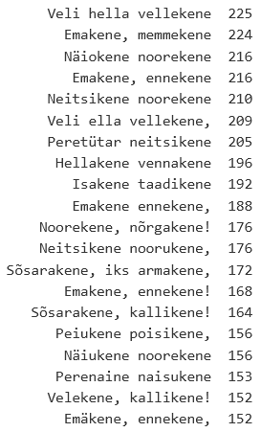
Frequencies of verse lines containing -kene DIM forms

Slide 20
Dataset 2: Relative frequencies of all verse lines that contain a -kene DIM sg Nom form in parishes
parish
county
absolute freq of songs
verse lines absolute freq
-kene dim verse lines freq
longitude
latitude

Slide 21
Relative frequencies of DIM runoverses along the axis of West-East in Estonia
Null hypothesis: Relative freqs of all verse lines that contain the diminutive -kene Nom sg form in a parish (RELFK) are equally distributed along the West-East axis of Estonia. The correlation between RELFK and longitudes of the parishes is statistically not significant.
Alternative hypothesis: RELFK is significantly influenced of the geographical location of the data on the West-East axis.

Slide 22
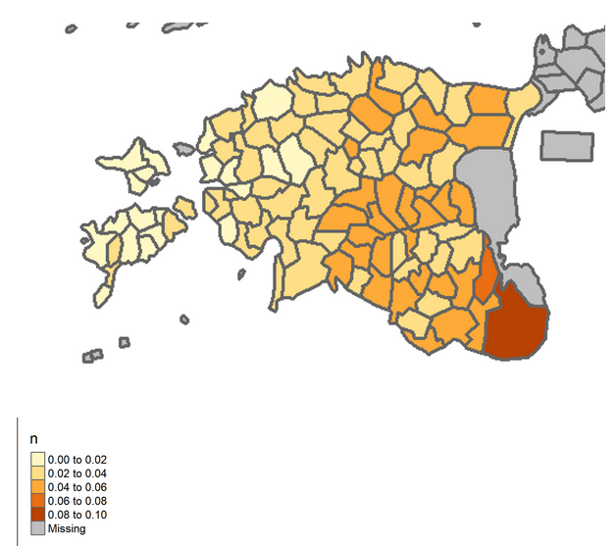
Results: RELFK on map

Slide 23
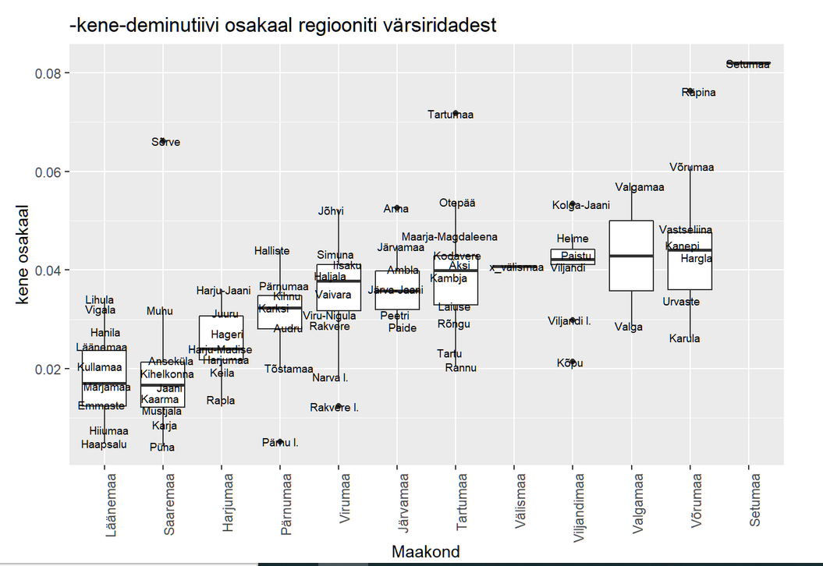
RELFK in parishes (grouped by counties)

Slide 24
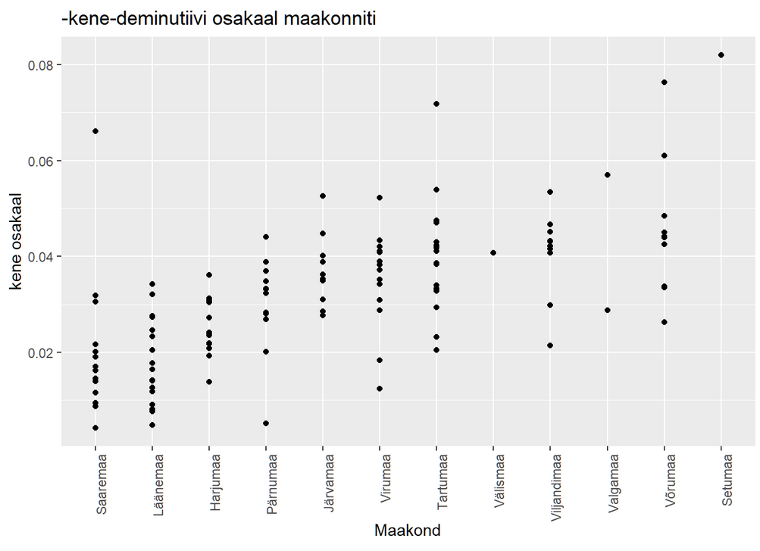
RELFK in parishes (grouped by counties)

Slide 25
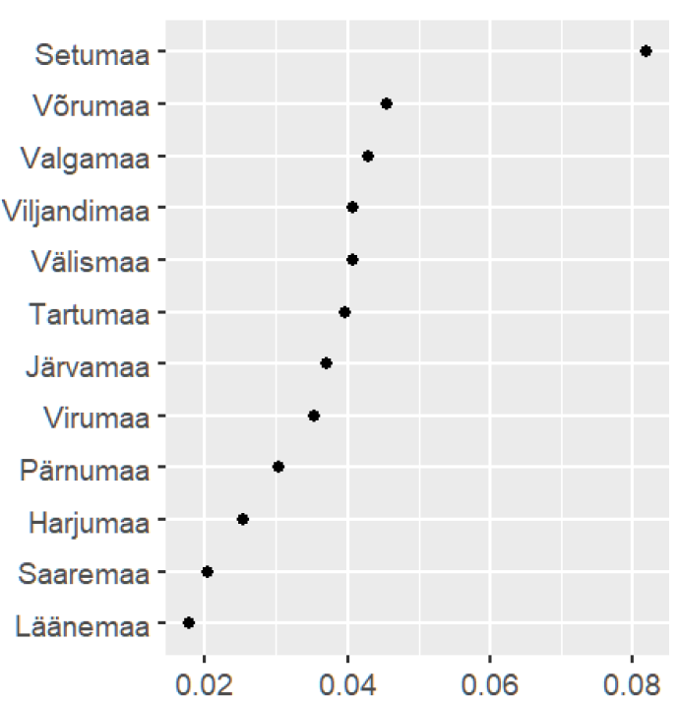
Average RELFK in parishes

Slide 26
RELFK grouped in West and East groups
H0 (t-test): RELFK in texts collected form Western Estonia are not significantly different from RELFK collected from Eastern Estonia. H1: RELFK in texts collected from Western Estonia are significantly different from RELFK collected from Eastern Estonia.
Result: H0 needs to be abandoned as the difference between groups is significant: t (124.32) = -8.5; p < 0.001. Cohen test: impact of this difference to RELFK is large. Multiple R-squared: 0.4168 (variation of longitudes explain 42% of variation of RELFK according to the linear model)

Slide 27
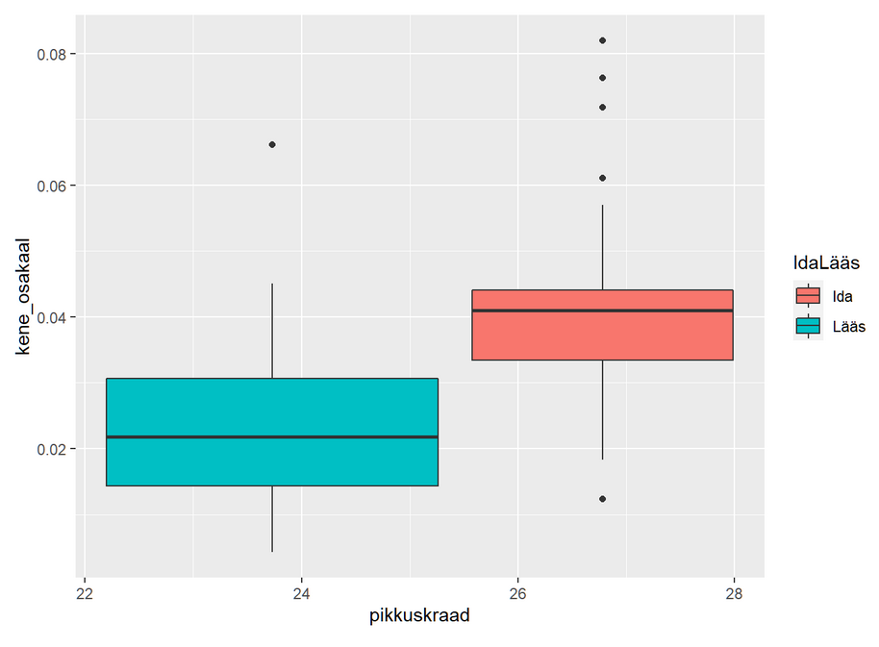
Results: RELFK grouped in West and East groups
WEST EAST

Slide 28
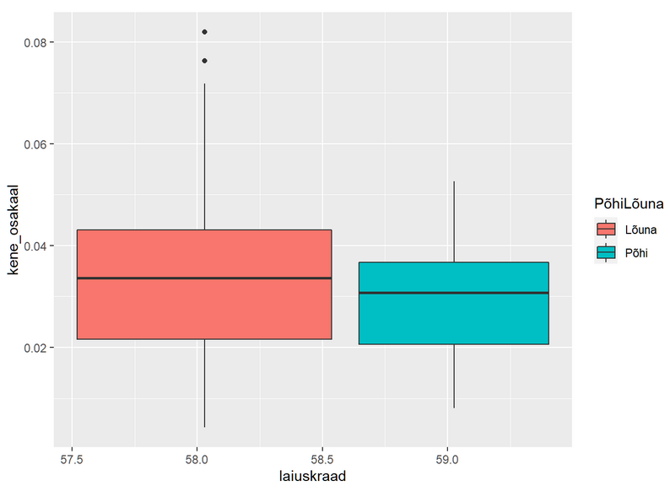
Results: RELFK grouped in South and North groups
SOUTH NORTH

Slide 29
RELFK West and East groups: interpretation
Ema poega õpetama: -> last word 4 syllable verb referring to direct speech (= mother starts talking)
"Ära sa poega, noorukene, -> last word 4 syllable adjective: noor (= young) + double DIM (-u + -kene)
too mul minit linnastage. -> last word 2 syllable noun (linnastage = from the city) elongated by 2 syllables
Linnapreili peenikene > last word 4 syllable adjective: peen + DIM -kene
Ei mõista lõnga eietada, ...“ -> etc
The metre of the runoverse shorter in West -> West: -ke / East: -kene ? TODO: try to add syllable counts automatically to datasets.

Slide 30
References
„FILTER – Formulaic Intertextuality, Thematic Networks and Poetic Variation across Regional
Cultures of Finnic Oral Poetry“. Vaadatud 1. mai 2022. https://blogs.helsinki.fi/filter-project/.
Kasik, Reet. Eesti keele sõnatuletus. Tartu Riiklik Ülikool, 1996.
Kehayov, Petar, ja Rogier Blokland. „Mittesufiksaalne deminutiivituletus eesti keeles. [Non-suffixal diminutive derivation in Estonian.]“. Emakeele Seltsi Aastaraamat 52 (2006): 87–124.
Kupp-Sazonov, Sirje. „Deminutiivsete noomenite funktsionaalsusest vene ja eesti keeles mõningate Tšehhovi jutustuste ning nende tõlgete näitel“ 29 (31. oktoober 2019): 113–40. https://doi.org/10.5128/LV29.04.
Oras, Janika, Liina Saarlo, ja Mari Sarv. „Eesti regilaulude andmebaas“. 564556, 2021 2003.
https://www.folklore.ee/regilaul/andmebaas/.

Slide 31
References 2
Sarv, Mari. „Keele mõju regilaulu värsimõõdule (Kullamaa)“, 1997. https://www.folklore.ee/era/nt/PF5/5Sarv.htm.
Sarv, Mari. „Regilaulude Teema-Analüüs: Võimalusi Ja Väljakutseid / Topic Analysis of Estonian Runosongs: Prospects and Challenges“. Methis. Studia Humaniora Estonica 21, nr 26 (15. detsember 2020). https://doi.org/10.7592/methis.v21i26.16914.
Wierzbicka, Anna. „Different Cultures, Different Languages, Different Speech Acts: Polish vs. English“. Journal of Pragmatics 9, nr 2 (1. juuni 1985): 145–78.
Цімашэнка, Н.П. / Tsimashenka, N.P. 2019. „Diminutive-Hypocoristic Nominations in the Language of the Belarusian Folk Songs About Love“. Известия Гомельского государственного университета имени Ф. Скорины, nr 1 (jaanuar): 145–50.

Slide 32
Thank you!
kaarel.veskis@ut.ee
kaarel.veskis@kirmus.ee

