Slide 1
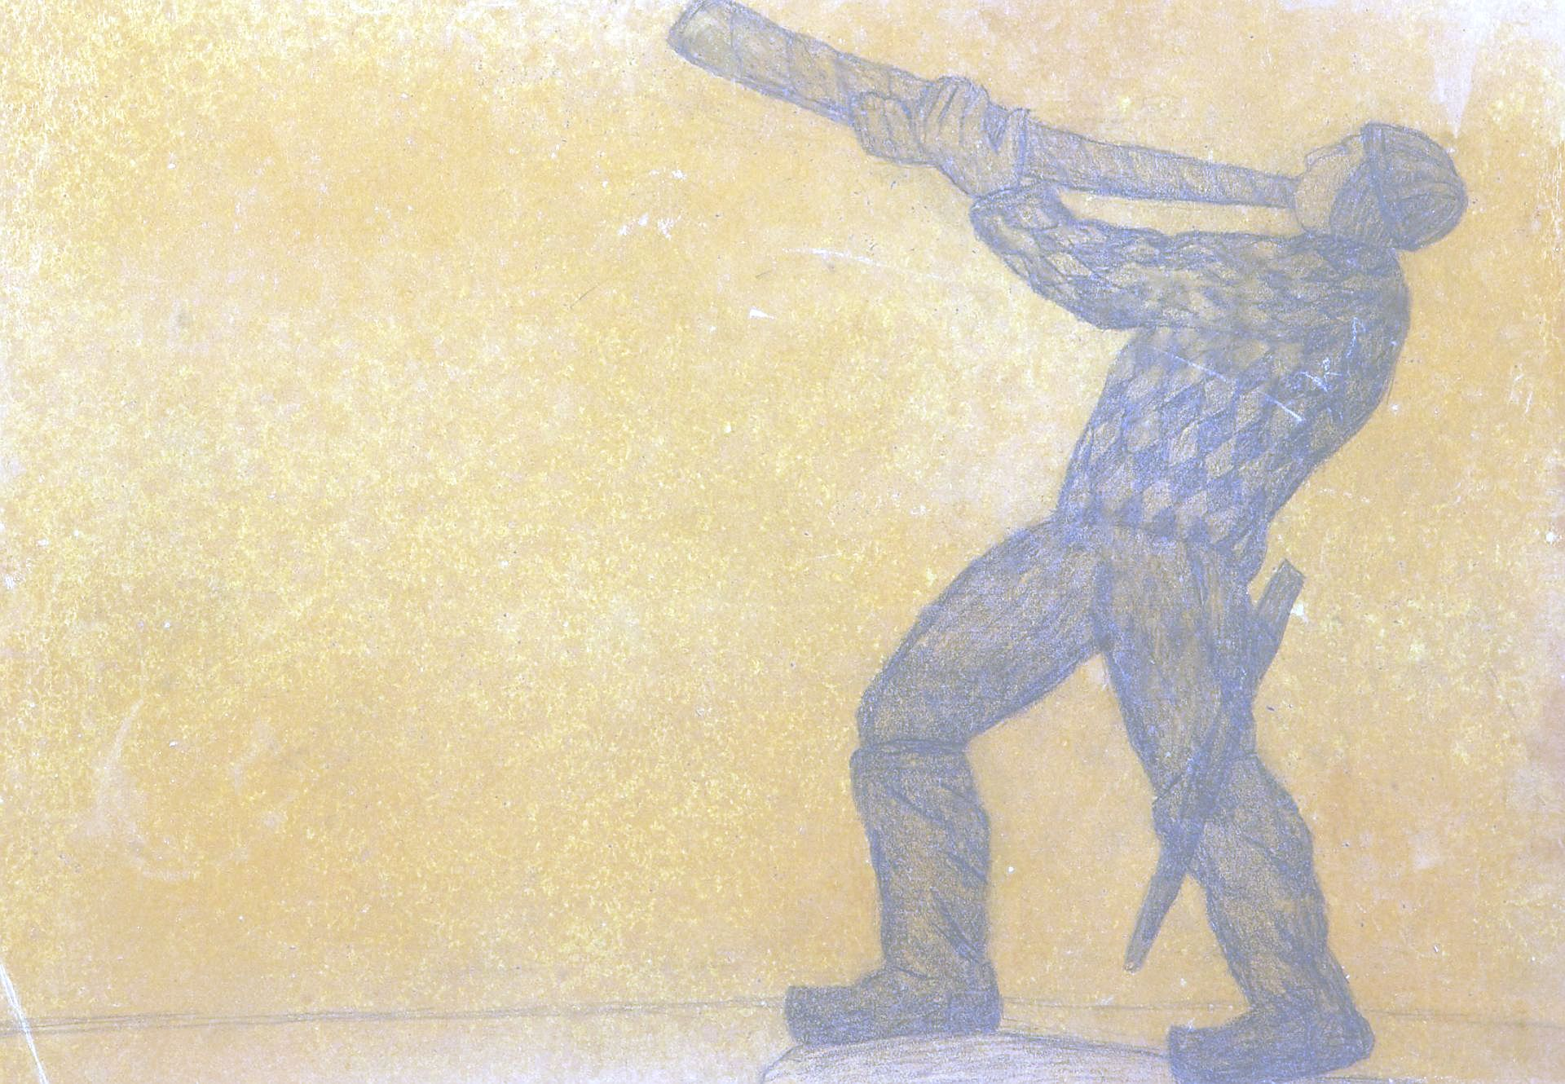
Kalevipoeg in the FILTER-machine New opportunities to study the links between literary and oral poetries
Liina Saarlo, Mari Sarv, Susanna Mett
Estonian Literary Museum
Plotting Poetry 5 - Popular Voices. 4-6 July 2022 – Estonian Literary Museum, Tartu

Slide 2
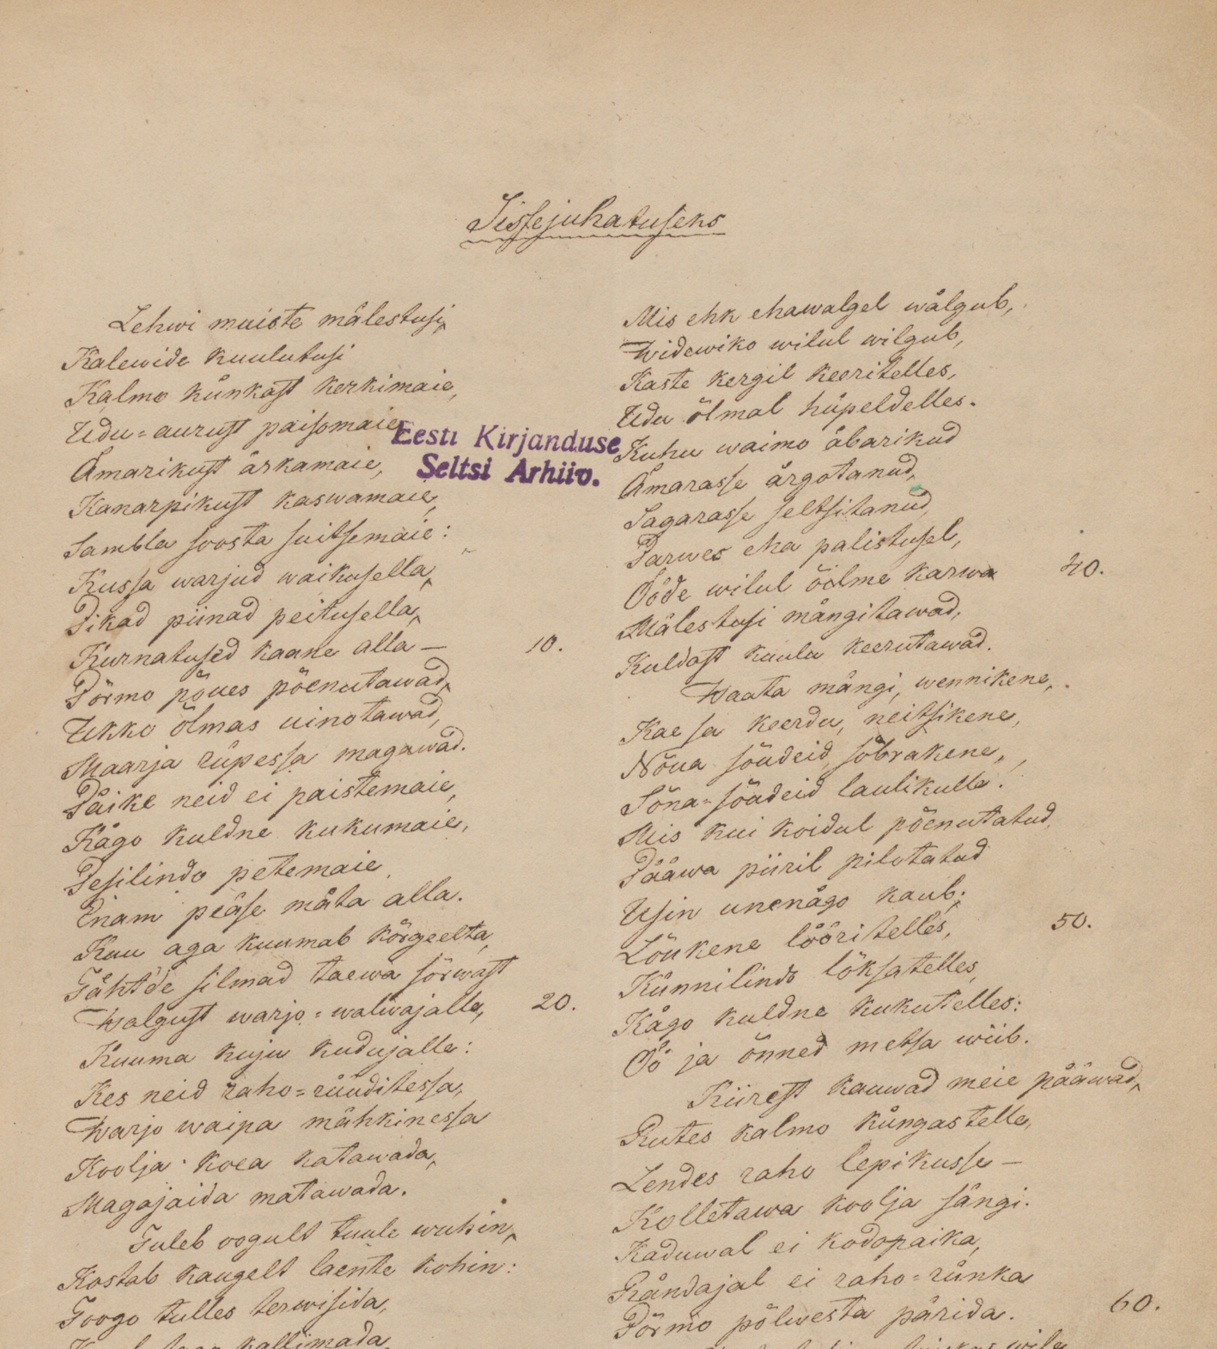
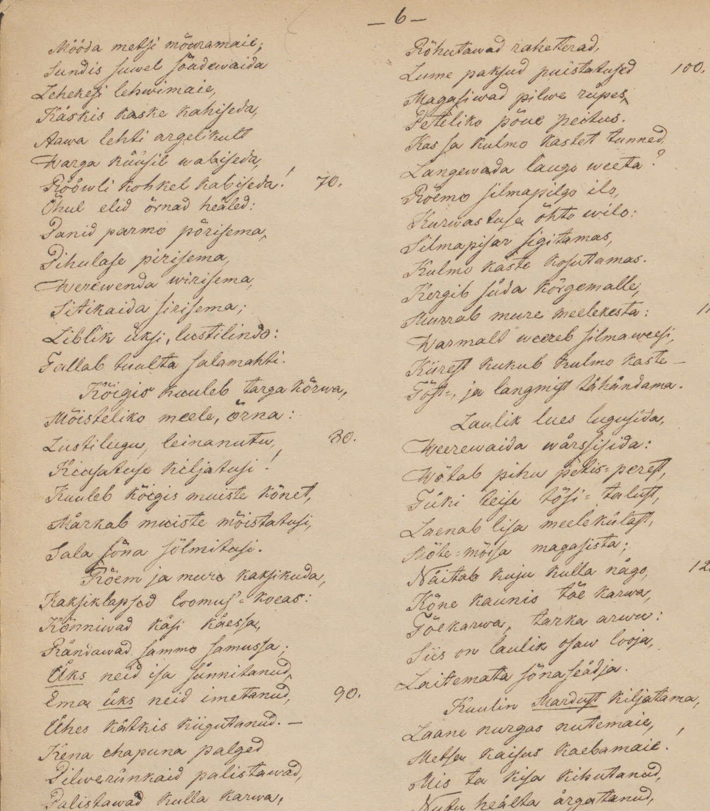
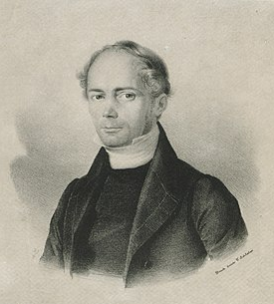
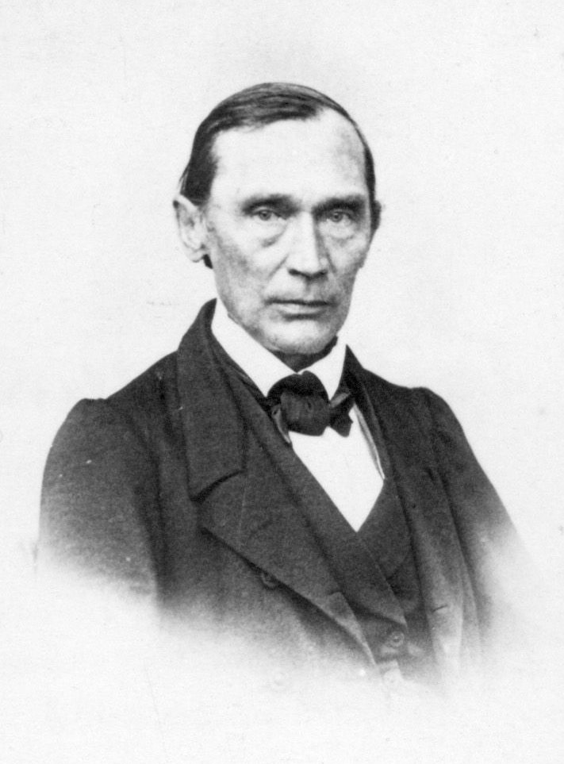
Friedrich Robert Faehlmann (1798-1850)
„Die Sage vom Kallewi poeg“ (1839)
Friedrich Reinhold Kreutzwald (1803-1882)
1853 Pre-Kalevipoeg
1862 “Kalevipoeg”

Slide 3
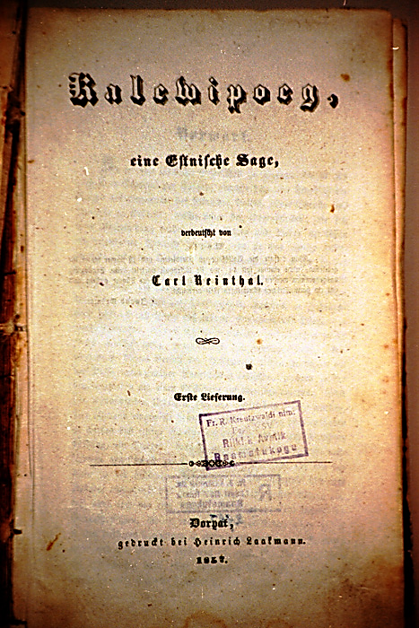
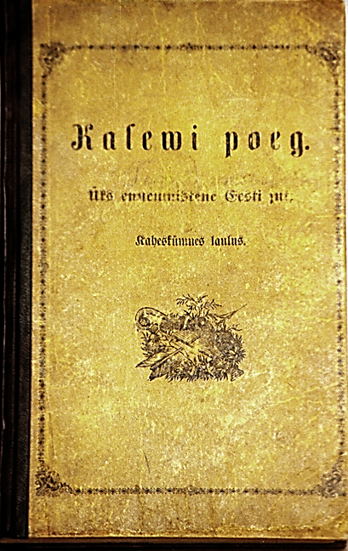
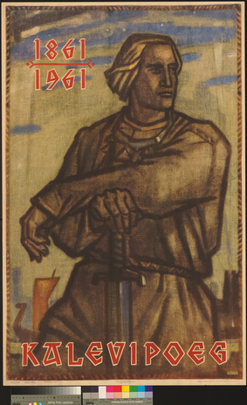
First printed version, with German translation, 1857
First folk-publication, 1862

Slide 4
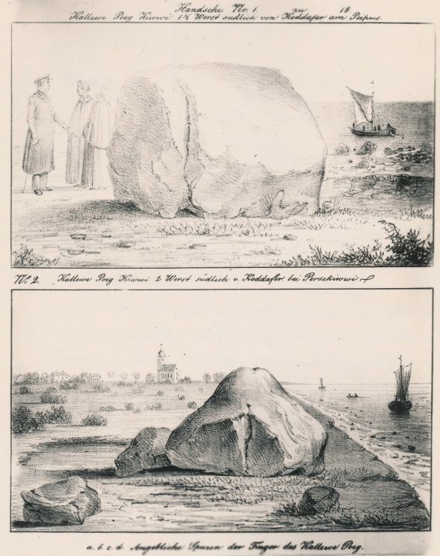
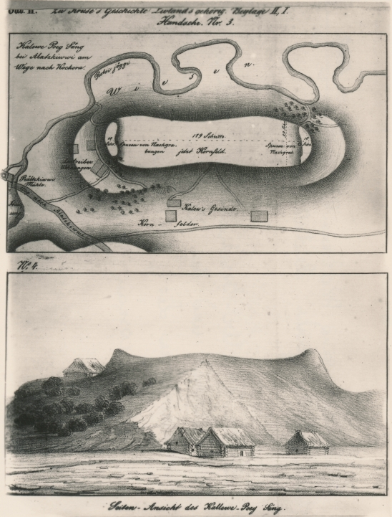
Estonian giant-lore:
Kalevipoeg
Vanapagan
Suur Tõll
1) Kalevipoeg’s Stone, 2 versts southwards from Kodavere; 2) Kalevipoeg’s Bed in Alatskivi, Kodavere parish. In: Kruse, Fr. Ur-Geschichte des Esthnischen Volksstammes und der Kaiserlich Russischen Ostseeprovinzen Liv-, Esth- und Curland. Moscau 1846

Slide 5
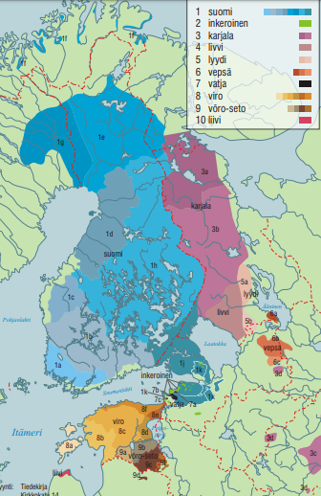
Runosong
archaic tradition of Finnic peoples (excl. Vepsians and Livonians)
stychic, not rhymed
syllabic, trochaic (stress and quantity of syllables)
alliteration and parallelism as structural poetic features
various genres: songs, charms, but also proverbs, sayings, riddles
Map: Grünthal & Sarhimaa 2004

Slide 6
Kreutzwald: if I have succeeded to melt the real folksong with my own work so skilfully that it is not possible to recognize clearly the boundaries of where one ends and another begins, I would have achieved my highest aim
Critics: the true runo verse folk song is artistic to such an extent that Kreutzwald was not able to imitate it sufficiently enough (Valk 2011)

Slide 7
Poetic system of runosong
metre
use of grammatical archaisms
alliteration
parallelism
sentence structure
traditional formulae

Slide 8
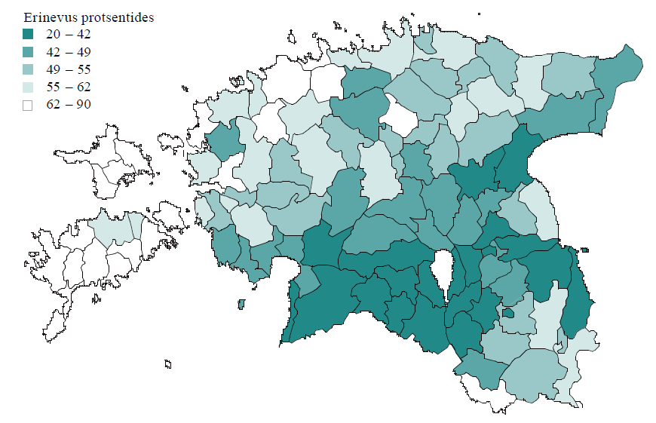
Metre of Kalevipoeg compared to regional samples of runosong

Slide 9
Poetic structure of Kalevipoeg compared to that of runosong
metre | close to runosong, based on the contemporary theory
archaisms | close to regilaul
alliteration | close to regilaul, less natural
parallelism | less than in regilaul
trad. formulae | less than in regilaul, romantic terms
sentence str. | radically different

Slide 10
Sentence structure
In runosong sentence is limited to the length of a verse, with parallel lines reformulating the main line or part of it; there are no subordinative sentences. Sentences do not continue in next parallelistic group or verse.
In Kalevipoeg long and complex sentences are broken into lines of metrical alliterative verses, occasionally ornamented with parallelism.

Slide 11
Example from Kalevipoeg
Käigist väsind kangelane
koopa suussa seisatelles
mõtteid nõnda mõlgutama:
õnnelt leian öömaja,
parajada puhkepaika,
sooja rooga õhtusöögiks,
mis ju kaua pole maitsend.
The Hero from his travels wearied
Halting by the cavern’s opening
In his thoughts deliberated:
I’m in luck to find the lodgings,
Fitting place to have my rest,
Hot food even for my supper,
Which for some time I’ve not tasted.

Slide 12
Kalevipoeg verse
Kreutzwald has successfully created a poetic system which
is based on runosong
enables to tell narrative plots
relates with national-romantic air
is easily intertwinable with elements and parts of runosong

Slide 13
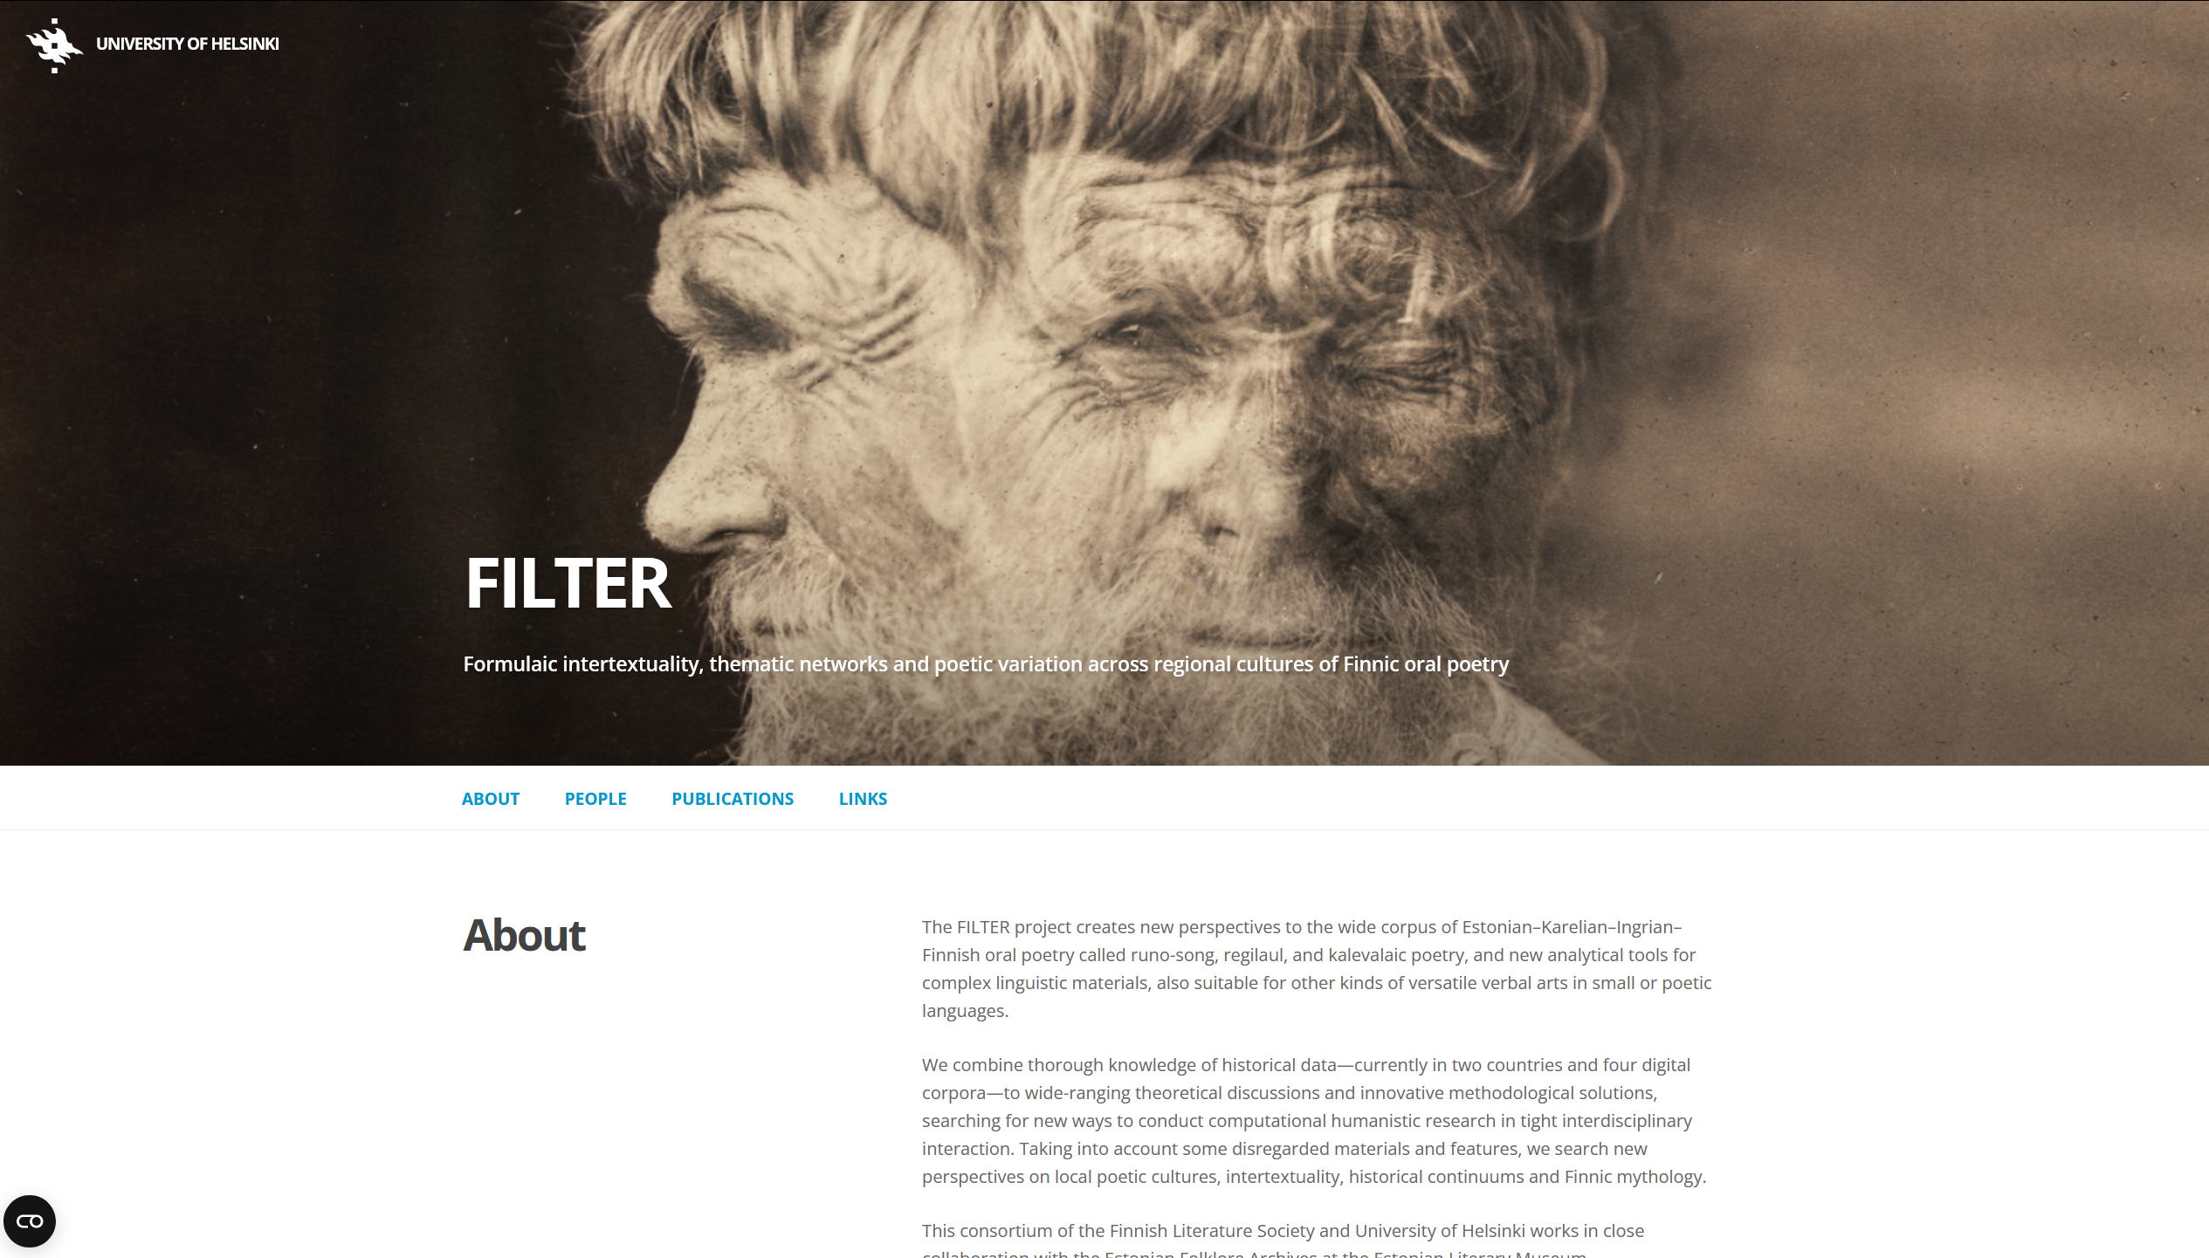
https://blogs.helsinki.fi/filter-project/
Research projects:
FILTER: Formulaic intertextuality, thematic networks, and poetic variation across regional cultures of Finnic oral poetry, 2020–2024 (Kati Kallio & Eetu Mäkelä, et. al.) Academy of Finland at the Finnish Literature Society & HELDIG, with Estonian Folklore Archives
Kati Kallio
Eetu Mäkelä
Maciej Janicki
Jukka Saarinen
Mari Sarv
Liina Saarlo

Slide 14
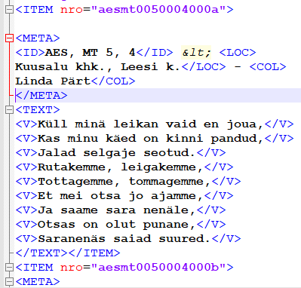
SKVR database based on publication
Estonian runosong database (ERAB) based on machine typed copies of runosongs
OCRed (ca 1998-2003)
rechecked
automatic XML tagging
brought together in 2020 in the framework of FILTER project
+ literary works based on runosong:
Kalevala
Kanteletar
Kalevipoeg
Databases

Slide 15
Interfaces
runoregi.rahtiapp.fi
(Maciej Janicki)

Slide 16
Research aims:
To find out how many verses known in oral tradition are there in Kalevipoeg
To find/verify how many excerpts from Kalevipoeg have been sent to folklore collections as examples of oral tradition. Their specific cases
To find the most productive collectors of "unauthentic songs"

Slide 17
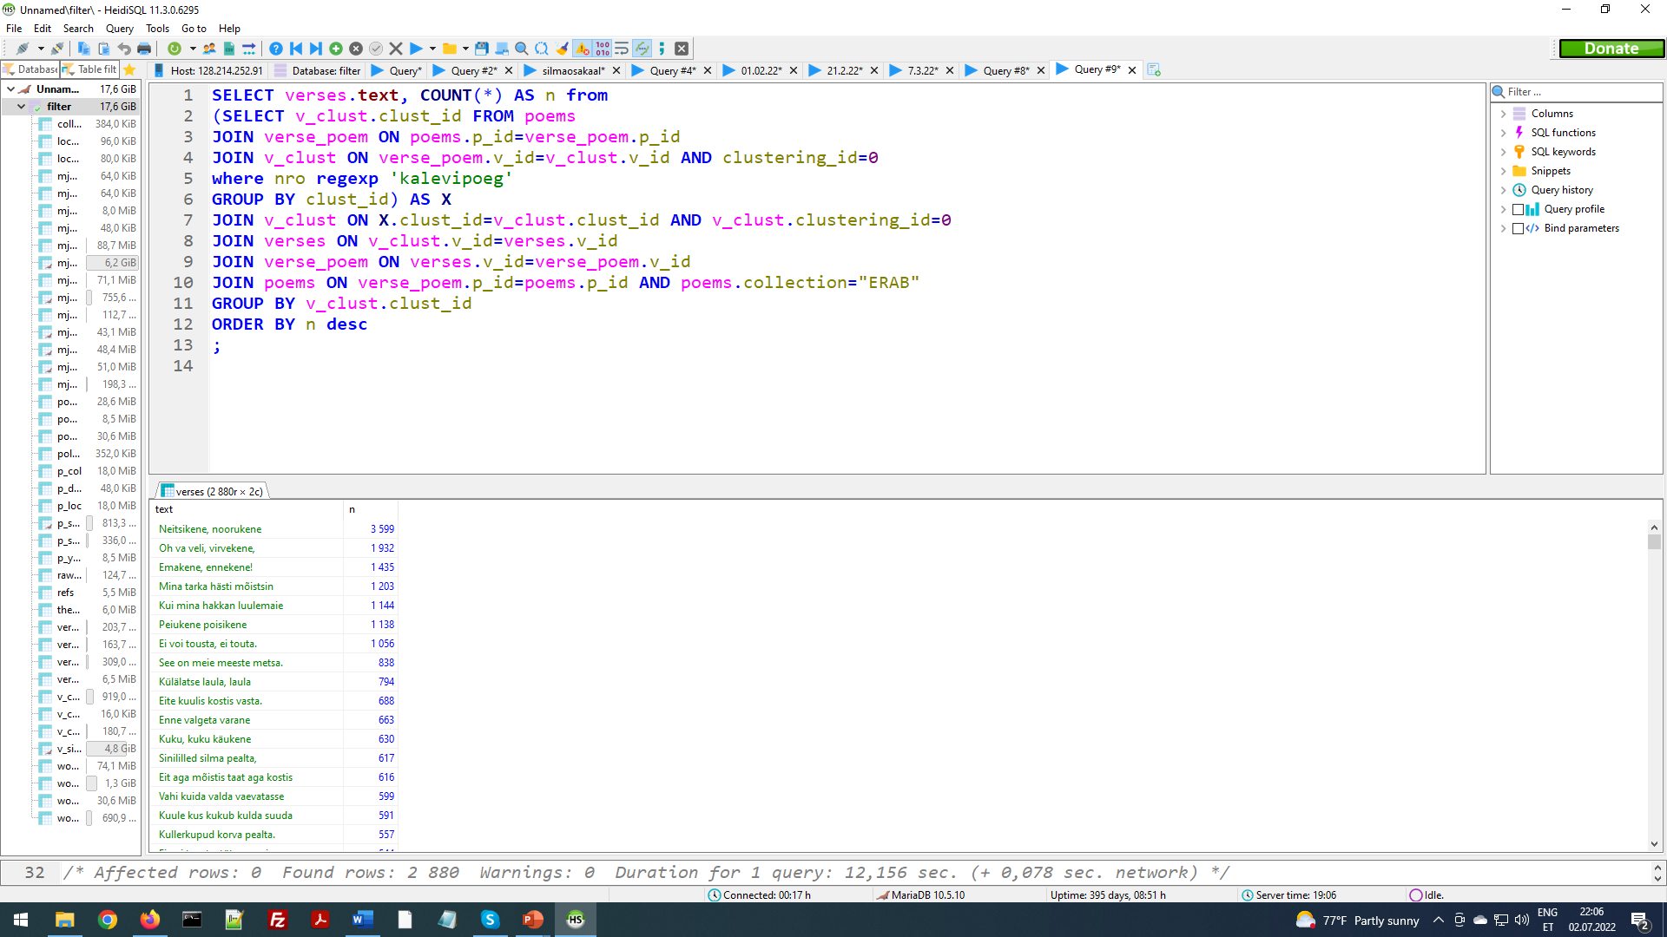
Similar verses of Kalevipoeg and ERAB

Slide 18
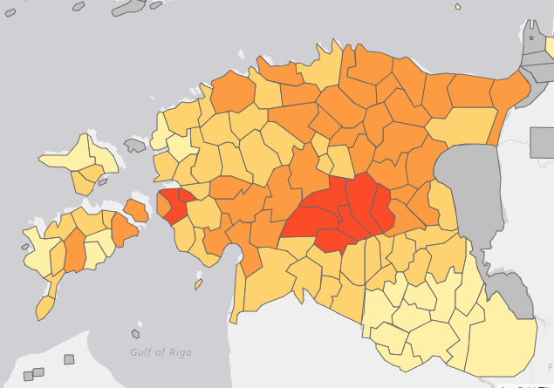
Problem:
tradition >> Kalevipoeg
or
Kalevipoeg >> folklore collections
Percentage of verses from Kalevipoeg by parishes

Slide 19
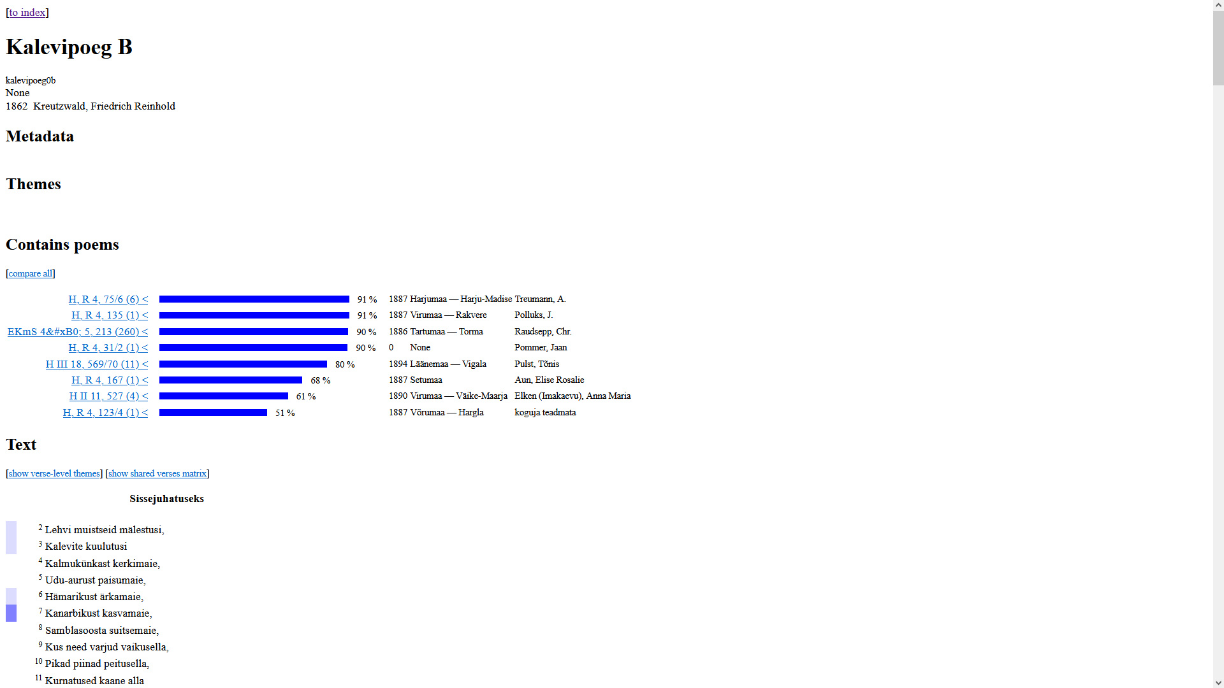
runoregi.rahtiapp.fi
Kalevipoeg and similar contributions in ERAB

Slide 20
Collectors with verses (less than 6) similar to epic in their contributions

Slide 22
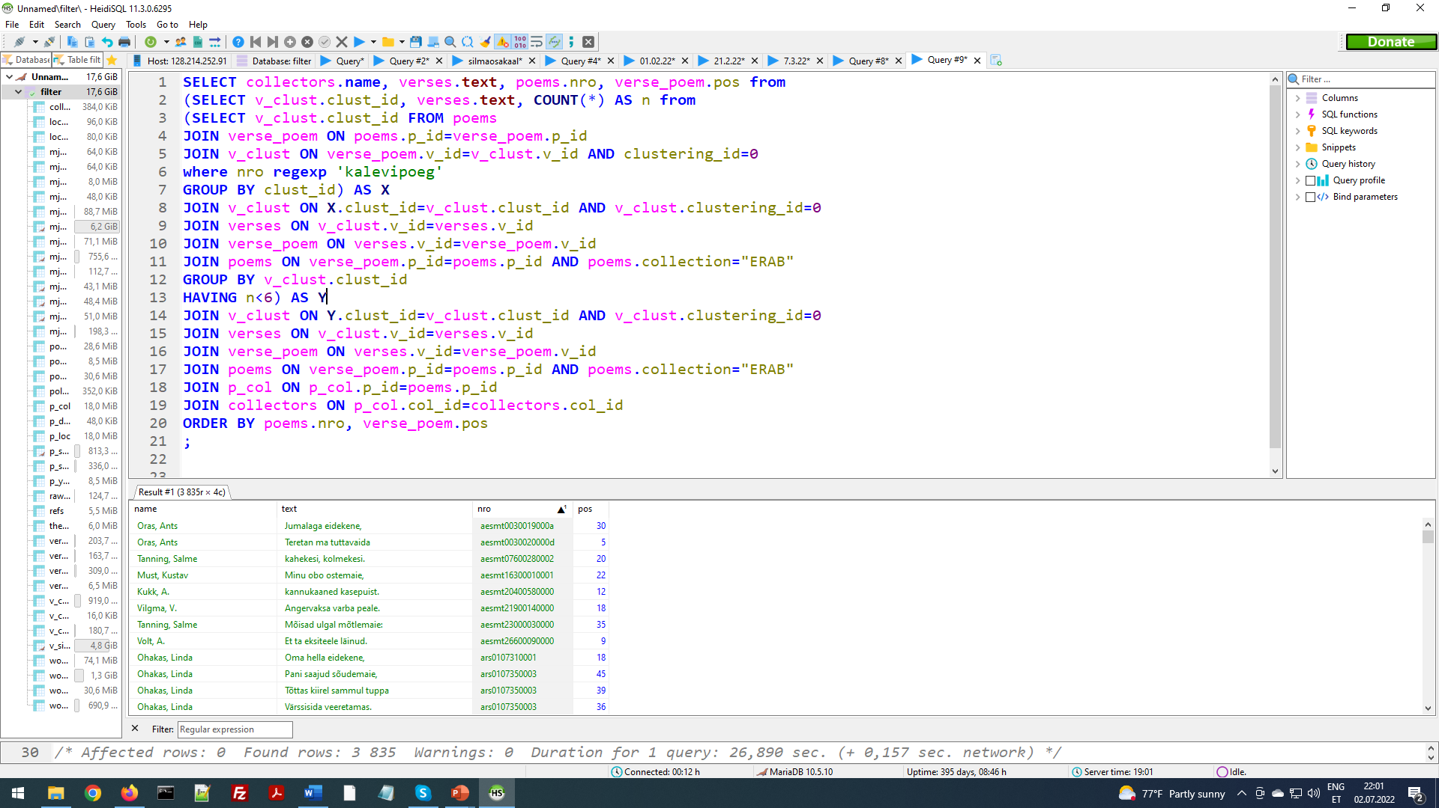
Similar verses of Kalevipoeg and ERAB

Slide 24
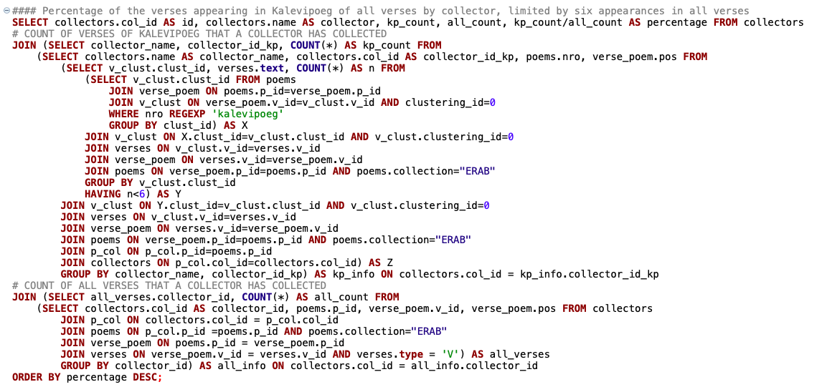

Slide 25
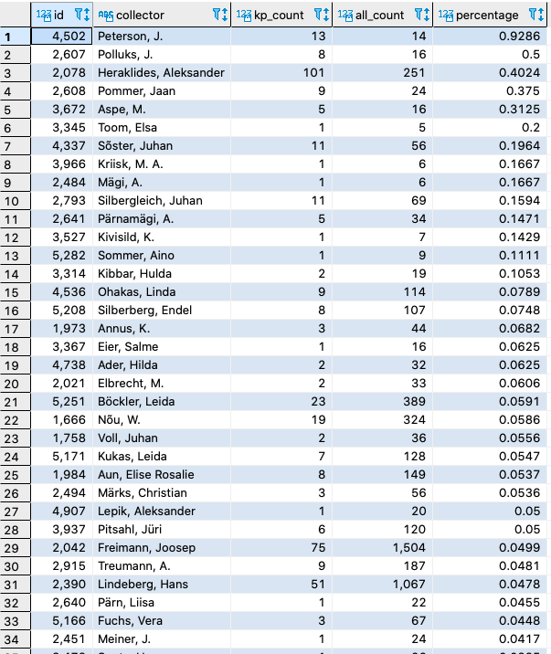

Slide 26
Results:
• Innovative words from Kalevipoeg have been acquired by folk singers and used in the runosongs (e.g. lust)
• Kalevipoeg is so runosongs-like that it can also be embedded in songs at verse level - some words, verses from Kalevipoeg are remembered that are suitable for use
• runosongs were composed in the style of Kalevipoeg, not just been written off (e.g. Karp Kuusik, Maria Lehtsaar)
• directly written off passages from Kalevipoeg (e.g. Friedrich Villem Vahe)
• Kalevipoeg was important not only to intellectuals/ideologists, but also to ordinary people who read it and acquired it unnoticed.

Slide 27
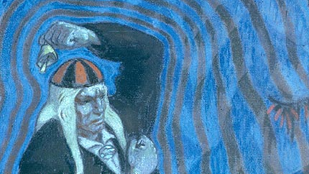
Thank You!
Oskar Kallis, 1915

