Slide 1
Jakobsonian “broad metrics”: a model for musical verse
Igor Pilshchikov (UCLA / TLU)

Slide 2
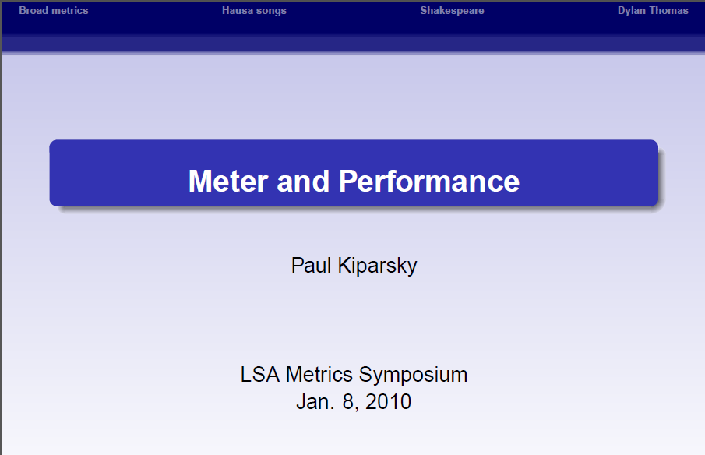
Kiparsky 2010

Slide 3
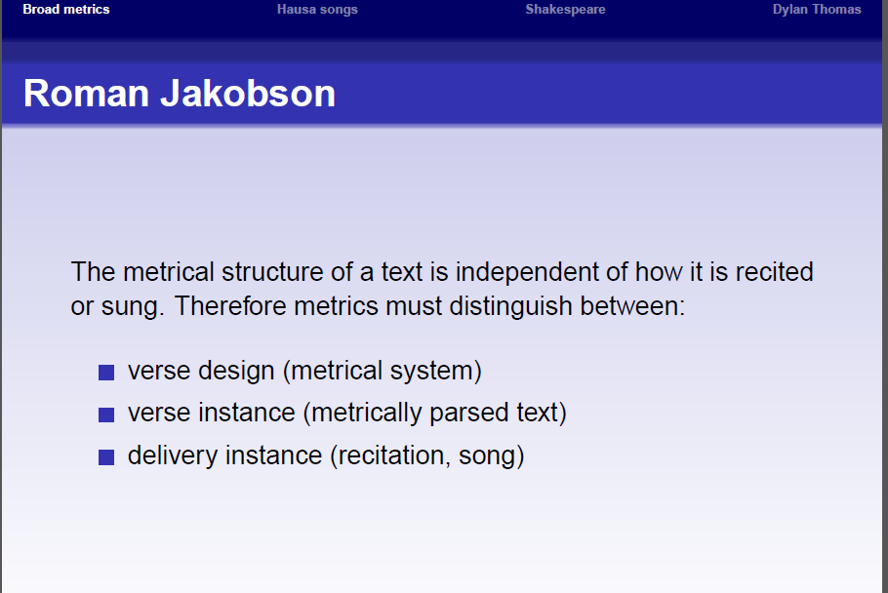
Kiparsky 2010 / Jakobson [1958] 1960

Slide 4
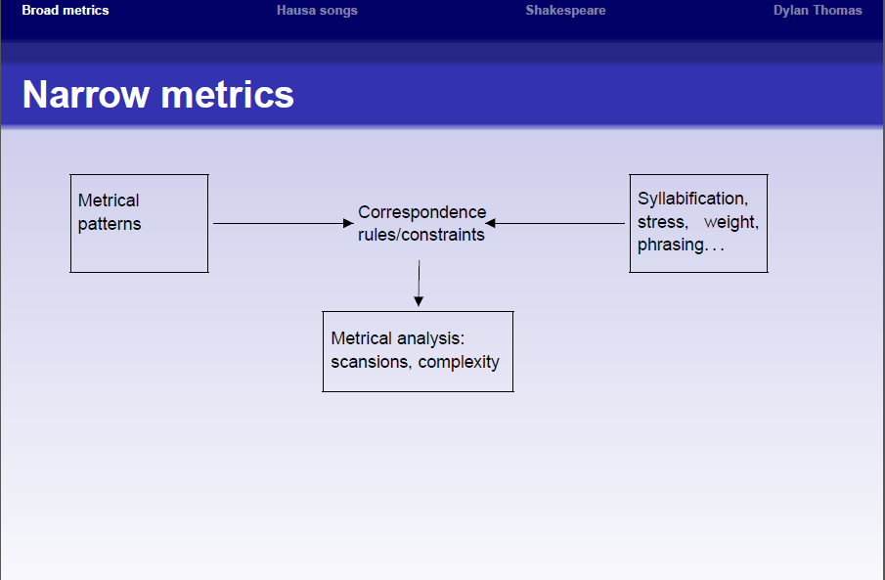
Kiparsky 2010 / Jakobson [1958] 1960

Slide 5
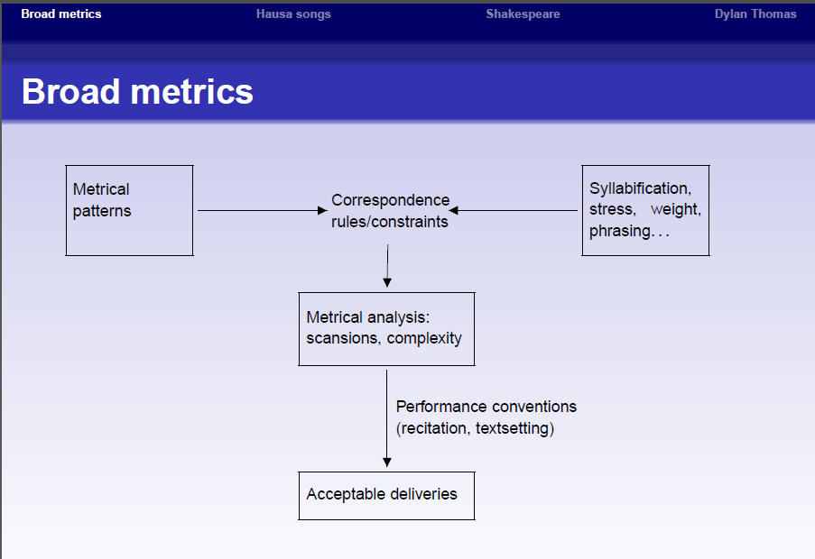
Kiparsky 2010 / Jakobson [1958] 1960

Slide 6
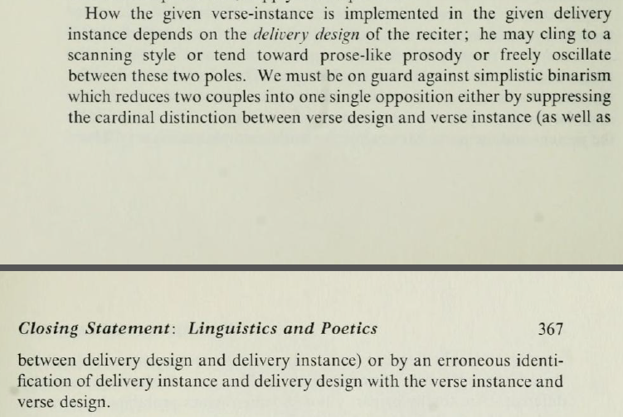
Jakobson [1958] 1960

Slide 7
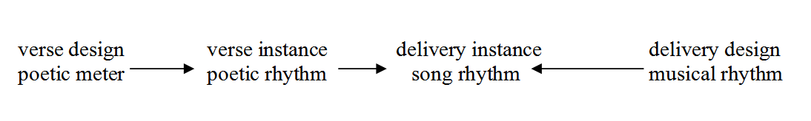
Jakobson [1958] 1960 (adapted)

Slide 8
Russian Guitar Poetry
“bard songs”, бардовская песня, a.k.a.
авторская песня, “author’s song”
Alexander Galich, Vladimir Vysotsky,
Bulat Okudzhava
Pavel Kogan, Mikhail Ancharov,
Mikhail Lvovsky

Slide 9
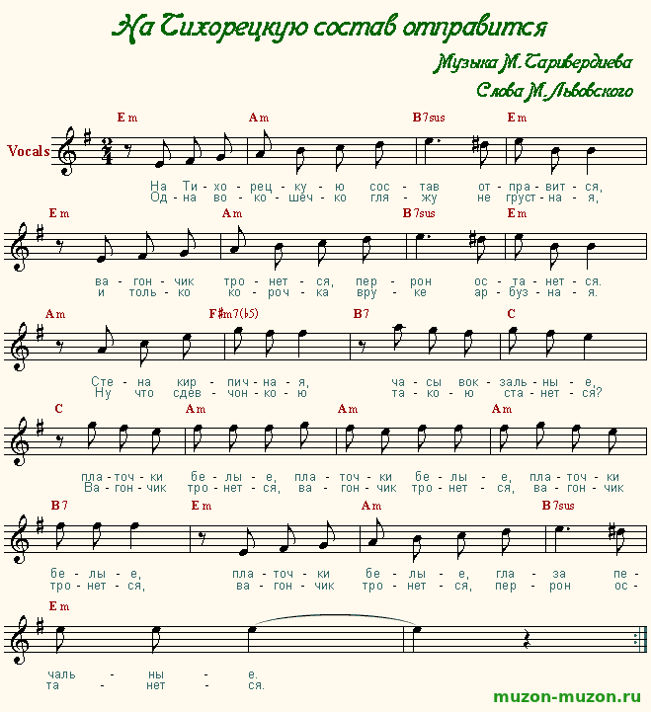

Slide 10
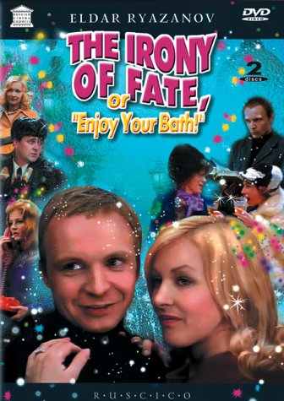


Slide 11
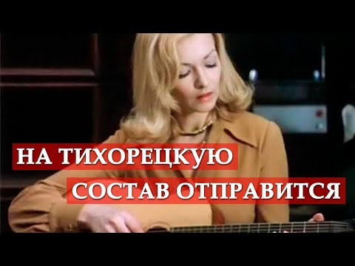

Slide 12
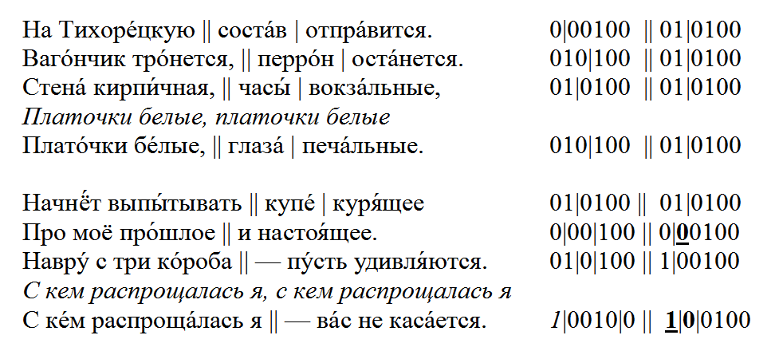

Slide 13
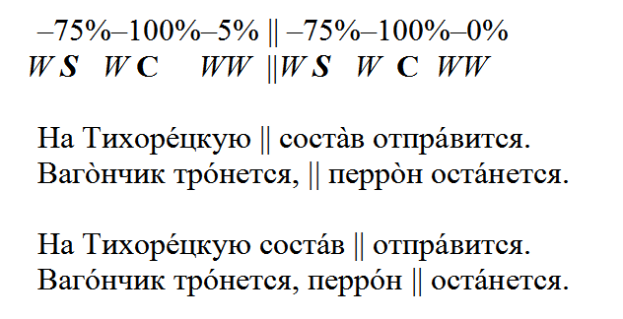

Slide 14
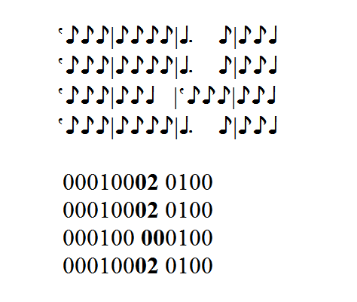
0 = upbeat, 1 = downbeat, 2 = downbeat occupied by a longer note

Slide 15
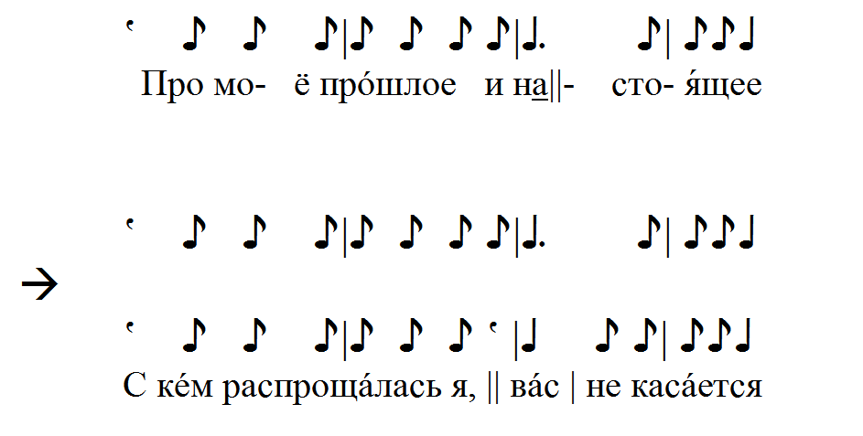

Slide 16
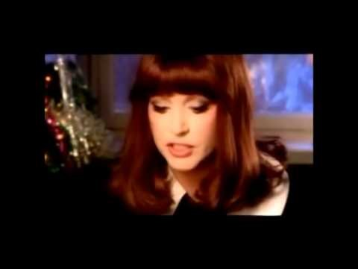

Slide 17
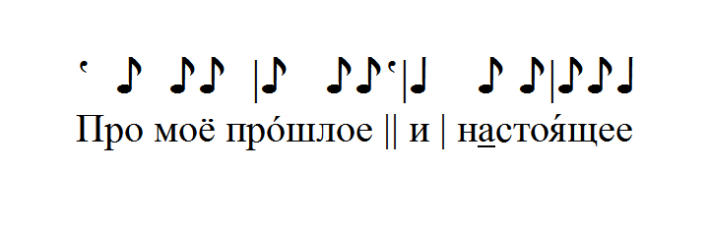

Slide 18
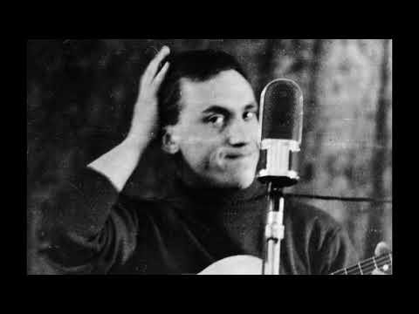

Slide 19
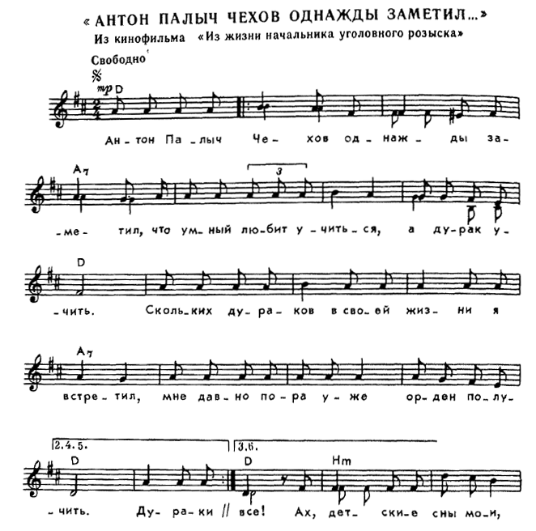

Slide 20
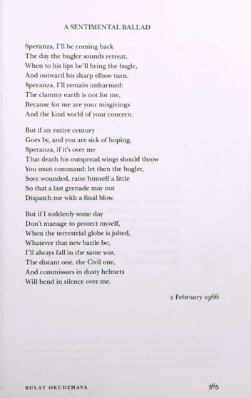
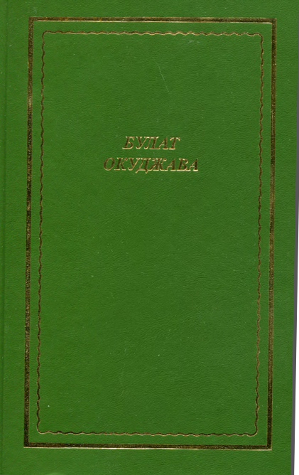

Slide 21
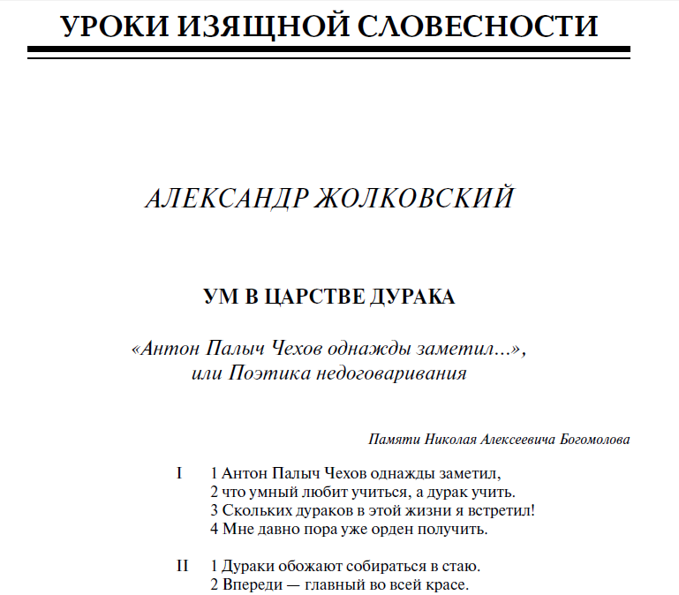

Slide 22
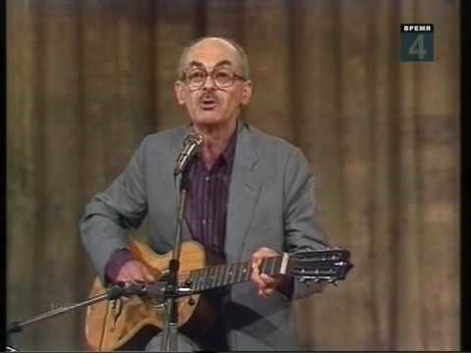

Slide 23
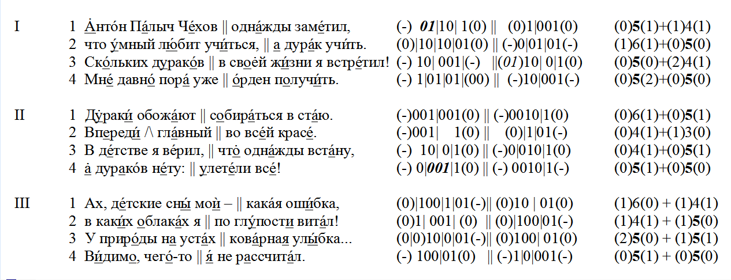

Slide 24
Verse stanzaics vs. song stanzaics
AAA AAA (six quatrains)
AAB AAB (two main quatrains
and a chorus; twice)

Slide 25
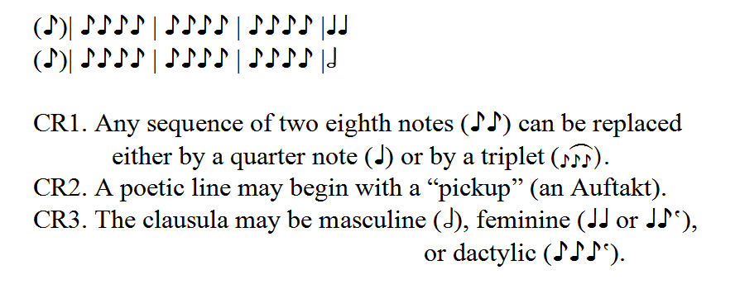

Slide 26
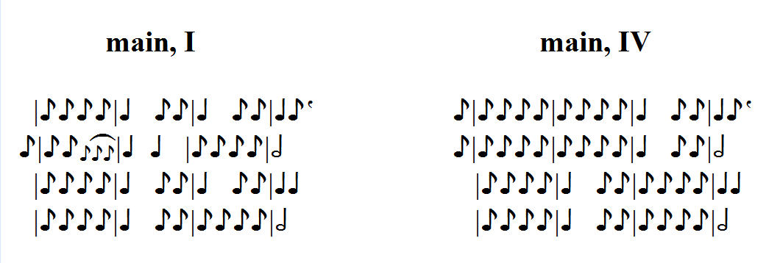

Slide 27
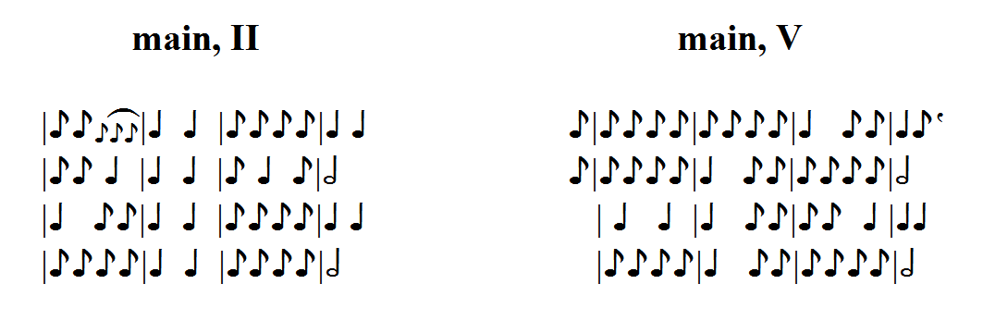
Syncopation (II.2)
0-syllabic interval (II.2, V.3)

Slide 28
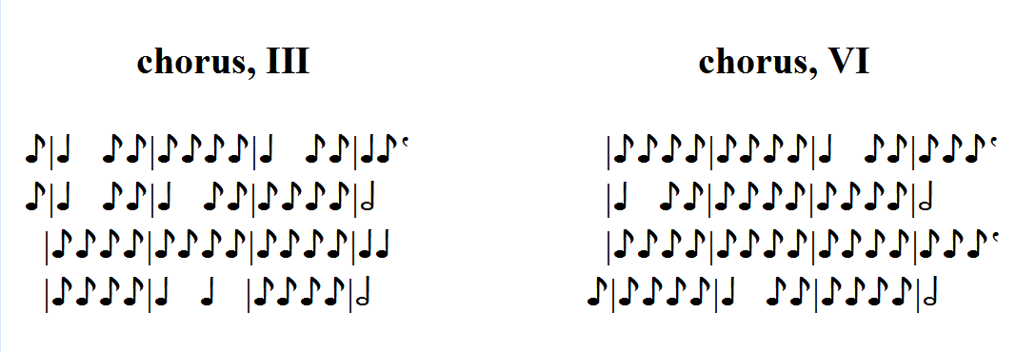
D major → H minor

Slide 29
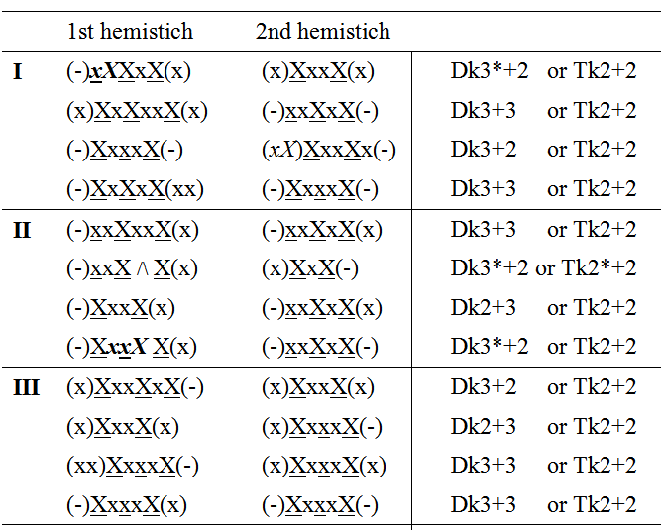

Slide 30
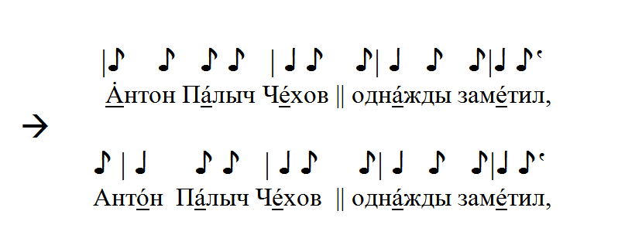
trans-accentuation or atonement (I.1)

Slide 31
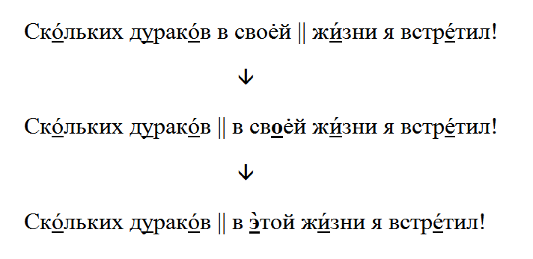
atonement (I.3)

Slide 32
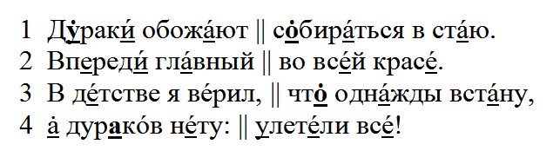
trans- and double-accentuation (st. II)

Slide 33
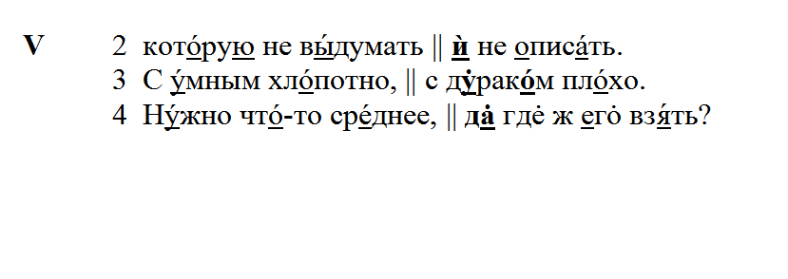
additional stresses

Slide 34
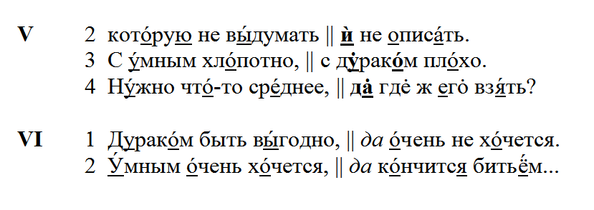
additional stresses

Slide 35
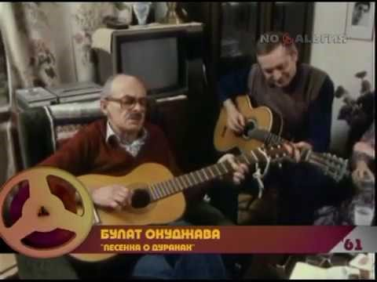

Slide 36


Slide 37
Jakobson [1958] 1960 (adapted)

Slide 38
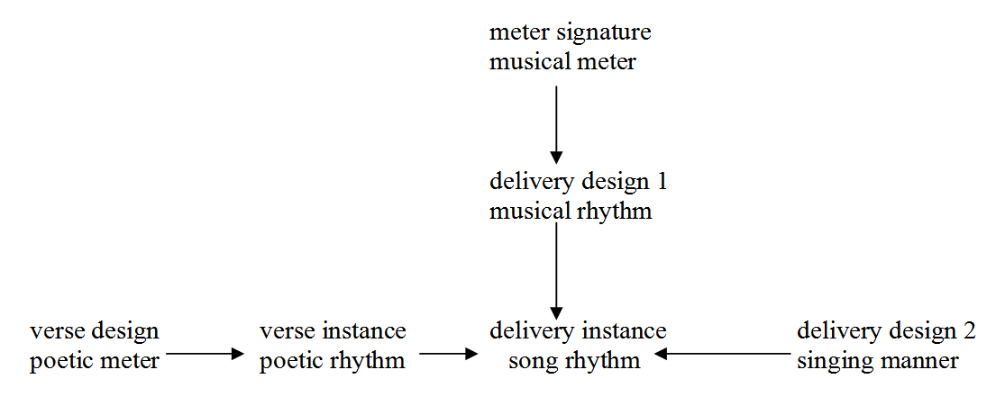
Jakobson [1958] 1960 (adapted 2)

Slide 39

UCLA & TLU stay with Ukraine

