Slide 1
The Voices We Do: Surplus Inscriptions in the Poetry Audio Archive
Chris Mustazza
University of Pennsylvania
Plotting Poetry 5: Popular Voices
Tartu, Estonia
July 4, 2022

Slide 2
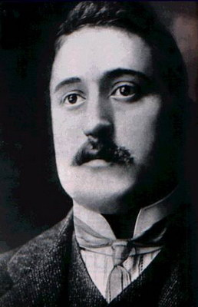
http://writing.upenn.edu/pennsound
World’s largest archive of recordings of poets reading their work, founded by Professors Charles Bernstein and Al Filreis in 2003. Recordings range from 1913 through the current month.
Apollinaire
Nathaniel Mackey

Slide 3
PennSound by the numbers
2,500,000 downloads per year
1,000,000 unique visitors per year
60,000 mp3 files
1,000 video files
~6,000 hours of audio
Always downloadable.
Never just s-
T
R
E
A
M
I
N
G

Slide 4
Global audience

Slide 5
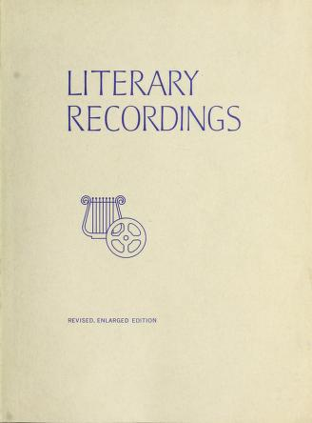
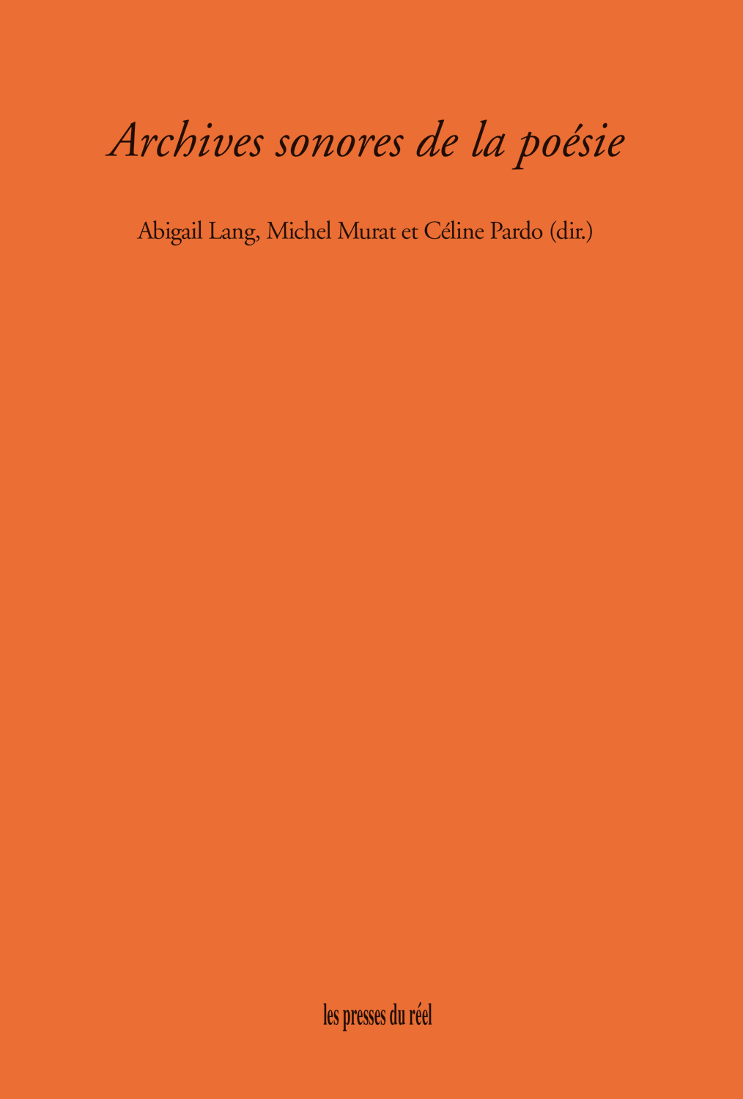
Literary Audio Archives

Slide 6
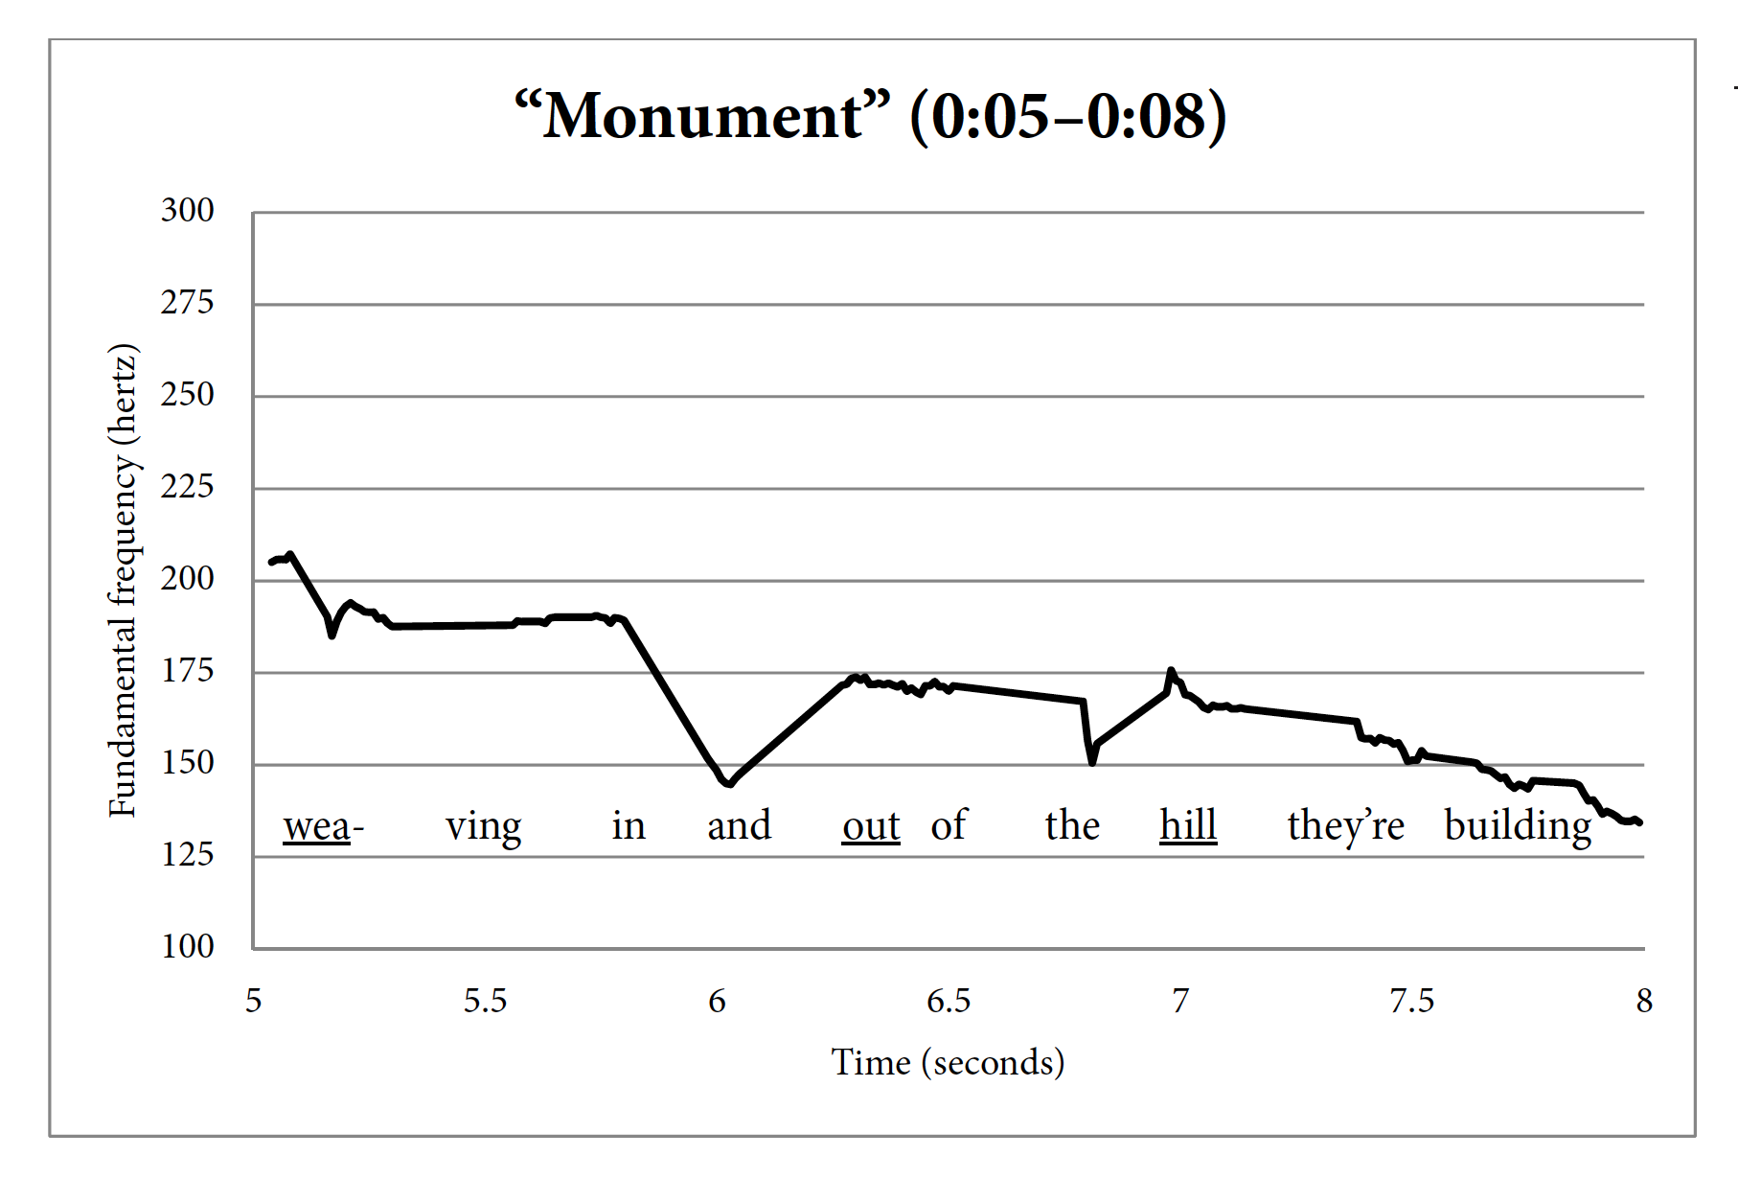
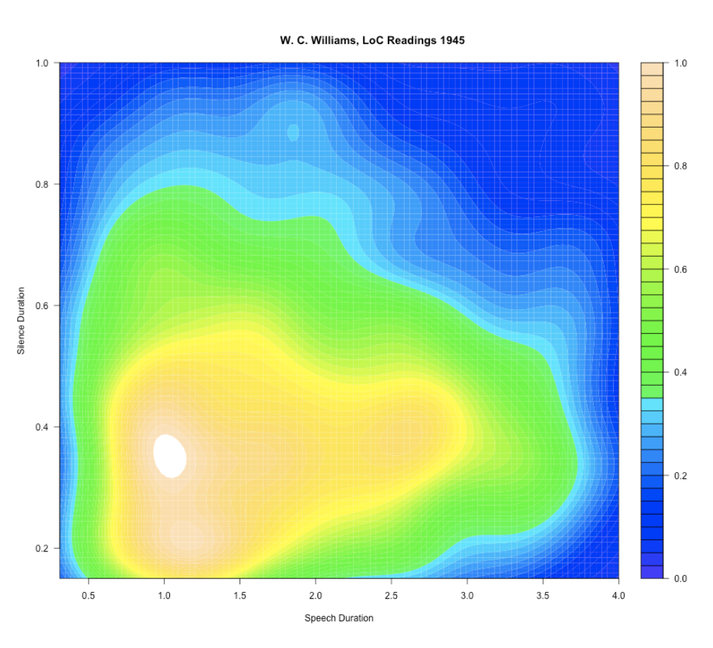
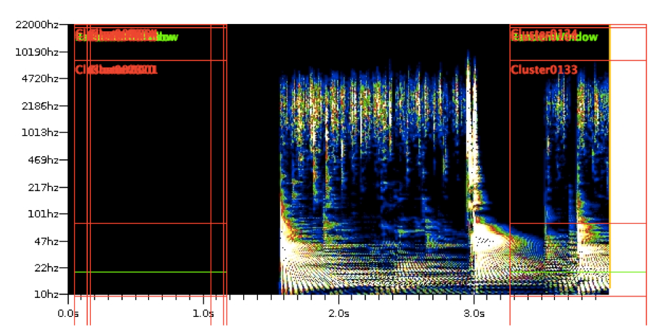
Poetry Audio as Data
Clockwise from top left: Visualizations by 1) Chris Mustazza, 2) Marit MacArthur, 3) Tanya E. Clement, 4) Mark Liberman

Slide 7
Can machine listening be used to identify sonic genre?
Is it possible to empirically define the sonic genre of a work through an attention to spoken prosody?
Pitch
Duration
Pauses
Tempo

Slide 8
I. Disclaimer/Introduction
A scathing critique of my own work / a philosophy of sound

Slide 9
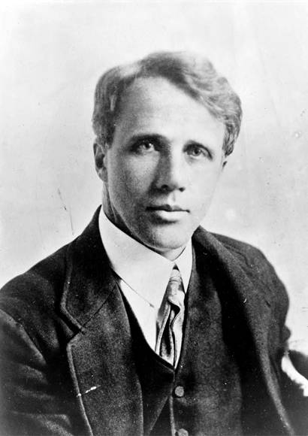
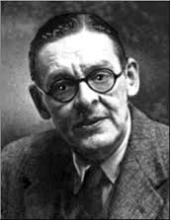
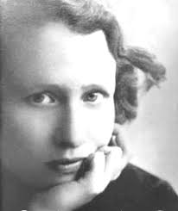
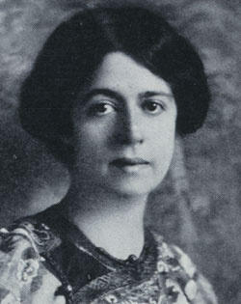
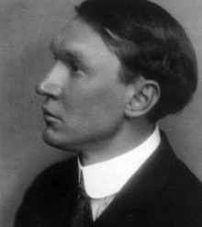
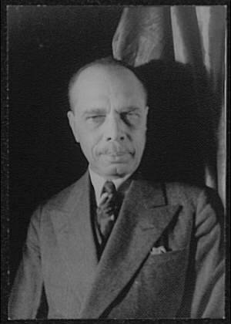
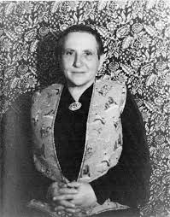
Genre ≠ Writing
Sonic Inheritances
Vaudeville/Plays
Sermons
Political Speeches
Comedy Monologue
Anti-Modernism
High-Modernism
Proto-Postmodernism
Populist Modernism
Afro-Modernism
Notes:
If we approach this literary genealogy primarily as sound, can we locate extra-poetic sonic influences on each strain of modernism?
Can we use sound to reorder categories that have have descended from understanding poetry as a visual form?
Can we think past medium—poetry opposed to vaudeville, etc—as a way to discuss vocal arts during the modern period (and after)?

Slide 10
Sermon Poems/Records
In previous paper for Plotting Poetry, I asked the question of whether machine listening could locate sonic similarities between James Weldon Johnson’s sermon-poems and the sermons of the preacher he modeled the poems on.

Slide 11
In search of the sermonic
Is there a sonic relationship between Johnson’s sermonic and vocal recordings that identify themselves as sermons?
Is it possible to describe and define this sound prosodically?
If so, it possible to locate instances of the sermonic across a heterogeneous audio corpus?

Slide 12
The Voices We Do
Voice
Regional Accent/Identity
Technologies of Mediation
Genre/Context
Personal Influences/Models
Notes:
If we approach this literary genealogy primarily as sound, can we locate extra-poetic sonic influences on each strain of modernism?
Can we use sound to reorder categories that have have descended from understanding poetry as a visual form?
Can we think past medium—poetry opposed to vaudeville, etc—as a way to discuss vocal arts during the modern period (and after)?

Slide 13
II. The Voice(s)

Slide 14
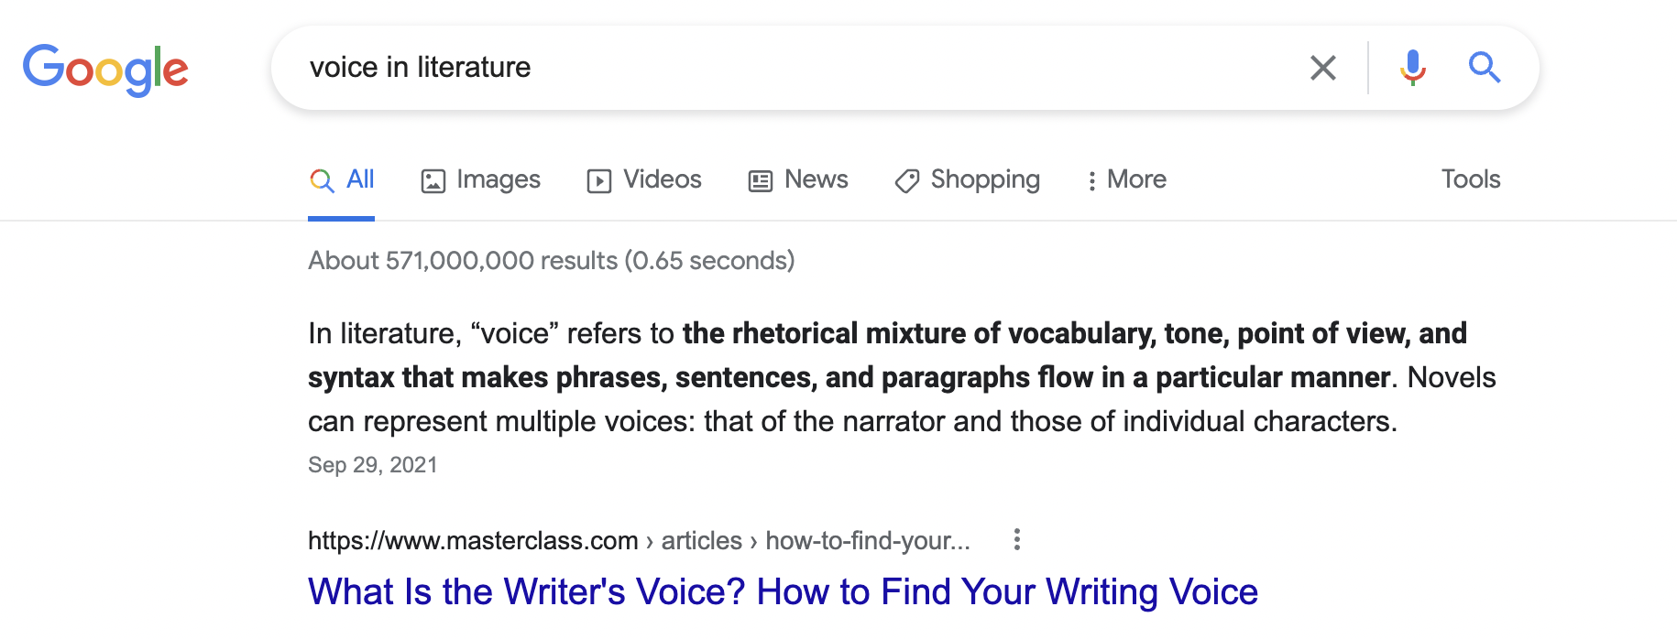

Slide 15
Sounds scored to the page, or sheet music
“For the first time the poet has the stave and the bar a musician has had. For the first time he can, without the convention of rime and meter, record the listening he has done to his own speech and by that one act indicate how he would want any reader, silently or otherwise, to voice his work” (“Projective Verse”).

Slide 16
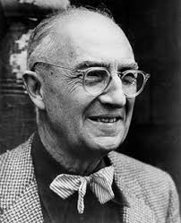
The Speech Lab Recordings
Greet is galvanized to start a series of poetry audio for “teachers, students & other lovers of literature.”
The series ran through the 1930s and ’40s
Vachel Lindsay
Harriet Monroe
James Weldon Johnson
T.S. Eliot
Robert Frost
Gertrude Stein
William Carlos Williams
Edna St. Vincent Millay

Slide 17
Corollary: Popular Voices
The creator of the first American poetry audio archive, W. Cabell Greet, was a linguist interested in American dialects.
For use in collecting dialect samples, Greet owned an amateur recording device that could cut aluminum records.
The most important American modernist poets of the century were recorded in this lab meant for linguistic human subjects research. Similar origins exist for early French, German, and Austrian poetry audio archives.

Slide 18
III. Identifying Voices
An attempt at enumeration

Slide 19
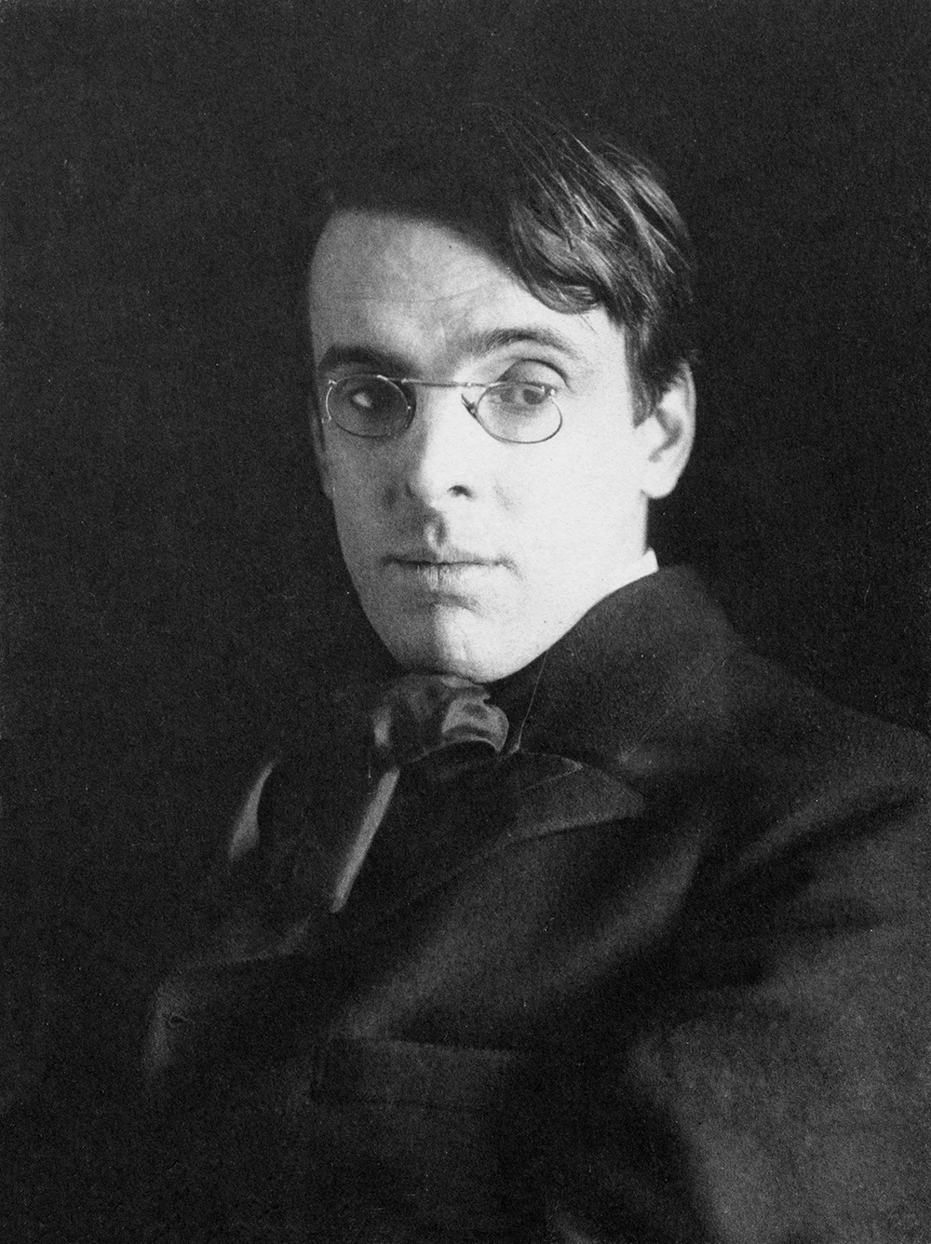
Personal and literary influence
W.B. Yeats – “The Lake Isle of Innisfree”
Recorded 1936
Ezra Pound – “Sestina: Altaforte”
Recorded 1939

Slide 20
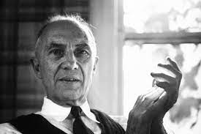
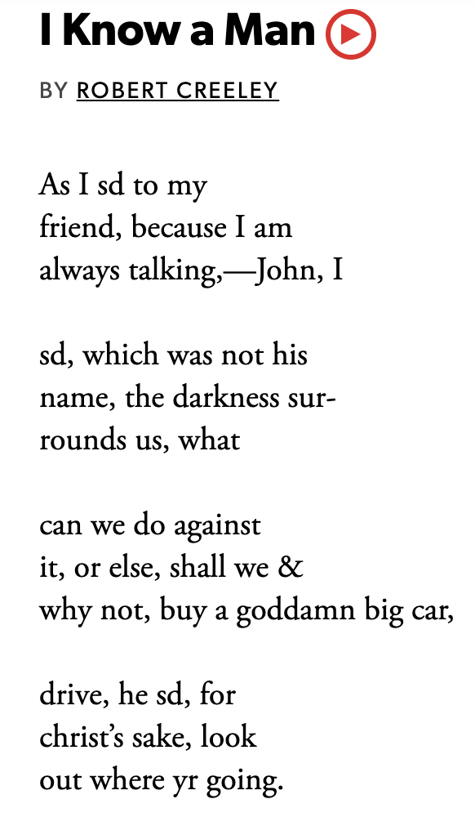
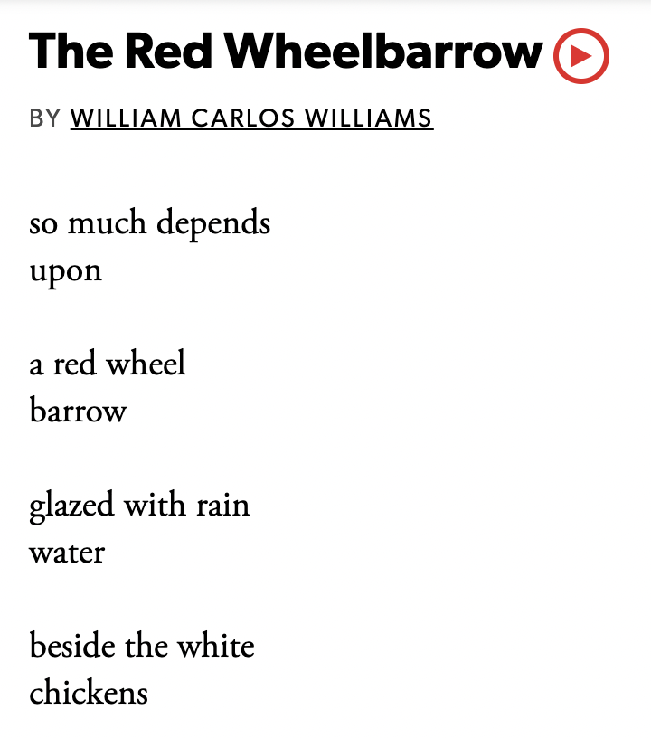
Imagined influence
Robert Creeley– “I Know a Man”
Recorded 1965
WCW – “The Red Wheelbarrow”
Recorded 1942

Slide 21
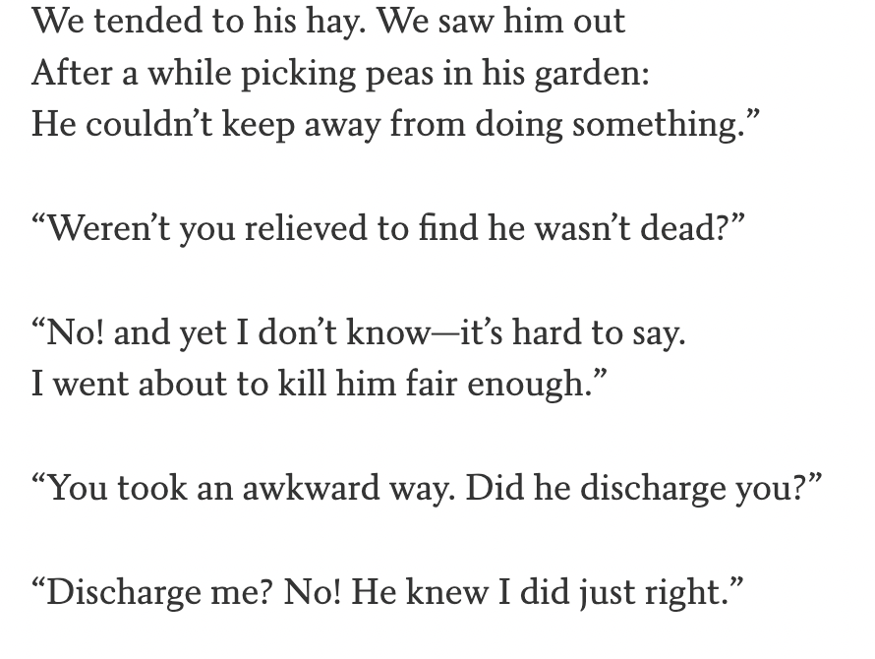
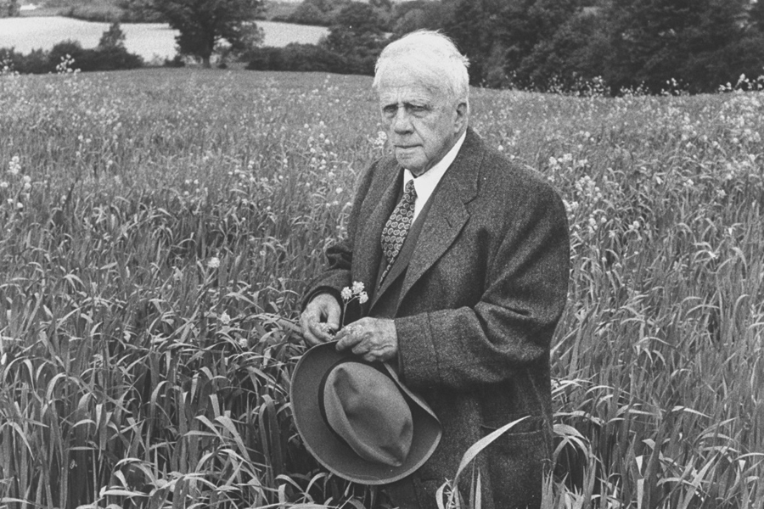
Whose local
Robert Frost – “The Code”
Recorded 1933

Slide 22
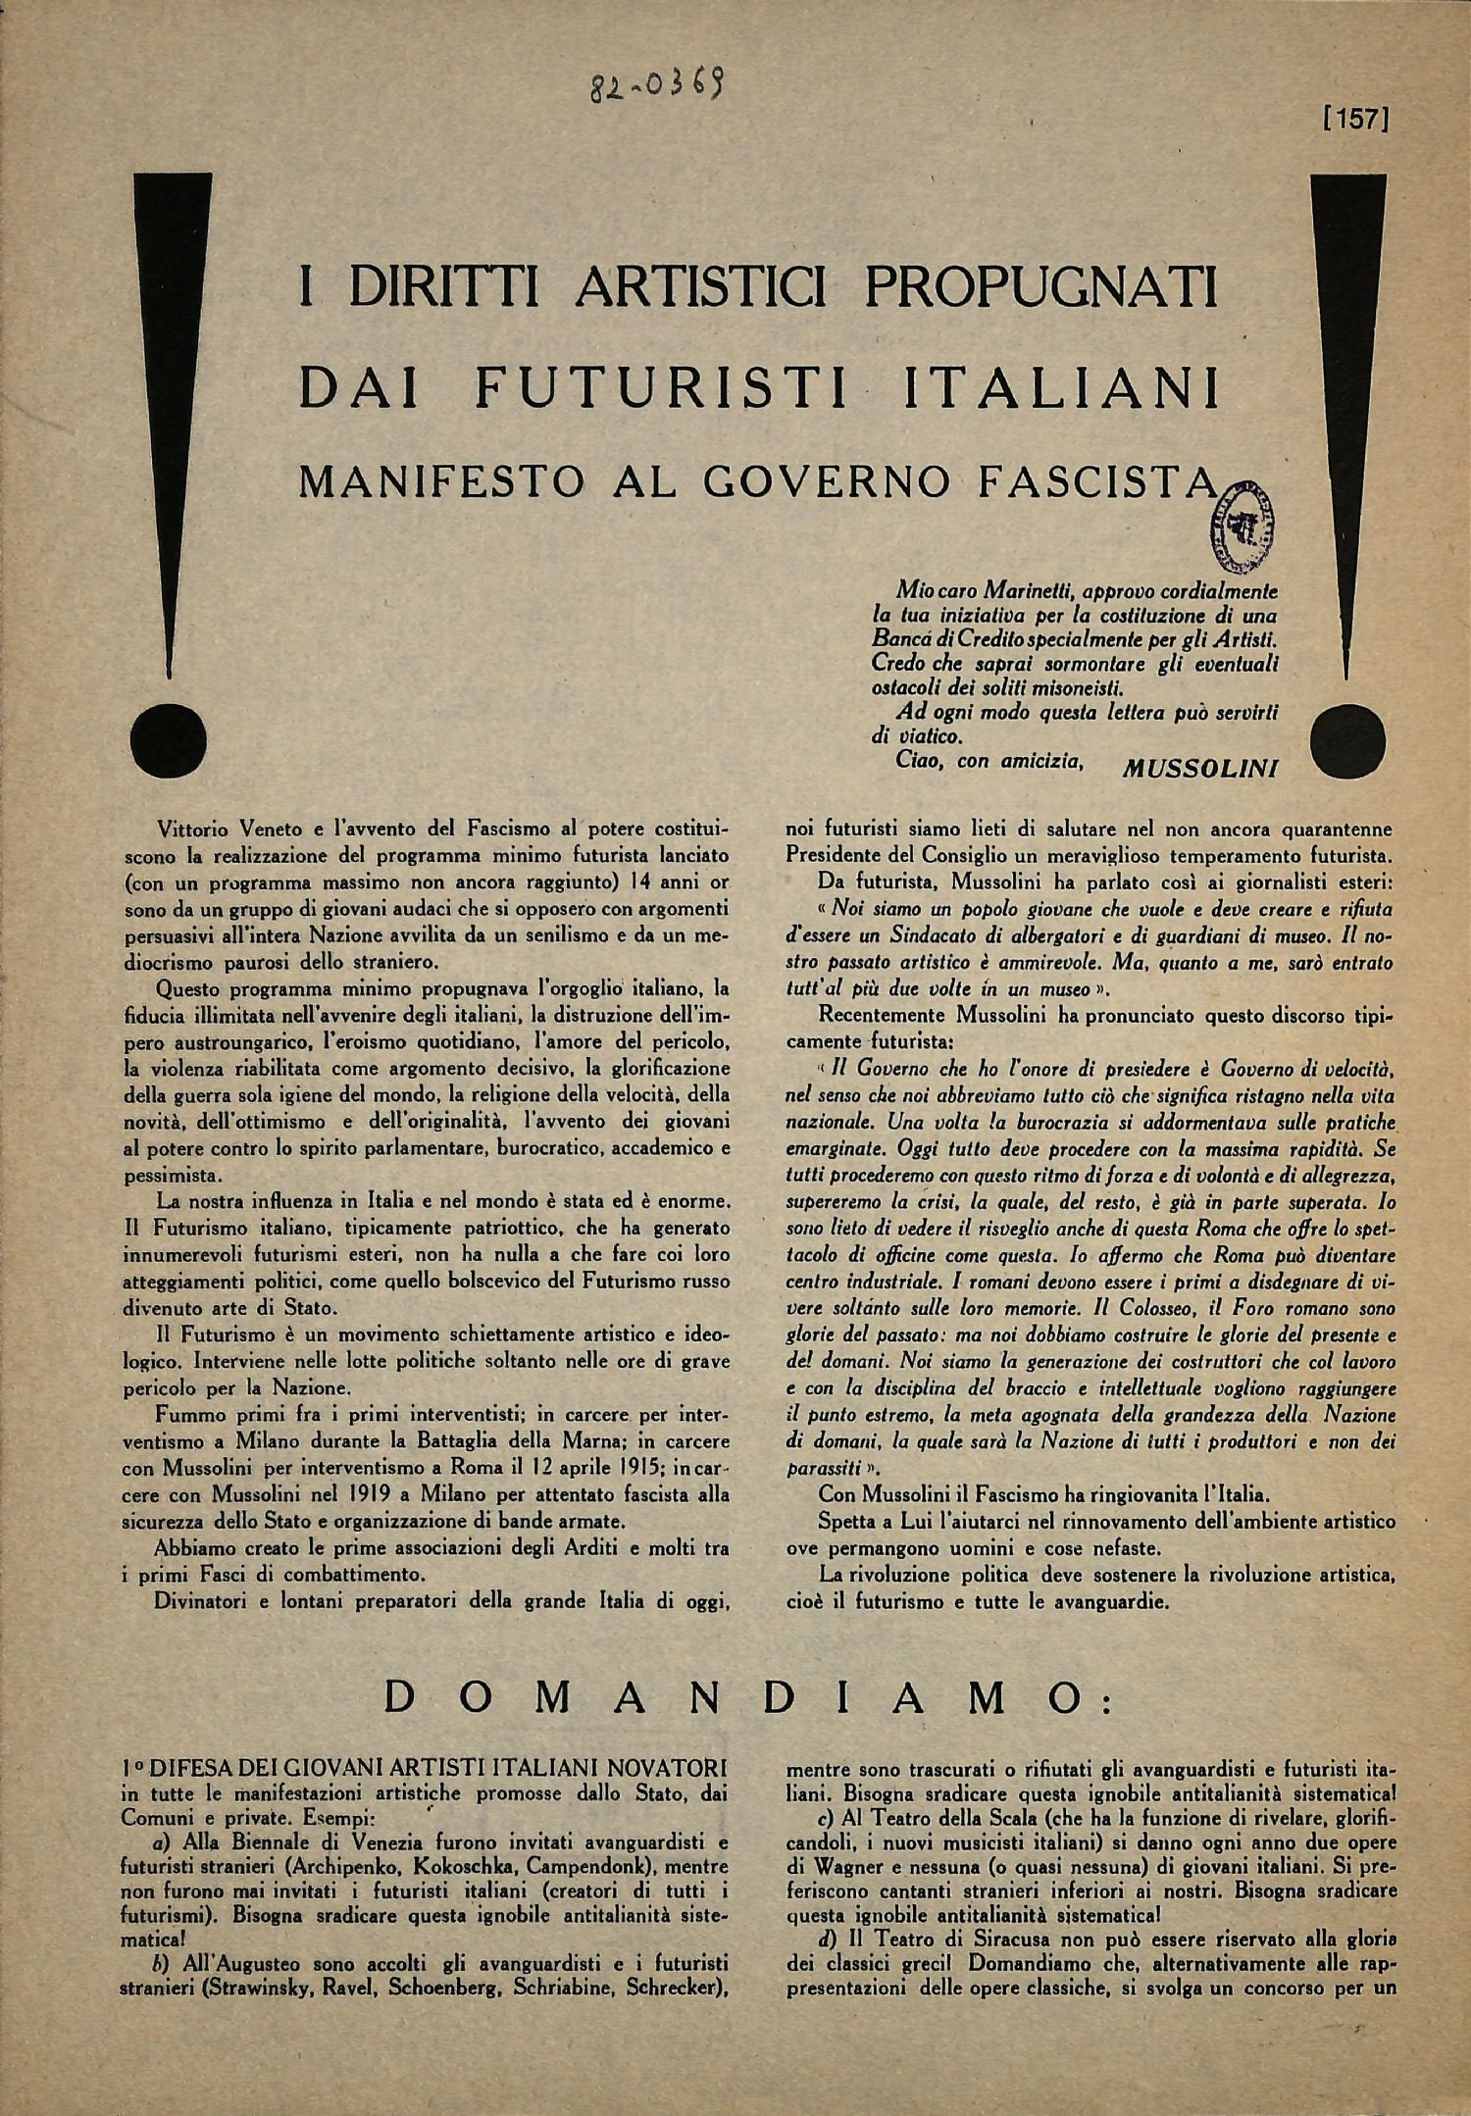
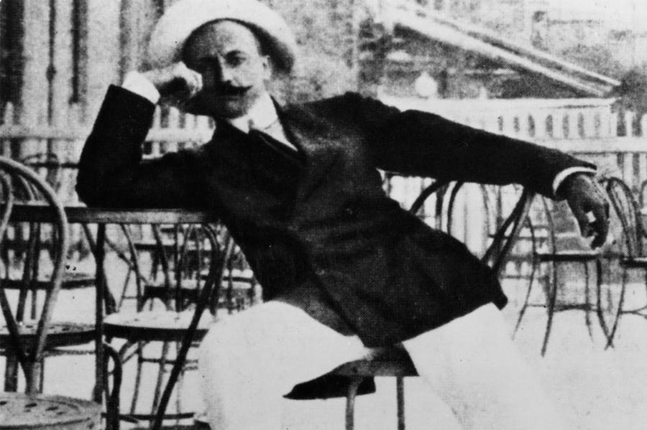
Microphones make speakers

Slide 23
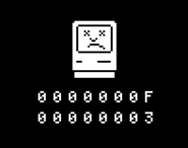
IV. Inconclusion
Machiner la poésie…ou pas?

