Slide 1
The fall of genres that did not happen:
formalizing historical dynamics of Russian poetic meter semantics
Antonina Martynenko (University of Tartu);
Artjoms Šeļa (Institute of Polish language, Polish Academy of Sciences; University of Tartu)

Slide 2
Background
Iambic tetrameter (Iamb-4) history:
The most “classical” meter of Russian poetry;
Genre domains:
18th century: odes;
Beginning of the 19th century: elegies, fragments → everything;
The 1820s & 1830s in Russian poetry:
Period of “expansion” of the Iambic tetrameter; since then Iamb-4 is a “universal” meter that can be used for any theme;
Collapse of the genre system: lost of connections between meters and genres.

Slide 3
Background
Iambic tetrameter in versification scholarship
Most of research focused on rhythmical forms and its changes in Iamb-4;
K. Taranovskiy: Iamb-4 rhythmic form started to change in the 1810s , i.e. right before expansion to other poetic genres (Taranovskiy 2010: 80-103; cf. Dobritsyn 2016);
M. Gasparov: hypothesis of direct connection between Iamb-4 expansion and collapse of the classical genre system (Gasparov 1970: 36-37; Gasparov 2000: 112-114, 166-167).

Slide 4
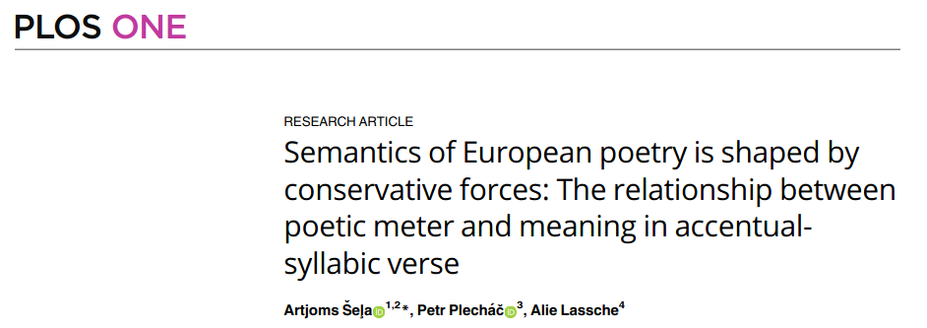
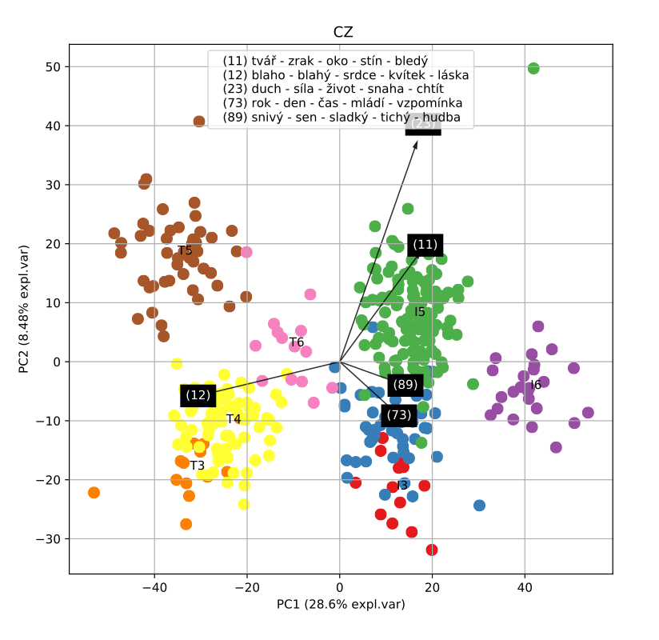
Background
‘Semantic halo’: an association between meters and semantics; the form and a way it is used:
Shown qualitatively on collections of poems in selected meters (pioneer work: Gasparov 1999);
Formal demonstration of meter & semantics association in several accentual-syllabic poetic traditions in large poetic corpora (Šeļa et al. 2022)

Slide 5
Research questions & aims
Is there meter-meaning relationship in “universally” used meters (e.g. Russian iambic tetrameter, English iambic pentameter)?
Can we formally/computationally model and trace a meter’s thematic expansion path over time?
Specify the chronological framework of Iamb-4 expansion to new themes;
Study the allocation of themes to Iamb-4 and their reallocation to other metrical forms after the “expansion” period.

Slide 6
Corpus overview
Poetic subcorpus of the Russian national corpus;
Poems written between 1770 and 1850;
13 344 poems (poems longer than 50 lines were sampled);
~ 560 000 tokens / ~ 34 000 lemmas
Only 5 000 MFW was used for building the model (~ 440 000 tokens)

Slide 7
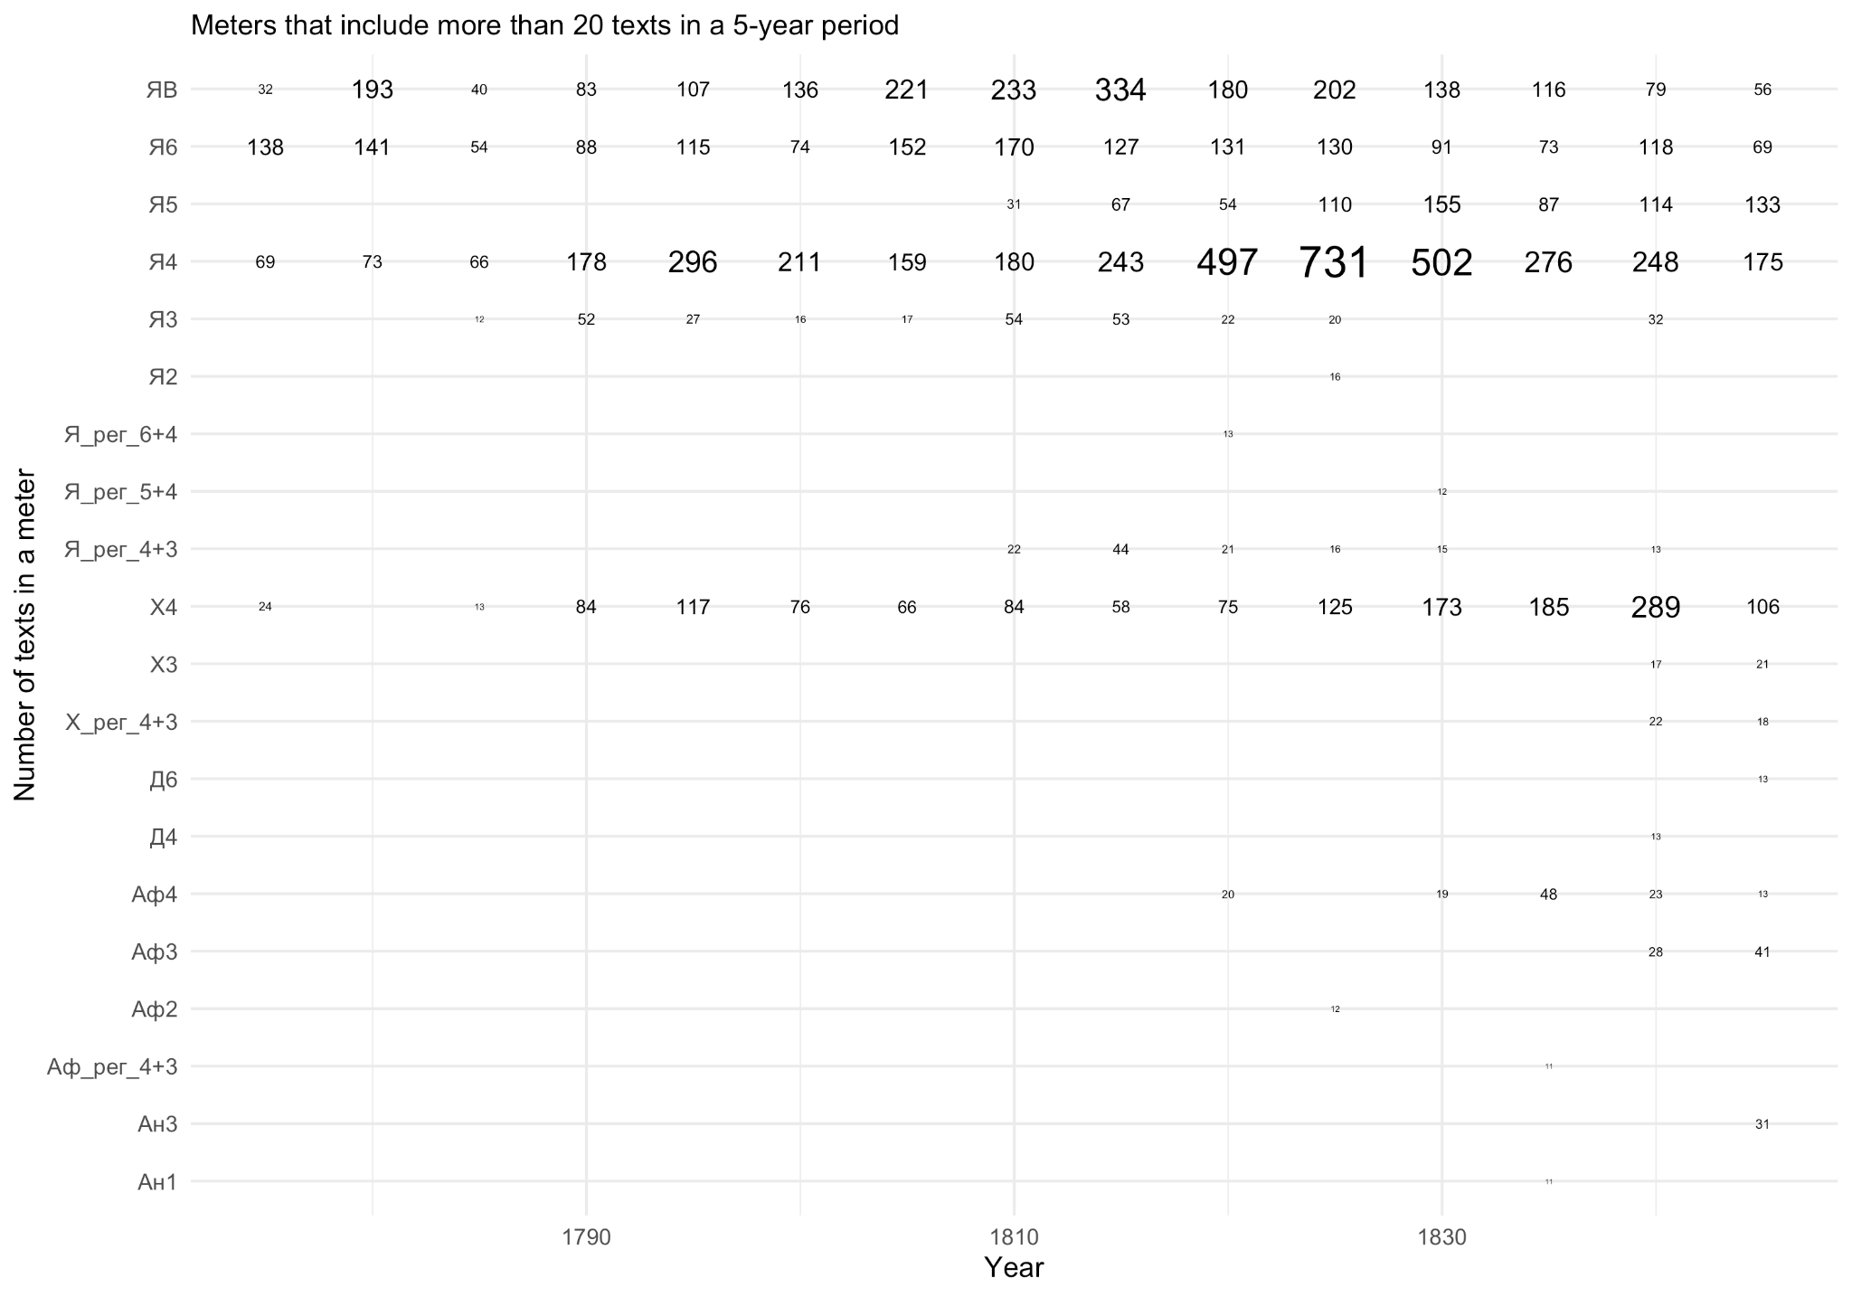

Slide 8
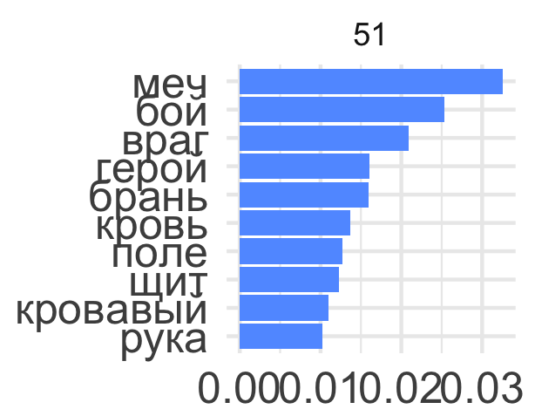
Methods
Semantic formalization: topic modeling
LDA model with 75 topics:
Each poem presented as a vector of probabilities of 75 topics;
Each topic includes the probabilities of all words in the corpus.
Topic 51 most probable words:
Sword, fight, enemy, hero, battle, blood, field, shield, bloody, hand

Slide 9
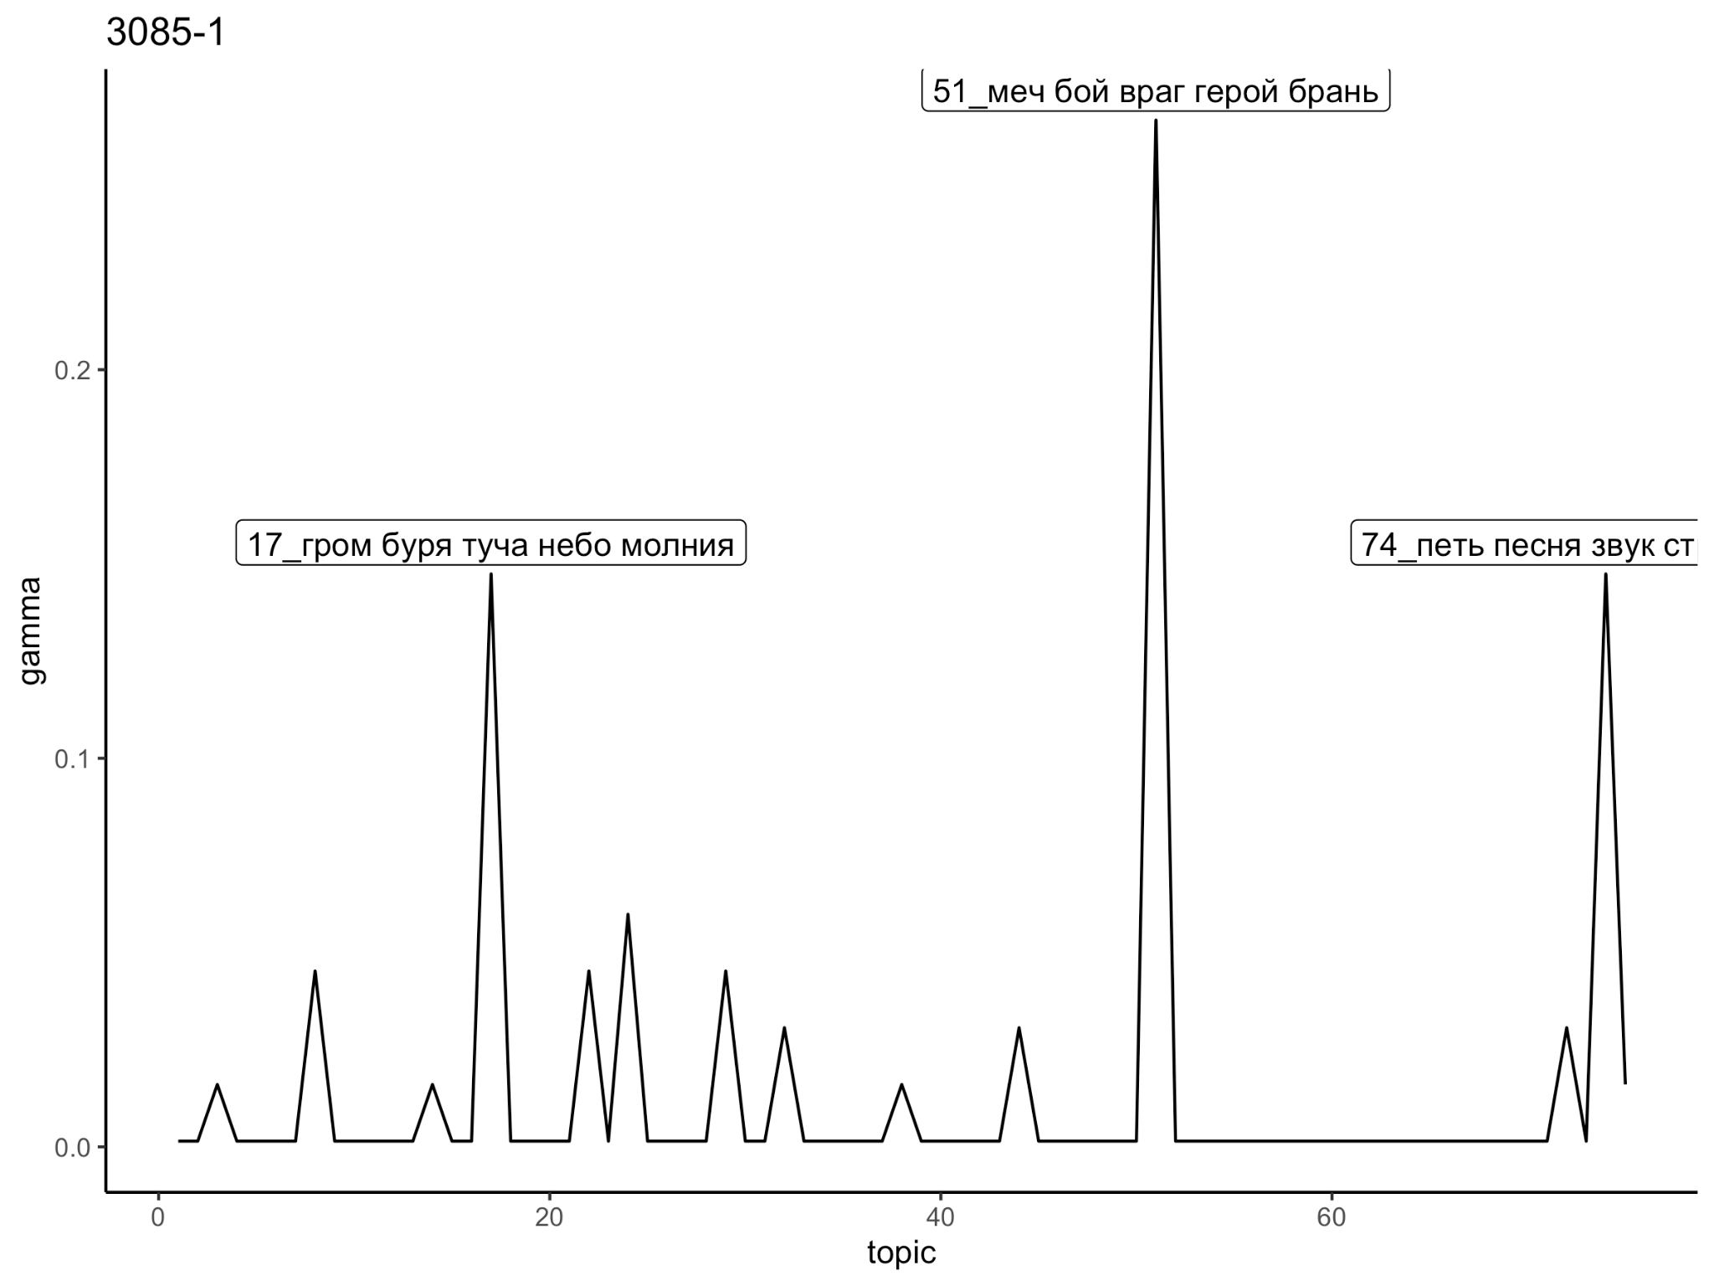
Methods
Connections between topics: networks
If two topics are presented in the same poem with very high probability*, we create a link between these topics.
Poem 3085-1 most probable topics: 51 (war), 17 (storm), 74 (song)
* topics with probabilities of the top 5 percentile of the overall distribution

Slide 10
Methods
Connections between topics: networks
If two topics are presented in the same poem with very high probability*, we create a link between these topics.
Poem 3085-1 most probable topics: 51 (war), 17 (storm), 74 (song) In the network:
* topics with probabilities of the top 5 percentile of the distribution
17
51
74

Slide 11
Methods
Why networks?
Poems assigned to meters give opportunity to study semantic changes in a meter’s network;
‘Semantic halo’ phenomenon does not depend solely on the usage of themes, but on the way how the themes are related to each other within a meter: Набор тем в размерах может быть одинаков или почти одинаков, но структура этого набора одинакова не будет [The set of themes in metrical forms can be the same or almost the same, but the structure of this set will not be the same] (Gasparov 1979)

Slide 12
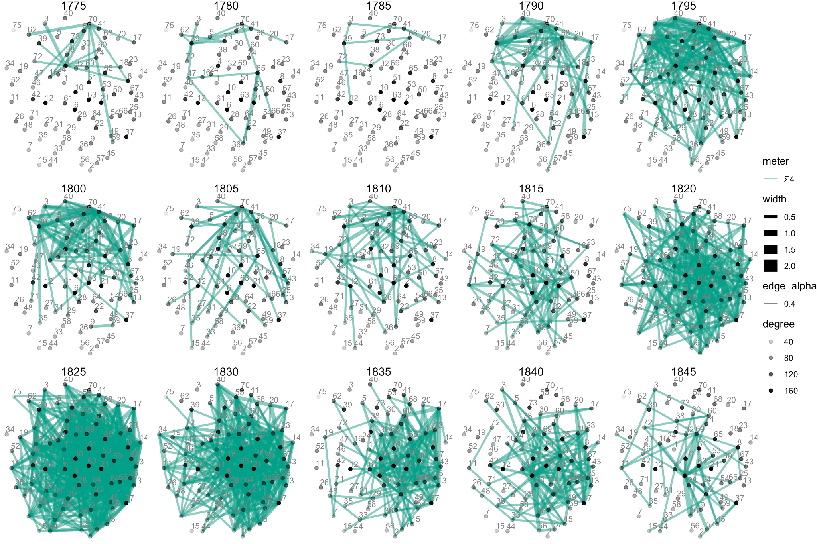
Was Iamb-4 “expansion” a real thing?

Slide 13
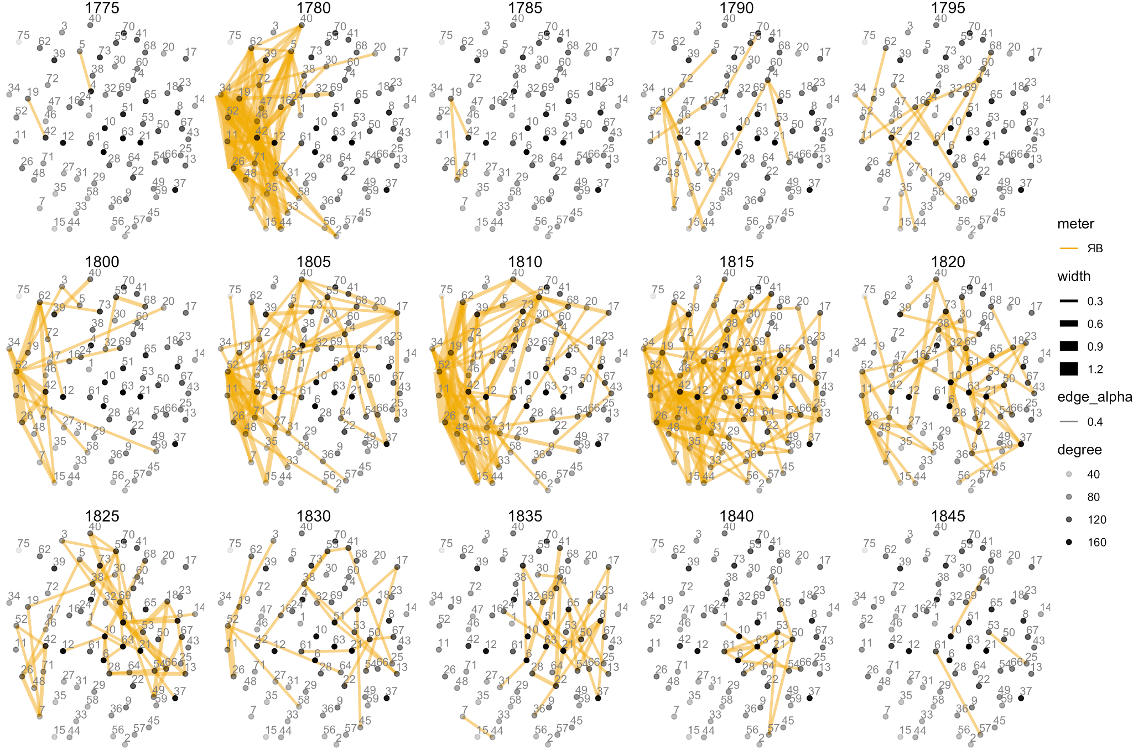
Networks of topics for iambic verse with irregular feet usage (‘free iamb’)

Slide 14
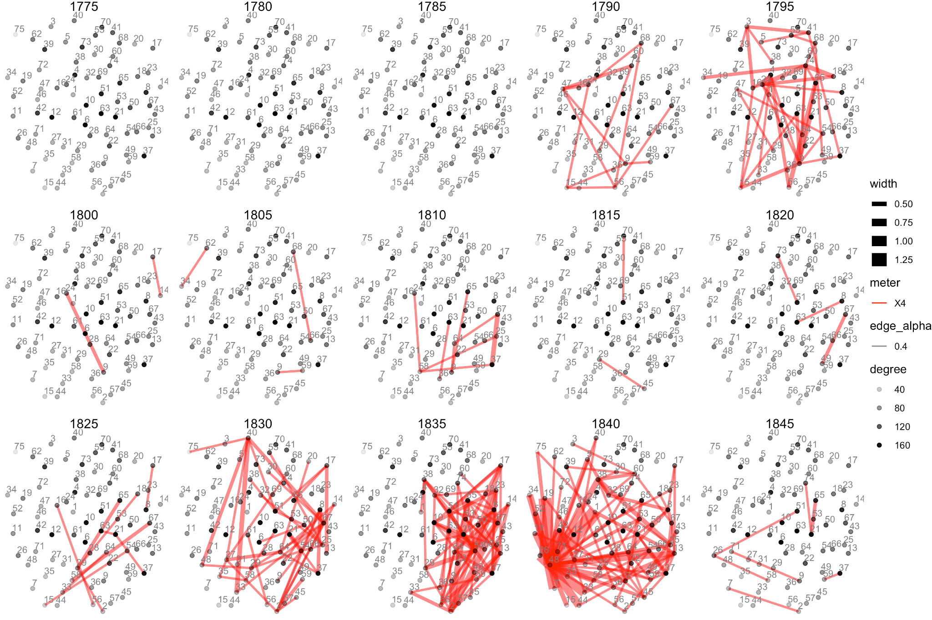
Networks of topics for trochaic tetrameter

Slide 15
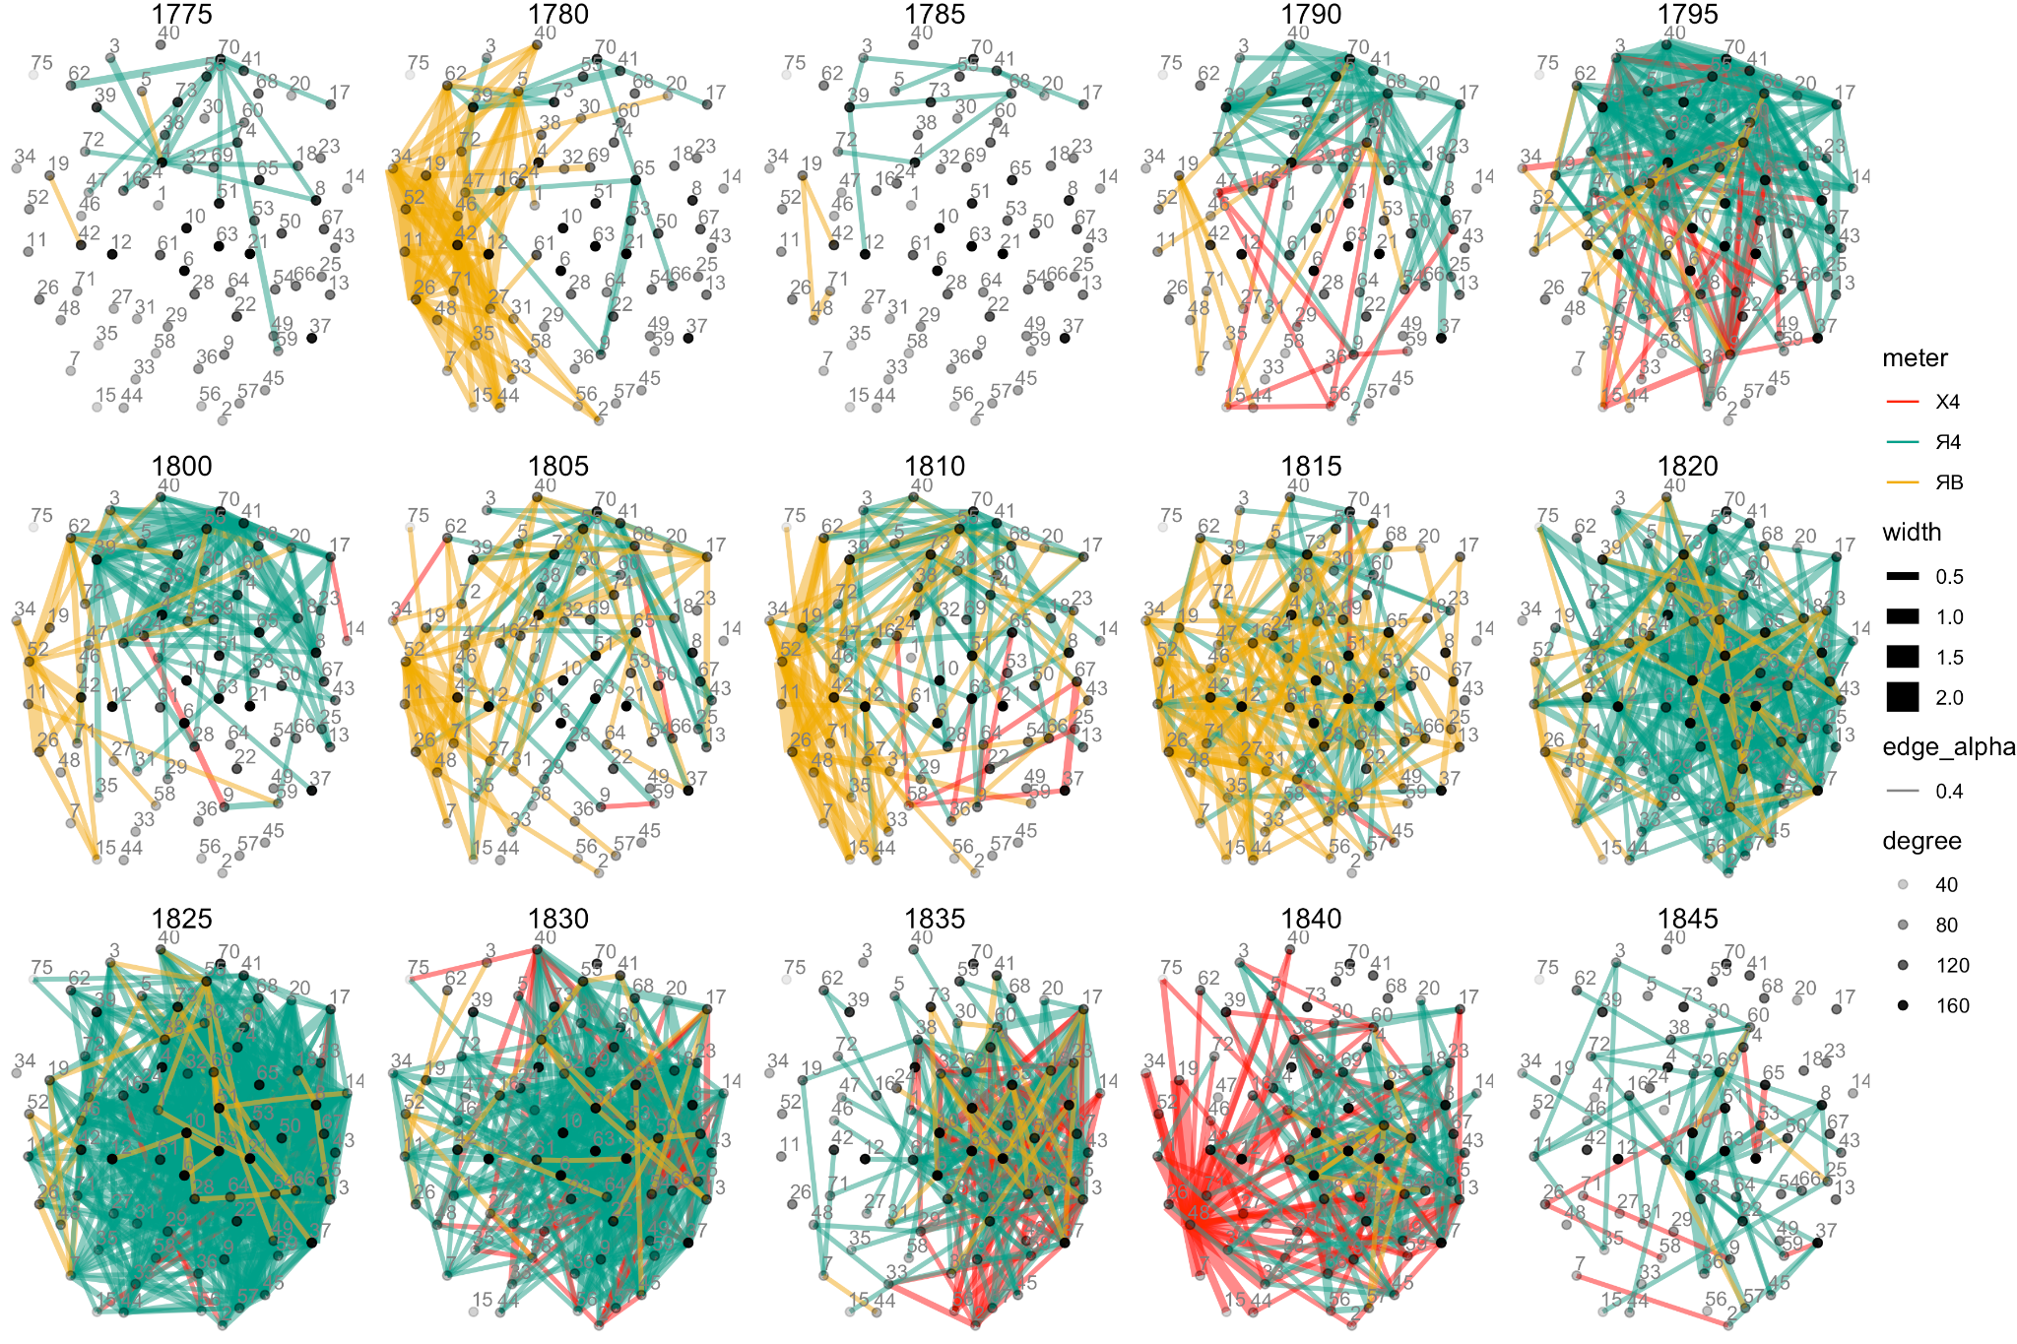
Expansion that did not last for long

Slide 16
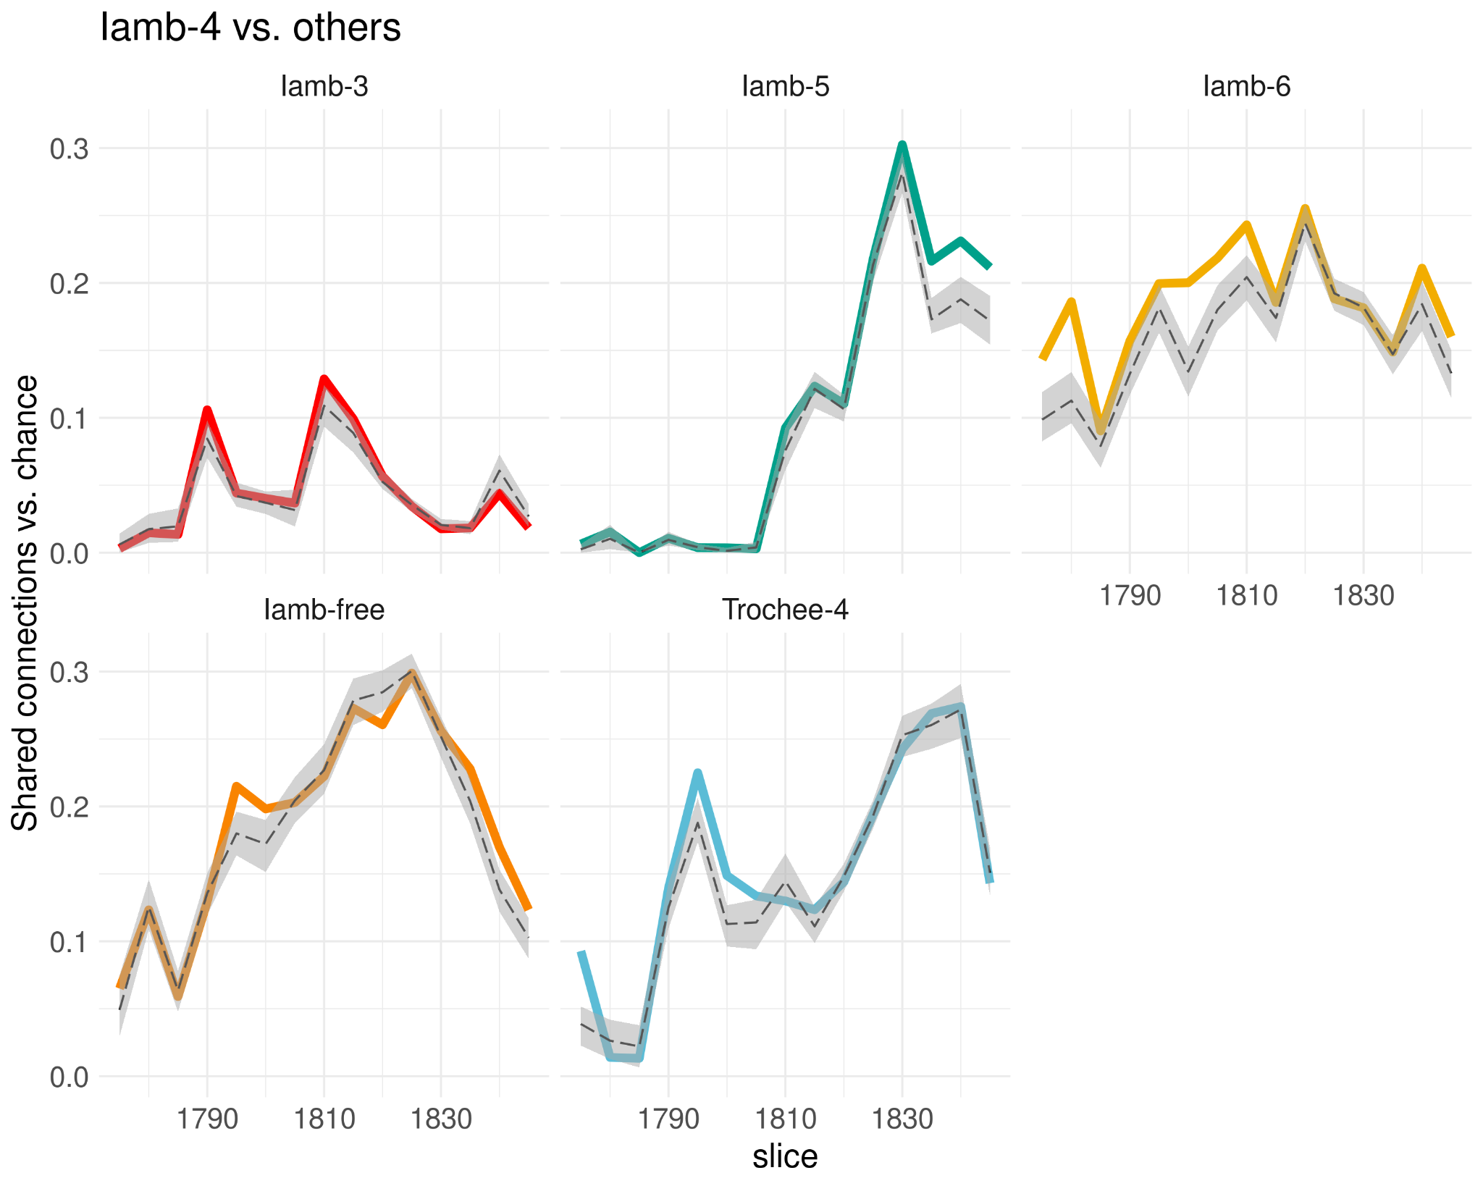
Number of shared connections

Slide 17
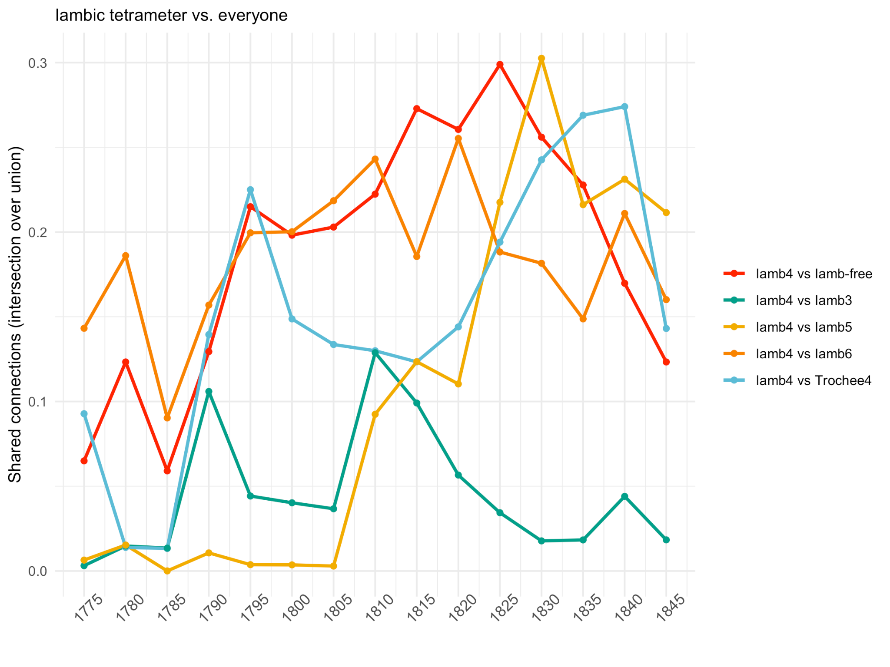
Number of shared connections (edges)
One of the ‘measures’ for the expansion: Number of shared connections, i.e. how much a meter takes other meters’ connections?
For Iambic tetrameter there are two peaks: 1795-1800 and 1820s;
Number of shared connections (as well as links in the network in general) reduces after 1835.
Notes:
Note once again that a connection is a pair of topics appeared in the same poem that we connected with an edge

Slide 18
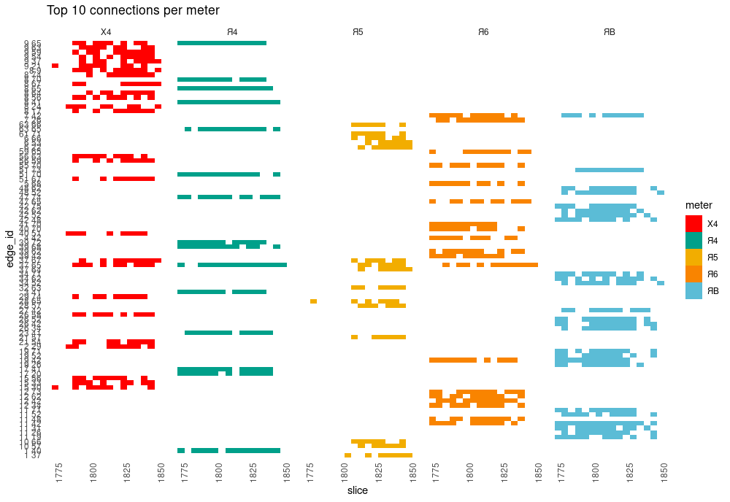
Connections (edges) stability in meters
Notes:
NB !!!!!!!!!!!! если будет время пару примеров сочетаний тем для разных размеров было бы идеально

Slide 19
Conclusions
Networks can help to model and analyze thematic structure within a meter;
The period of iambic tetrameter thematic expansion is visible in the 1820s and first half of the 1830s, however, it stops around 1835 with other meters obtaining new semantic connections;
The relationship of meter and semantics is conservative: meters retain their most probable connections until the end of the 1840s, despite the Iamb-4 expansion.
Iamb-4 remains distinct, too!
NB! Size difference in meter popularity complicate the analysis

Slide 20
Thank you for your attention!

