Slide 1
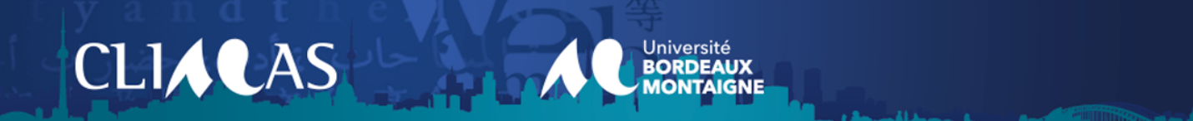
Charles Bukowski’s poetry re-performed online
Amélie Macaud, Ph.D.

Slide 2
Charles Bukowski’s poetry re-performed online
Remediation
“the way in which one medium is seen by our culture as reforming or improving upon another”(59); it is ‘the formal logic by which new media refashion prior media forms’ (273).
Bolter, D., Grusin, R. (2000), Remediation: Understanding New Media, Cambridge: MIT Press.
Youtube
“YouTube’s immense popularity has created various forms of public and informal collections and archives that have allowed us greater access to overwhelming amounts of moving image media and data, including materials that extend beyond YouTube.” (196)
Tran, T. (2016) Coding and Visualizing the Beauty in Hating Michelle Phan: Exploratory Experiments with YouTube, Images, and Discussion Boards, in The Archlight Guidebook to Media History and The Digital Humanities, Acland, C.R. and Hoyt E., (Eds.), 196-215.

Slide 3
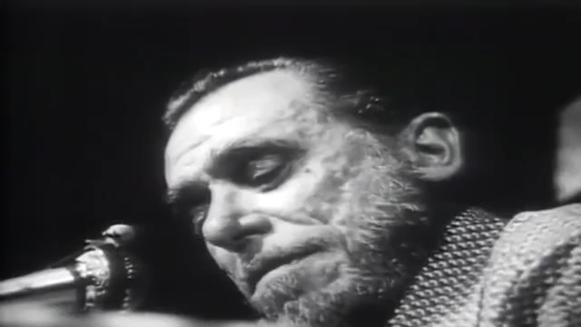
Bukowski’s performance on stage
Excerpts from :
Video 1: “Bukowski Reads Bukowski, Artbound”, KCET, Youtube (2014)
Video 2: “Charles Bukowski - The Last Reading”, Andreas Hörmark, Youtube (2021)

Slide 4
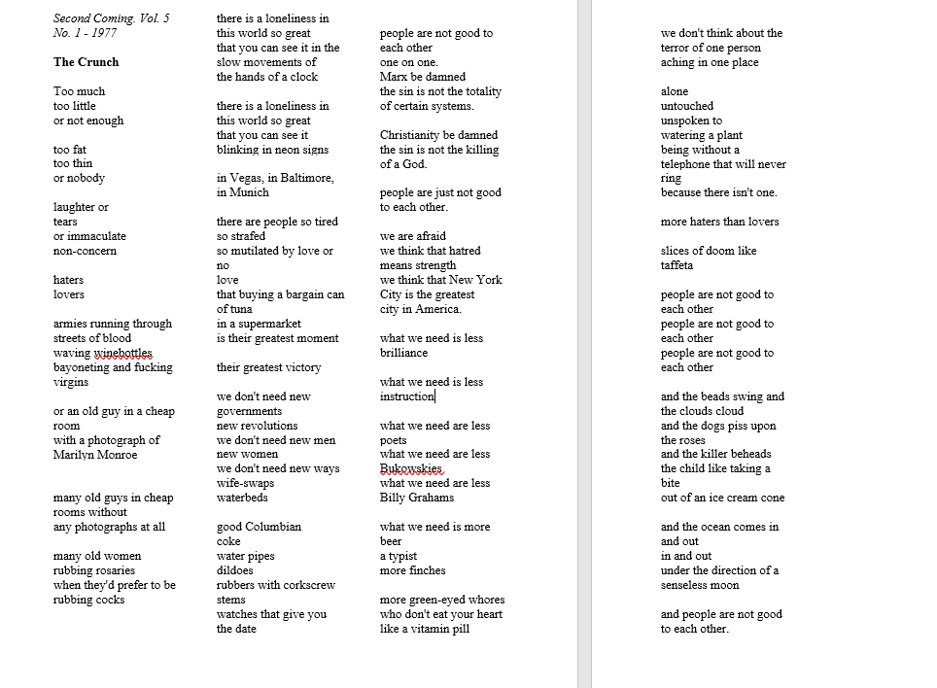
The Crunch : first version, Second Coming vol.5, 37% of videos
Adapted from https://bukowski.net/poems/crunches.php (last consulted 9.07.2022)

Slide 5
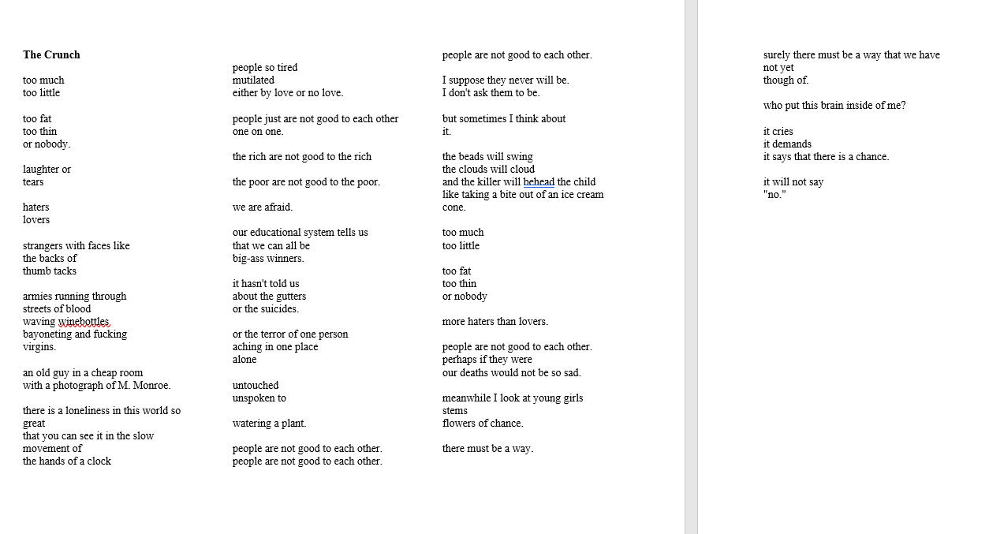
Second Version: Love is a Dog from Hell (1977), 63% videos
Adapted from https://bukowski.net/poems/crunches.php (last consulted 9.07.2022)

Slide 6
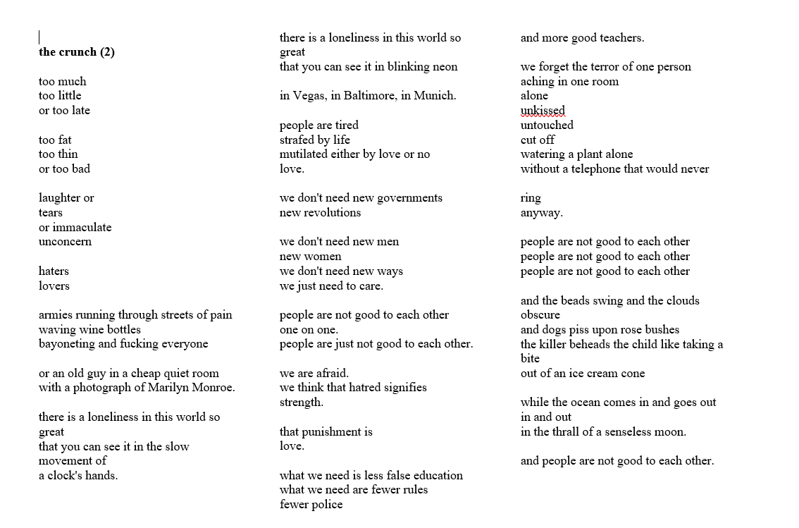
Third Version: 0%
What matters most is how well you walk through the fire - 1999
Deletions
Add-ons
Modified
Adapted from https://bukowski.net/poems/crunches.php (last consulted 9.07.2022)

Slide 7
YouTube videos
General data

Slide 8
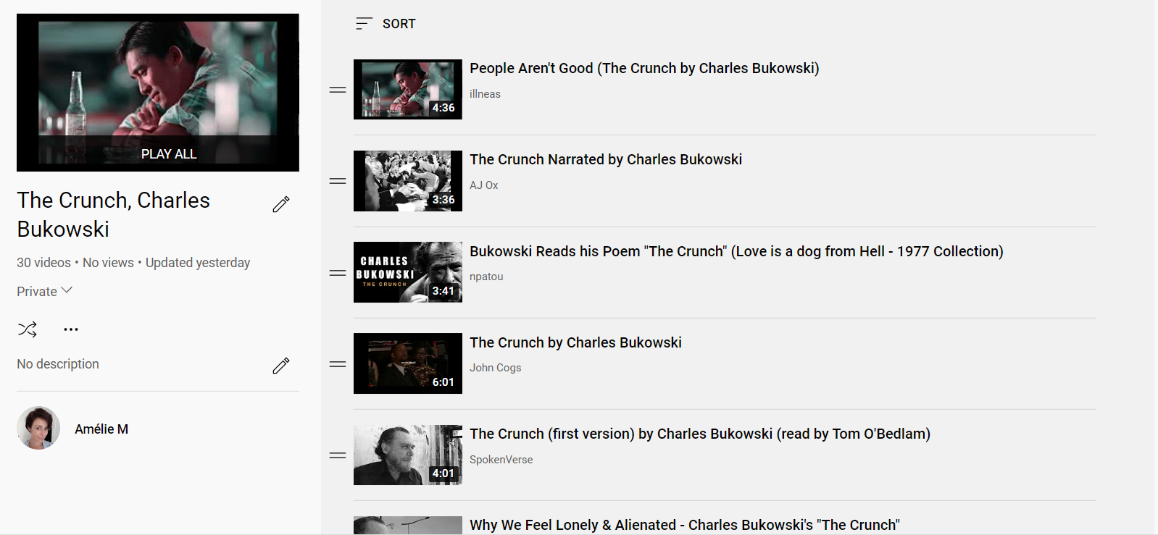
30 YouTube Videos: “The Crunch” (1977)
https://www.youtube.com/playlist?list=PL8O0X5hr8SgmYcmFDjkJzIxgnCR-_Bp6R

Slide 9
# views, comments, likes, per video

Slide 10
Similarities
Music | # Videos | %
Yes | 19 | 63%
No | 11 | 37%
Year: between 2008 and 2022
Text in video (subtitles etc.) | # videos | %
YES | 14 | 46.7%
NO | 16 | 53.3%
Length | # videos | %
Below 3 minutes | 11 | 37%
Between 3 and 6 minutes | 19 | 63%

Slide 11
Differences
Audio and Voice
Type of video
Type of video | # videos | %
Video montage | 10 | 33.3%
Still Photograph | 6 | 20%
Original content | 7 | 23.3%
Text only | 1 | 3.3%
Uploads of documentary excerpts | 6 | 20%
Voice or voice-over | # videos | %
Bono | 3 | 10%
Tom O’Bedlam | 9 | 30%
Charles Bukowski | 10 | 33.3%
Content Creator(s) | 7 | 23.3%
No voice | 1 | 3.3%

Slide 12
YouTube videos
Comments analysis and two examples

Slide 13
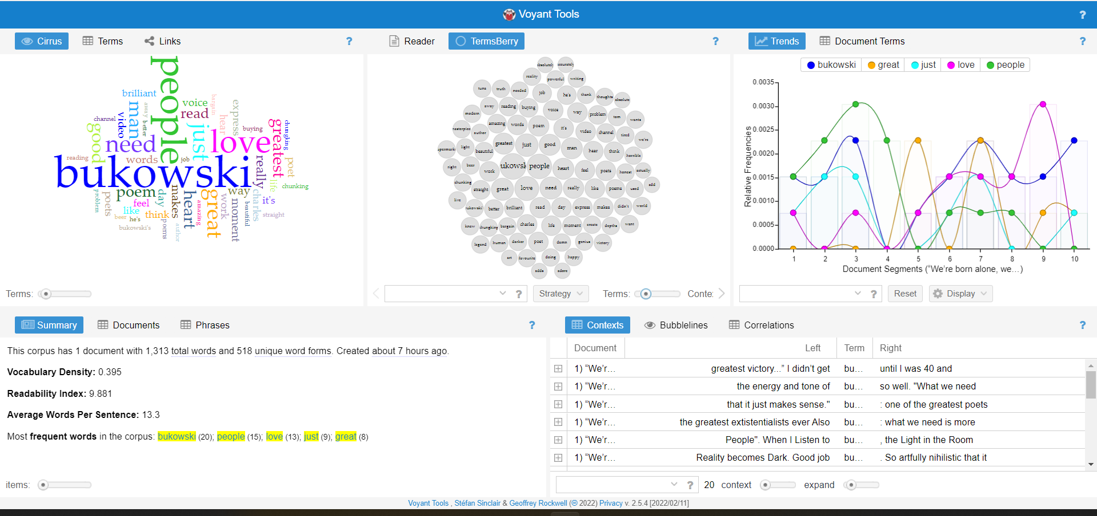
YouTube comments analysis “People aren’t Good” – 2,065 comments (last consulted 31.05.2022)
https://voyant-tools.org/?corpus=52fa4f6cffc30fff6cef61b29e92a6af

Slide 14

YouTube videos: “The Crunch” re-performed
Excerpts from:
Video 1: “The Crunch narrated by Charles Bukowski”, AJ Ox, Youtube (2012)
Video 2: “The Crunch by (Charles Bukowski) x Kids (1995)”, ClydeCreates, YouTube (2020)

Slide 15
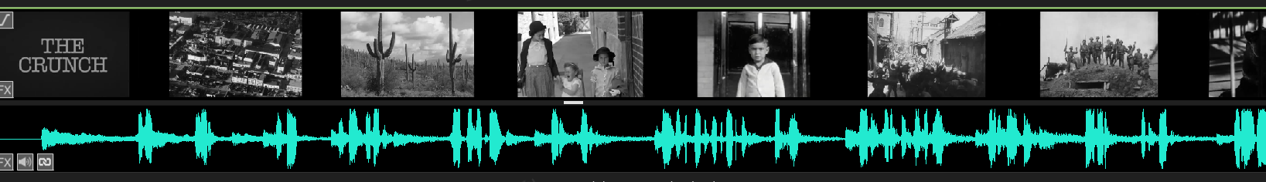
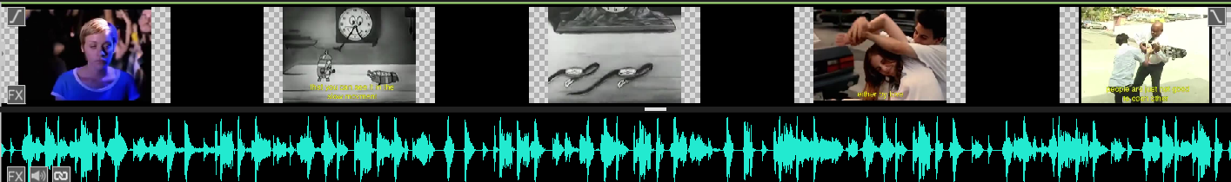
VideoPad sequence image/audio comparisons
“The Crunch” by Bukowski – Video 1
“The Crunch” by Bukowski – Video 2

Slide 16
Conclusion
Extraction of image/audio corpus, metadata processing
- Vectorization of images and texts (+audio) (captions);
- Comparison and search for similarities and duplicates between images (ImageJ);
- Visualization and classification (D3.js, UMAP);

Slide 17
Thank you
Amélie Macaud, Ph.D.
Climas EA 4196
University Bordeaux Montaigne
Amelie.Macaud@etu.u-Bordeaux-Montaigne.fr
Amelie.macaud@gmail.com

