Slide 1
Rhyming strategies in Estonian rap lyrics: a statistical view
Maria-Kristiina Lotman
Rebekka Lotman

Slide 2
Statistical analysis
Karl-Eduard Sööt (the end of the 19th century); 424 verses
Henrik Visnapuu (first half of the 20th century), 646 verses
Betti Alver (1930s); 402 verses
Artur Alliksaar (1950s and 1960s), 490 verses
Metsakutsu and Genka (21th century); 628 and 689 verses

Slide 3
Problems of rhyming in Estonian language
The abundance of vowels and diphthongs:
25 diphthongs according to Tiit-Rein Viitso,
27 diphthongs according to Ilse Lehiste.

Slide 4
Estonian diphthongs (Lehiste 2001: 40)
First component | Second component
 | i | e | a | o | u
/i/ |  |  |  |  | iu
/e/ | ei |  | ea | eo | eu
/a/ | ai | ae |  | ao | au
/o/ | oi | oe | oa |  | ou
/u/ | ui
/õ/ | õi | õe | õa | õo | õu
/ä/ | äi | äe |  | äo | äu
/ö/ | öi | öe | öa
/ü/ | üi

Slide 5
Three degrees of duration: rhyme partners of different durations are not advisable in puristic approach.
Karl Eduard Sööt:
Homme ootab sõjapõrgu!
Aga mees ei kohku, tõrgu
(‘Pääliku hüüd’ [The shout of the chief])

Slide 6
Morphological and lexical problems
Inflectional types and phenomena like consonant or suffix gradation result in too large a variation of possible endings.
Difficulties pertaining to vocabulary: the rhyme repertoire has had a limited time to develop, as compared to the ‘old’ European poetic cultures.

Slide 7
Rhyme types in Estonian poetry (1)
(1) full rhyme, where the only difference lies in the onset of the stressed syllable (nelgid : kelgid), and
(2) the potential deviations from full rhyme:
(a) differences in the vowel of the stressed syllable (laheneb : läheneb),
(b) the vowel of the non-initial syllable (ikka : ikke),
(c) the syllable-end consonants (king : pilt), durations (ta : maa),

Slide 8
Rhyme types in Estonian poetry (2)
(d) so-called semirhyme (in which one of the rhyming words has an additional syllable: vist : pistma), and
(e) identical rhyme, in which case the phonemic structure of the rhyme pairs matches completely.
In addition, in the case of a few authors, we encountered
(f) orphan rhymes, that is, verses found in a rhyme context that lack a rhyme partner, and
(g) identical holorhymes where the entire verse line was repeated.

Slide 9
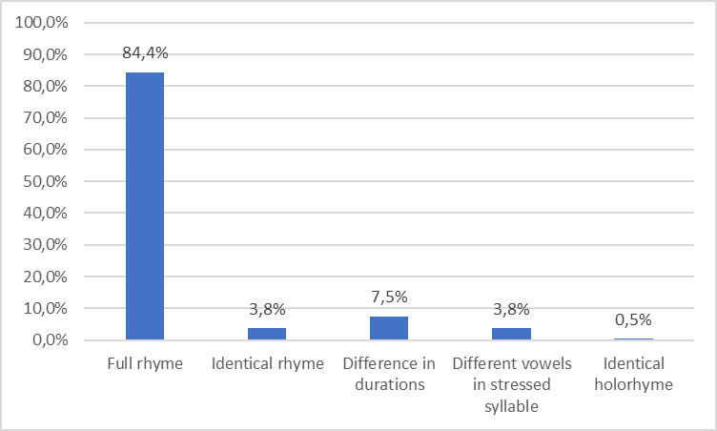
Rhyme types in Karl Eduard Sööt’s poetry

Slide 10
20th century rhyme: modernists
Diversity of approaches:
The continuance of traditional rhyme
“New rhyme” (i.e near rhymes propagated by Valmar Adams)
Puristic rhyme in the poetry by the literary group Arbujad

Slide 11
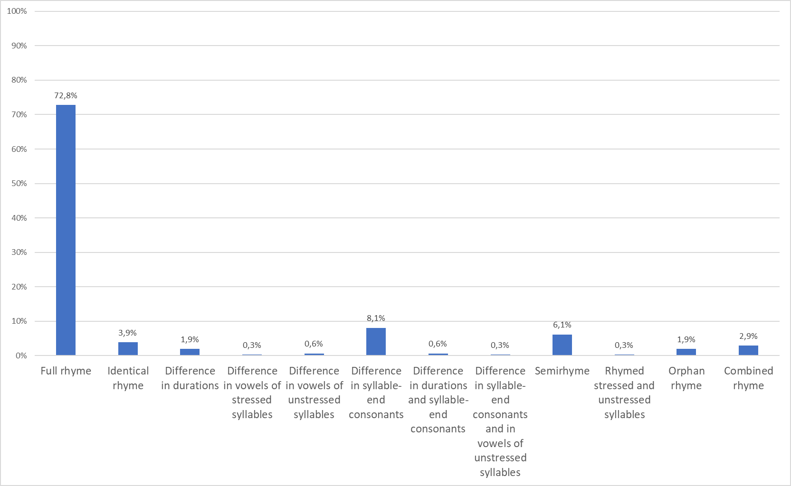
Rhyme types in Henrik Visnapuu’s poetry

Slide 12
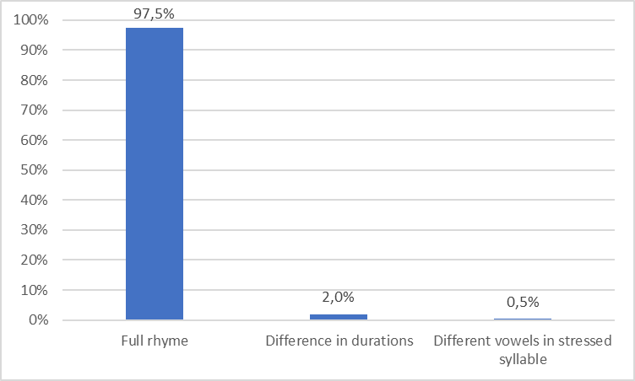
Rhyme types in Betti Alver’s poetry

Slide 13
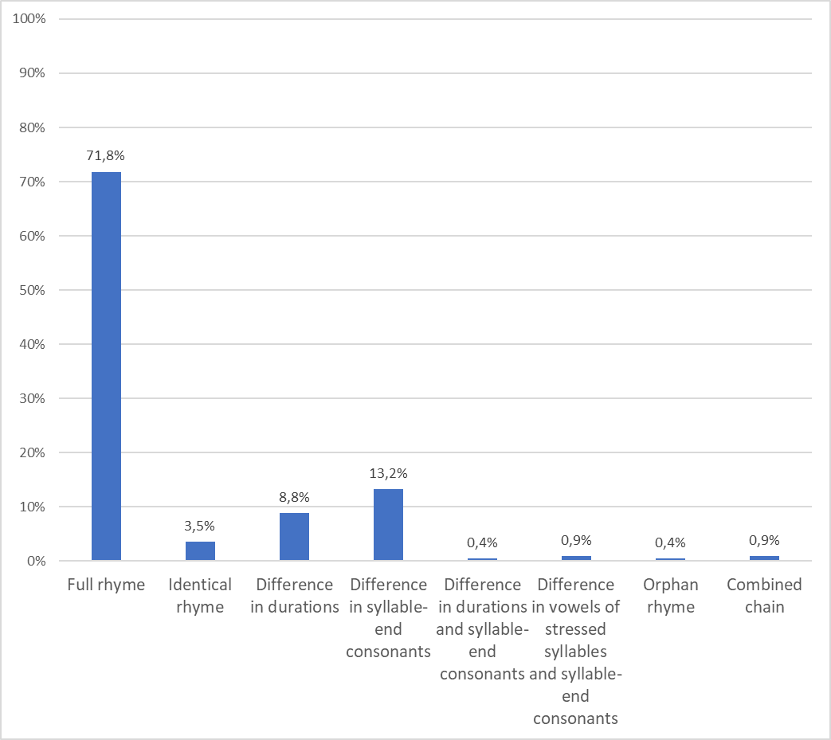
Rhyme types in Artur Alliksaar’s poetry

Slide 14
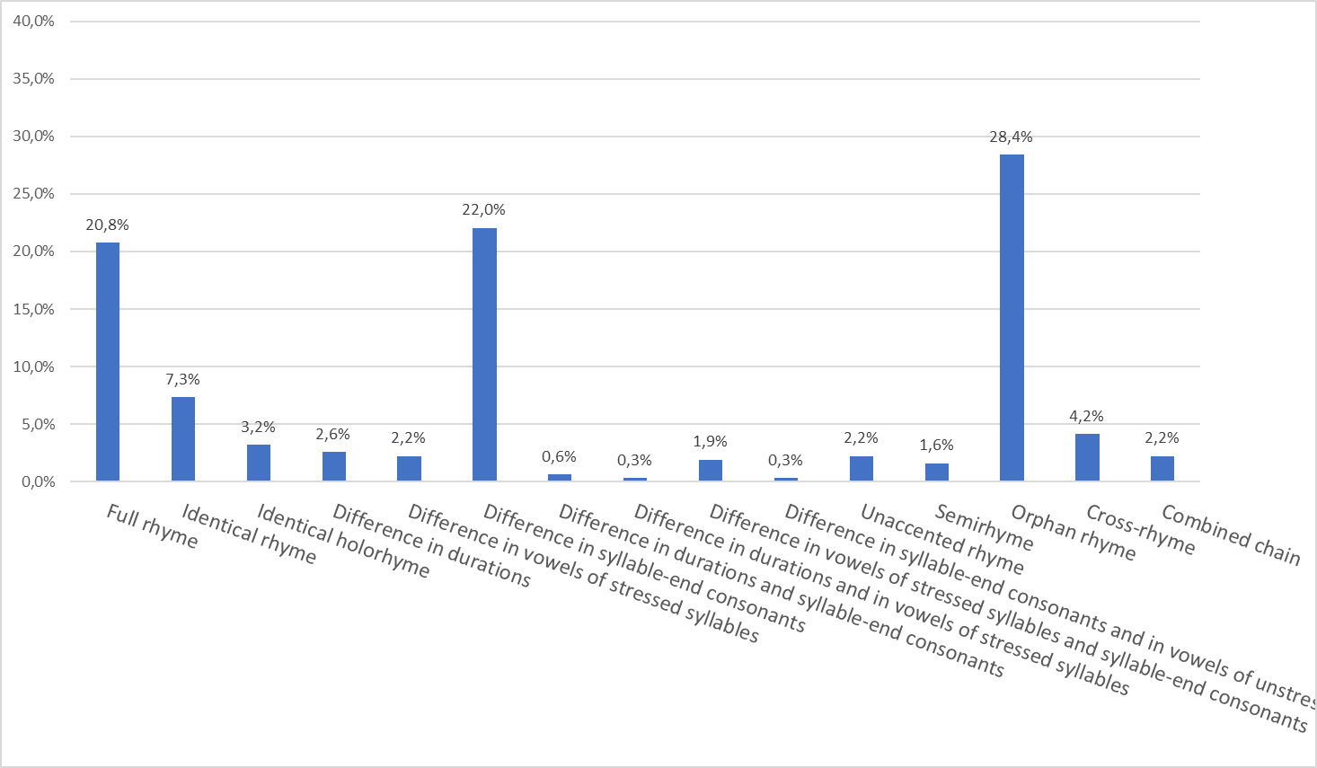
Rhyme types in Genka’s lyrics

Slide 15
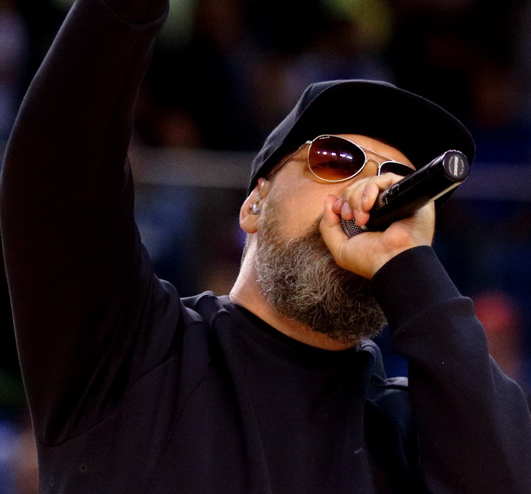
Genka “Pankrot”
Ja me pappi ei saagi, me pappi ei saagi
Me pappi ei saagi, pole mõtet kartagi
Kulutused meil samas tõusevad taevani
Me pappi ei saagi, a kas on vajagi
Ja me pappi ei saagi, me pappi ei saagi
Me pappi ei saagi, pole mõtet kartagi
Kulutused meil samas tõusevad taevani
Me pappi ei saagi, a kas on vajagi

Slide 16
Genka&Metsakutsa “Värsiarhitektuur”
keevitab me keeles uusi avastusi lingvistikas
meil riime sama palju nagu numbreid statistikas
valimata kohta, vahendeid või aega
sõnu kirjutame palju, kasvõi puusse mootorsaega
või salvrätikule mis majoneesist läbi kulund
kabanossist koos pahnutiga mu autosse on unund
ma respektin kui tasemel on värsiarhitektid
sest sõnadeta räpp on lahja nagu anorektik
sestap võõrustame metsast sõbraliku krantsi
familija fucking riimid, kaifige me assonantsi!

Slide 17
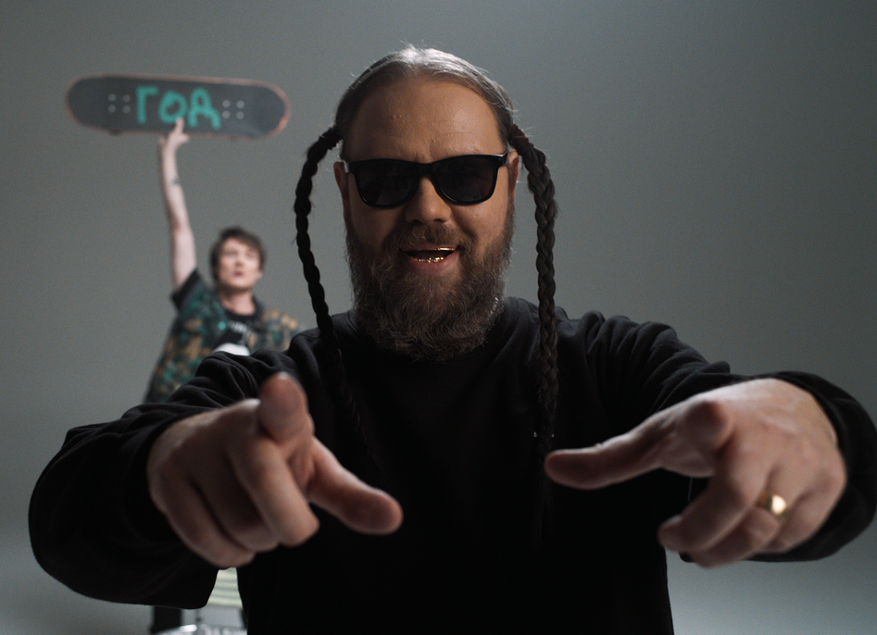
Genka, “Legendaarne”
Aga okei, see kõik ei
Suju lihtsalt, kui sul puudub lakei,
Keegi, kes ajaks asju, sest ise me'i
Ole usinad, et tööle panna masinad
Sellest räägibki hetkel see biit siin
Kuda Toe Tag jälle ei viitsi

Slide 18
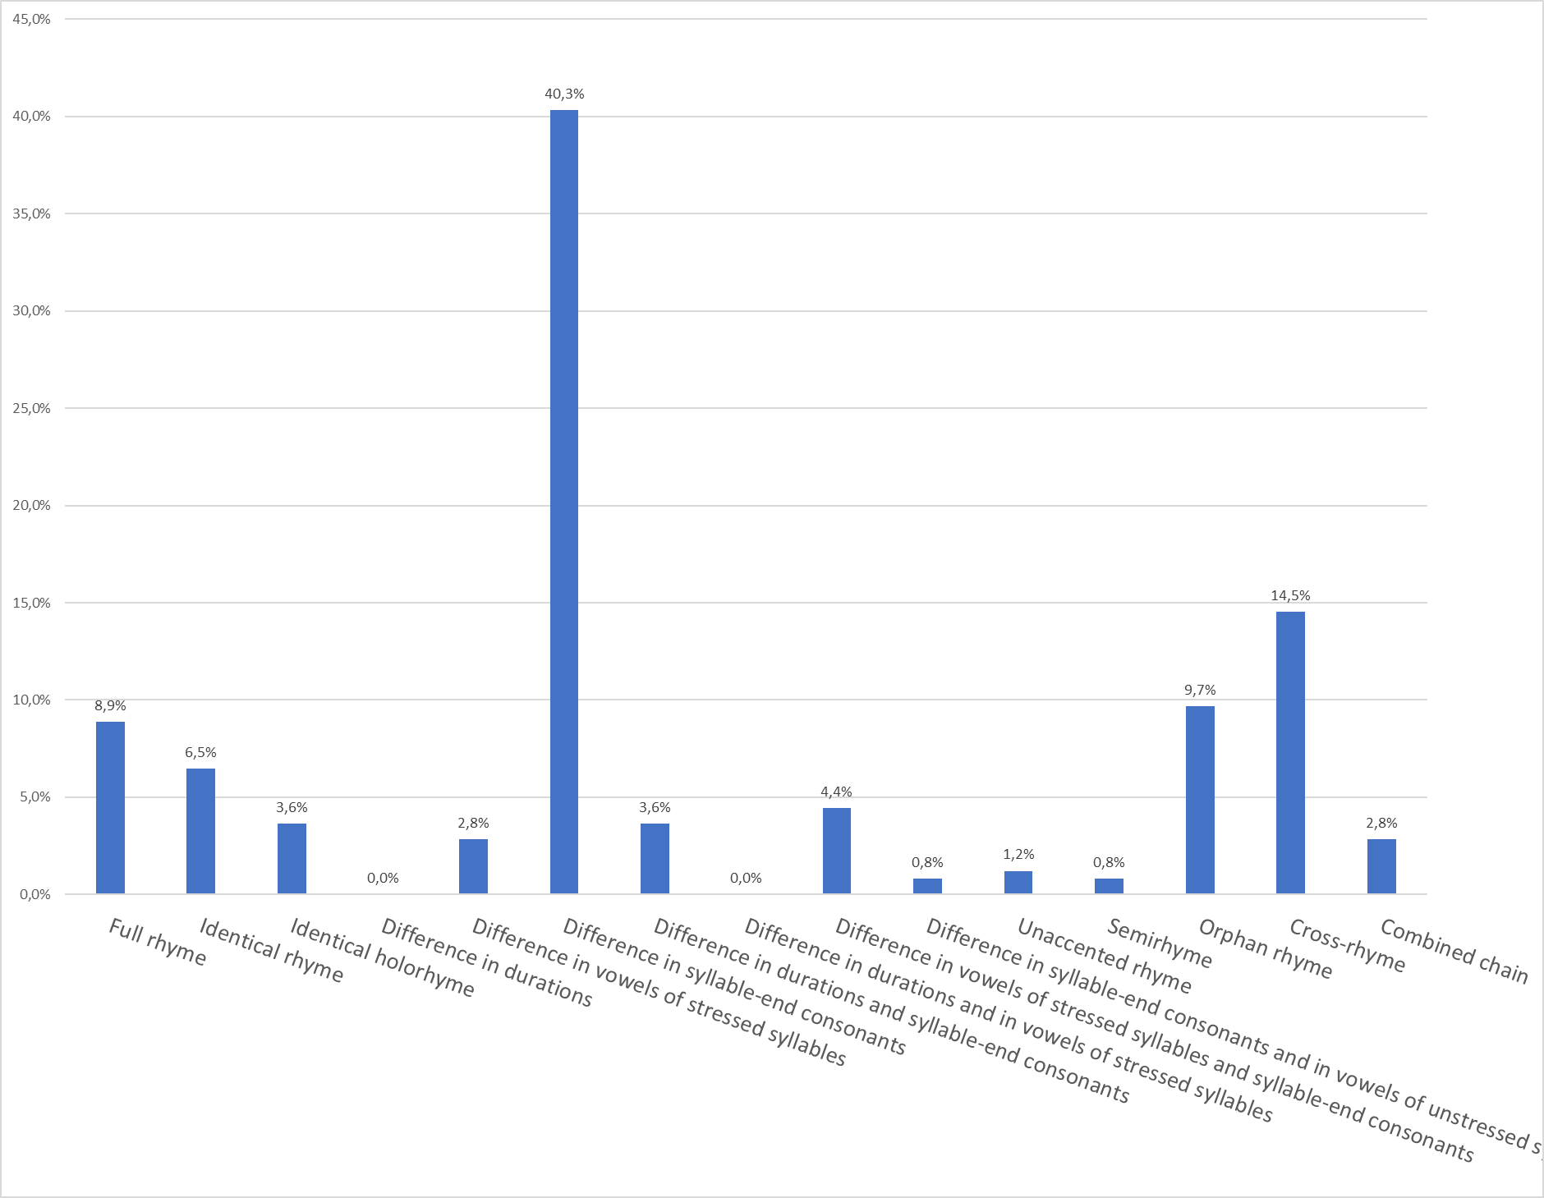
Rhyme types in Metsakutsu’s lyrics

Slide 19
Metsakutsu “Huntide kasvatatud”
üksi puidust tornide vahele eksind,
tänavale loobitud koer, kes otsis oma ketti,
wild diseasega külg-külje vastas
jooksin neid radu ja hundipoeg kasvas
ja genka tegi siis nii seda,
et kutsikas haukus koos liidritega
ja torm tõusis ja ladvad murdusid,
krantsid ulgusid, ükskõik, mis tulgu siit,

Slide 20
Estonian rap rhyme: conclusions
Drastic decrease of full rhyme, as compared to literary poetry.
The idea that was expressed already by some modernist poets that near rhyme is a solution and an escape from the sound inertia of traditional rhyme has developed even further in rap poetry.
Still, Estonian rap rhyme adheres to the Western models rather than Estonian rhyming culture.

Slide 21
Thank you for listening! Aitäh kuulamast!

